Slide 1
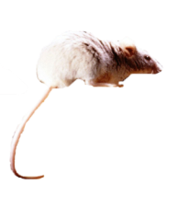
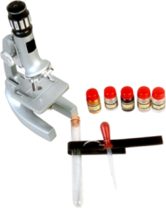
Animals in Research

Slide 2

Objectives
To examine the role of animals in research.
To discover the benefits different species have provided to humans through research.
To analyze the policies, laws and regulations concerning animal research.

Slide 3
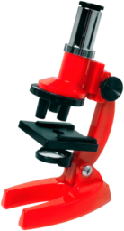
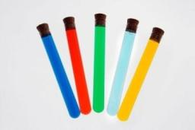
Research
Is the act of making extensive investigations
Cannot be initially completed on humans in science
  animals with similar traits to humans are often used

Slide 4

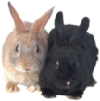
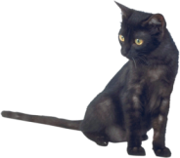
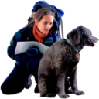
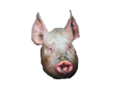
Animals Researched
Mice
Rabbits
Cats
Dogs
Nonhuman Primates
Pigs

Slide 5
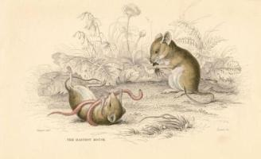

Mice
Are the most used animals in research due to the following:
  small size
  low cost
  fast reproduction
Share over 90 percent of genes with humans
Lab Fact: The typical lab mouse will run two and a half miles per night on a treadmill.

Slide 6
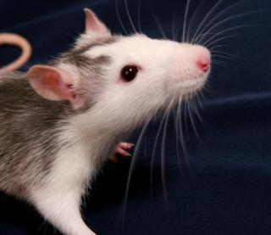
Mice
Immunologically Deficient –
lacking some element or characteristic of the immune system
Can be used in the following:
  cancer research
  product testing
  toxicology
  virology

Slide 7
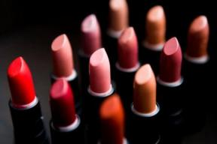

Product Testing
Exposes the mice to substances to measure the safety of household items, such as:
  food additives
  fabric treatments
  cosmetics
Lab Fact: The first mice to arrive in North America were stowaways on ships.

Slide 8
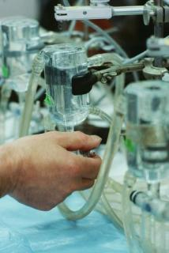
Toxicology
Is the science of chemical substances and their effects on living organisms
Gives chemical substance tests at different levels to:
  study short to long term effects
  monitor continuous and accidental exposure
  examine if irritant to skin or eyes

Slide 9
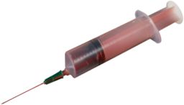
Virology
Is the science studying viruses and the diseases they cause
Shows effects of vaccines on test subject in pre-clinical studies

Slide 10
Virology
Results in mice led to the development of vaccines combating:
  influenza: contagious viral infection characterized by inflammation of the respiratory system, fever and muscular pain
  polio: viral disease distinguished by inflammation of nerve cells of the brain and spinal cord
  yellow fever: infectious tropical disease causing liver damage and jaundice
  rabies: viral disease attacking the central nervous system

Slide 11
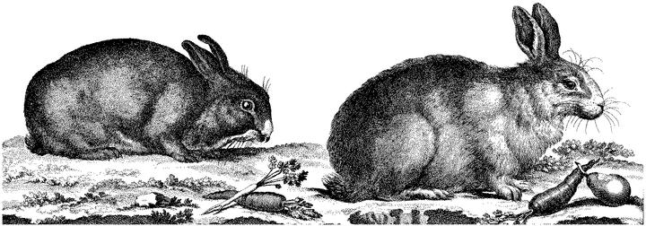
Rabbits
Share similar physiology to humans
Suffer from some of the same diseases as humans
Half a million rabbits are used annually for scientific research

Slide 12
Cancer Implementation
Is used in rabbits for the following:
  produce tumors
  study chemotherapy and immunotherapy
  study prevention of some cancers

Slide 13

Cholesterol Levels
Are monitored in rabbits
  allowed the testing of Probucol which lowers cholesterol and slows hardening of arteries
Fun Fact: Rabbits can see behind them without turning their heads.

Slide 14
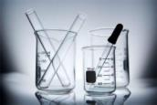
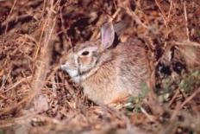
Rabbit Eyes
Were used to study entropion
  a disorder when eyelashes are turned inward
Are used to study glaucoma
Are important in running toxicology tests
Were the model for the first human corneal transplant
Glaucoma – abnormally high fluid pressure in the eye

Slide 15
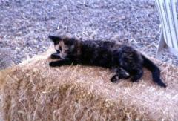
Cats
Account for less than one percent of animals used in research each year
Share some diseases with humans
  leukemia: cancer of the bone marrow which inhibits the normal manufacturing of red and white blood cells as well as platelets
  AIDS: immune system disorder which heightens susceptibility to opportunistic diseases and infections

Slide 16
Feline AIDS
Shares symptoms with human AIDS
  extreme weight loss
  swollen lymph nodes
  infected respiratory system
Led to the creation of a vaccine which is being researched as a model for a human AIDS vaccine

Slide 17
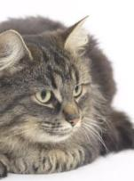
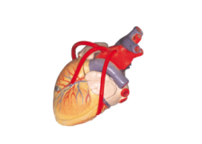
Cats
Lab Fact: Cat hearts beat twice as fast as human hearts
Serve as models for the study of some human diseases
  Type II Diabetes: disorder when body does not produce enough insulin or cells ignore the insulin
  Breast Cancer: any type of cancerous growth in the breast tissue
  Leukemia: cancer of the bone marrow which inhibit the normal manufacturing of red and white blood cells as well as platelets

Slide 18
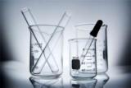
The Feline Nervous System
Led to understanding how neurons function
Shows how humans recover from the following:
  strokes
  traumatic injuries
Allows for the exploration of gangliosidosis which causes the following:
  human skeletal disorders
  mental retardation
Neuron –
cell that is specialized to conduct nerve impulses

Slide 19
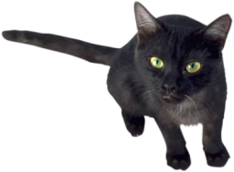
Anticoagulants
Prevent the clotting of blood
Were discovered after studying felines

Slide 20
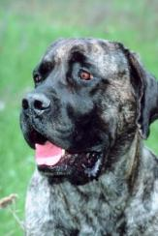
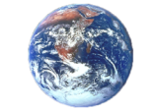
Canines
Fun Fact: The first living creature sent into space was a dog named Laika
Represent less than one percent of animals used in research each year
Resemble the human respiratory and cardiovascular systems

Slide 21
Surgical Procedures
Were often studied first in canines, including:
  heart surgery, such as:
    coronary bypass surgery
    artificial heart valve surgery
    Pacemaker instalation
  hip replacement

Slide 22
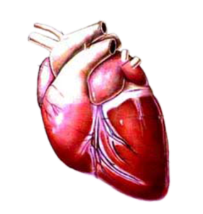
Surgical Procedures
Were often studied first in canines, including:
  transplantations involving the:
    heart
    limbs
    liver
    kidney
  angioplasty
    the unblocking of coronary arteries

Slide 23
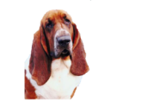
Diabetes
Fun Fact: A dog’s smelling is about 1,000 times more sensitive than a human’s smelling.
Is researched in canines
  discovered it was an insulin deficiency which causes diabetes
  presently shows ways of transplanting insulin-cells to the pancreas

Slide 24
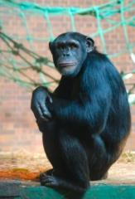
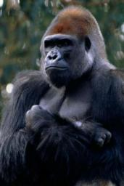
Non-human Primates
Share more behavioral and biological traits with humans than any other animal
Comprise the smallest percent of animals used in research
Include the following:
  gorillas
  chimpanzees
  macaques

Slide 25
The Poliomyelitis Virus
Can only successfully infect nonhuman primates which are then used for the production and testing of the polio vaccine
Poliomyelitis Virus–
causes polio, a viral disease distinguished by inflammation of nerve cells of the brain and spinal cord

Slide 26
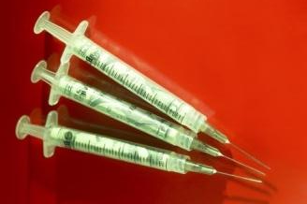
HIV
Is related to the simian immunodeficiency virus (SIV) which effects nonhuman primates, whose:
  vaccines are administered to stop viral progression
  vaccine is being researched to apply to humans with HIV

Slide 27
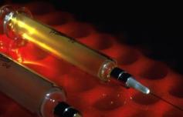
Hepatitis
Inflammation of the liver caused by various infectious agents or toxins, including alcohol
A is an acute infection transmitted through fecal contamination of infected animals
B and C are more serious infections which are transmitted through infected bodily fluids

Slide 28
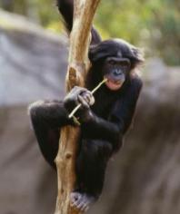

Hepatitis
Infections gained through blood transfusions have almost been eliminated due to research in nonhuman primates
A has no vaccine, should use prevention
B vaccine was created after researching and testing on nonhuman primates
C has no vaccine and nonhuman primates are still studied to find one
Fun Fact: Wild chimpanzees use medicinal plants to treat themselves for injuries and illnesses.

Slide 29
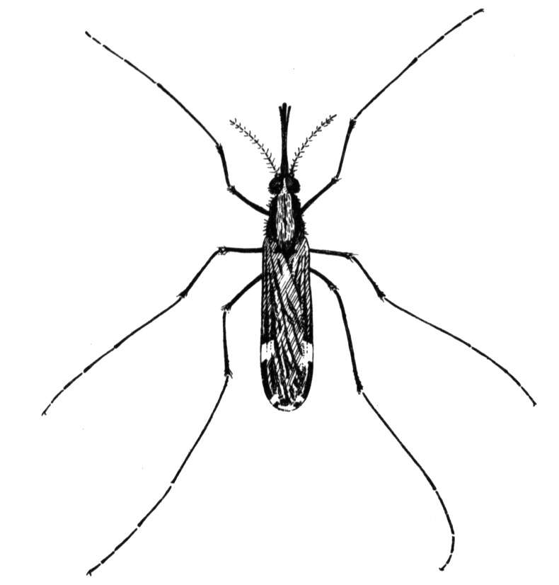
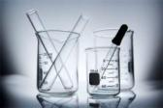
Malaria
Infected humans share the same strain of parasite only with nonhuman primates
Vaccinations are tested on infected nonhuman primates
  promising results have been found and may soon be tried on humans
Malaria –
an infectious disease caused by the parasitic infection of red blood cells and marked by episodes of fever, chills, sweating and anemia

Slide 30
Acute Respiratory Disease
Can be caused by the respiratory syncytial virus:
  naturally effects both humans and chimpanzees
  chimpanzees suffer similar symptoms as humans
  vaccines are being tested on chimpanzees
Respiratory Syncytial Virus – causes respiratory infections in adults and bronchitis in children

Slide 31
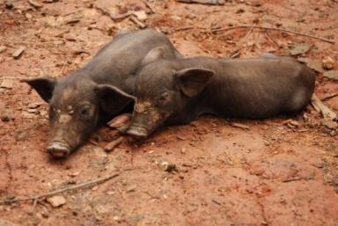
Swine
Are closely related to humans in the following ways:
  skin
  body systems
  anatomy

Slide 32
Xenograft
Is the transplantation of living tissue from one species to another
Is often completed on human burn victims using swine tissue
Procedures so successful that xenotransplantation is now being looked at in swine, which will allow organs to be transplanted into humans

Slide 33
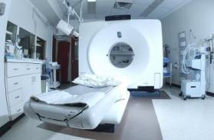
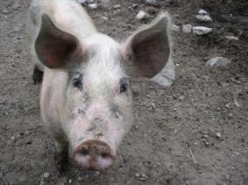

CAT Scan
Developed by using swine as models for humans
Lab Fact: The largest pig recorded weighed 2,552 pounds.

Slide 34

Policies, Laws & Regulations
Are enforced to protect the safety and well-being of research animals
Are administered at the national, state and local levels

Slide 35
The Animal Welfare Act (AWA)
Was passed by U.S. Congress in 1966
Protects certain animals from inhumane treatment
Requires minimum standards of treatment and care
Guarantees research animals the following:
  veterinary care
  anesthesia or pain relievers
  opportunity to exercise daily

Slide 36
The Animal & Plant Health
Inspection Service
Is a branch of the U.S. Department of Agriculture
Enforces the Animal Welfare Act
Administers license and registration of regulated commercial animal breeders, dealers, transportation companies and research facilities

Slide 37
The Public Health Service
Policy (PHSP)
Includes nine U.S. government principles said to be the foundation of humane care and use of research animals
Is not a federal law, but institutions must adhere to it to receive funding from PHSP member agencies, such as:
  Food and Drug Administration
  Center for Disease Control and Prevention

Slide 38
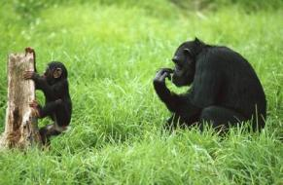
The Chimpanzee Sanctuary Act
Guarantees lifetime care for chimpanzees used, purchased or bred for research at the following:
  Food and Drug Administration
  National Institutes of Health
  Other U.S. agencies

Slide 39
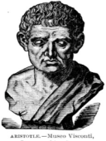
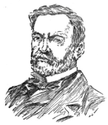
Important Activist
Aristotle – among the first to experiment on animals
Louis Pasteur – produced the germ theory of medicine by using anthrax in sheep
Peter Singer – wrote “Animal Liberation”
  Experimentation on Animals
Rudolph Jaenisch- produced the first transgenic mammal
  First closed in 1996

Slide 40
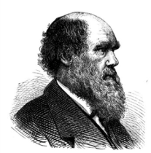
Important Activist
Charles Darwin – promoted Cruelty of Animals Act of 1876
  Supported testing of animals for advancements in physiology and medicine
Charles Bernard – “Prince of vivisection” and “Father of Physiology”
  He argued the effects of experimenting on animals vital to health of humans

Slide 41
Animals in Research
ASSESSMENT

Slide 42
Assessment
1. Which of the following is the most used animal in research?
A. Rabbits
B. Mice
C. Cats
D. Pigs
2. What is the science of studying viruses and the diseases they cause?
A. Toxicology
B. Virology
C. Pathology
D. Epidemiology

Slide 43
Assessment
3. Which of the following species research has led to the creation of a vaccine being researched as a model for human AIDS vaccine?
A. Rabbits
B. Mice
C. Cats
D. Pigs
4. Which of the following is the science of chemical substances and their effects on living organisms?
A. Toxicology
B. Virology
C. Pathology
D. Epidemiology

Slide 44
Assessment
5. Which of the following is the transplantation of living tissue from one species to another?
A. Autograft
B. Homograft
C. Sheet graft
D. Xenograft
6. Who enforces the AWA?
A. Food and Drug Administration
B. Animal Safety Commission
C. Animal and Plant Inspection Service
D. None of the above

Slide 45
Assessment
7. Which animals are used least in research?
A. Cats
B. Dogs
C. Nonhuman primates
D. Mice
8. The PHSP is not a federal law.
A. True
B. False

Slide 46
Assessment
9. Anticoagulants thin blood.
A. True
B. False
10. Dog eyes were researched for the first corneal project
A. True
B. False

Slide 47
Resources
International AIDS Vaccine Initiative
  www.iavireport.org
Animals in Research
  www.kids4research.org
University of Oxford
  www.admin.ox.ac.uk
American Bar Association
  www.abanet.org
California Biomedical Research Association
  www.ca-biomed.org
Center for Disease Control and Prevention
  www.cdc.gov
National Association for Biomedical Research
  nabr.org

Slide 48
Acknowledgements
Production Coordinator:
Brandon O’Quinn
Production Manager:
Dusty Moore
Project Coordinator:
Meghan Blanek
Executive Producers:
Gordon Davis, Ph.D.,
Jeff Lansdell
Graphic Designer:
Ann Adams
© MMIX
CEV Multimedia, Ltd.

