Slide 2
Objectives
To summarize the legal rights of animals.
To identify and interpret laws put into effect for the protection of animals.
To describe the jobs and legal limitations offered in the field of animal services.

Slide 3
Animal Rights
Marine
Research
Endangered
Domestic
Laws
Wild
Production

Slide 4
Domestic Animals
Main Menu

Slide 5
Domestic Animals
Are animals that have been tamed and kept as a pet
Depend on people for food
Fun Fact: Every year, two and a half million people get new puppies

Slide 6
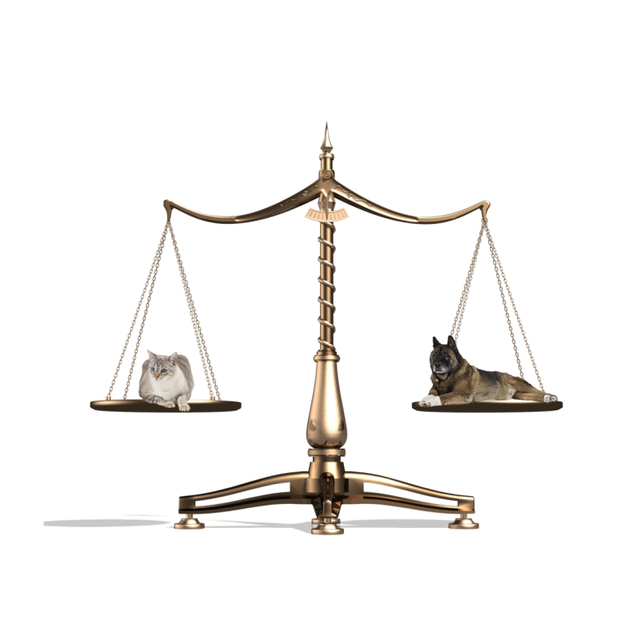
Laws
Main Menu

Slide 7
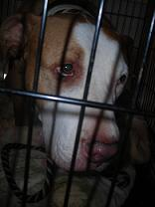
The Animal Welfare Act (AWA)
Seeks to regulate:
who may possess or sell certain animals
animal living conditions
Is enforced by the Animal and Plant Health Inspection Service
Violating the AWA may result in:
criminal penalties
civil penalties
revocation of permits

Slide 8
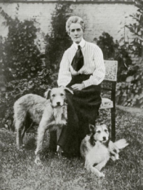
Animal Rights
1879 – first known use of Animal Rights
Also known as Animal liberation
Animals can live their own lives
All animals have a moral right
Prohibits humans from
violating their basic instincts

Slide 9
Welfare vs. Rights
Welfare advocates
Believe animals should not experience
Pain or suffering
Believe animals should have basic needs fulfilled
Food, Shelter and Health
Endorse animals use for human satisfaction
Needs
Food, Clothing and Medical research

Slide 10
Welfare vs. Rights
Rights advocates
There is no difference in humans and animals
Against all animal use
No matter how humane it is

Slide 11
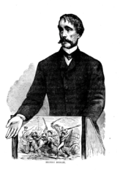
Animal Rights Founders
Henry Bergh
American Society for the Prevention
of Cruelty to Animals
George Thorndike Angell
Massachusetts Society for Prevention of Cruelty to Animals
Ingrid Newkirk
People for the Ethical Treatment of Animals (PETA)
Mike Burgwin – initial chairman
National Animal Control Association

Slide 12
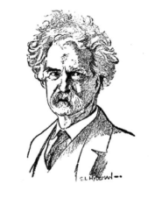
Animal Rights Founders
Fred Meyers
One of four people who formed Humane Society of the United States
Peter Singer
Philosopher and activist focused on animal suffering and consequences
Mark Twain
Protested animal cruelty and
research in “A Dog’s Tale”

Slide 13
Animal Rights Groups
People for Ethical Treatment of Animals (PETA)
Mercy for Animals
The Humane Society of the United States (HSUS)
American Society for the
Prevention of Cruelty to Animals
Several state and local groups

Slide 14
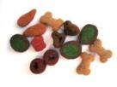
The Companion Animals Act
Is a pet protection act which keeps shelters from selling found pets to organizations for a period of five days to prevent the following:
pets from being stolen
animals being used for scientific testing
animals being used for illegal activities such as fighting
Fun Fact: Americans spend around three billion dollars a year on dog and cat food

Slide 15
The Pets Evacuation and Transportation Standards Act
Requires states and local emergency authorities to show how they will accommodate households with pets or service animals in evacuation situations
must be present in disaster preparedness plans to receive funding from the Federal Emergency Management Agency
Main Menu

Slide 16
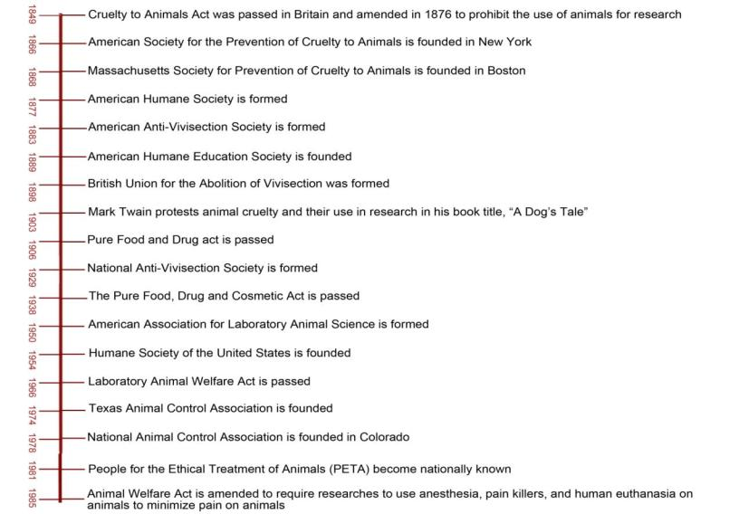
Animal Welfare Timeline
Vivisection- performing surgical operations on animals
for the purpose of research

Slide 17
Wild Animals
Main Menu

Slide 18
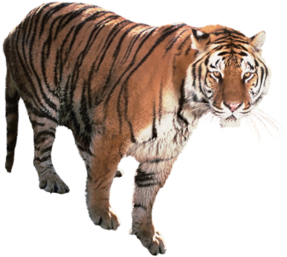
Wild Animals
Live in a natural, undomesticated state
Forage their own food

Slide 19
The Fish & Wildlife Coordination Act
Protects fish and wildlife when federal action is taken to control or alter natural streams or bodies of water
Provides assistance to state and federal agencies in order to protect, rear, stock and increase the supply of game and fur bearing animals
Calls for research on the effects of sewage and other pollutants on wild animals and their environment
Requires consultation with the Bureau of Fisheries prior to building dams to ensure fish migration is not inhibited

Slide 20
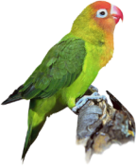
The Wild Bird Conservation Act
Responded to the population threat of non-indigenous birds
The U.S. is the number one importer of exotic birds
Imposed immediate moratorium on importing certain exotic birds, including most parrots, cockatoos and macaws
Moratorium – a suspension of activity

Slide 21
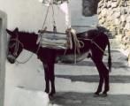
The Wild Horses & Burro Act
Provides protection for wild horses and burros living on land managed by the Forest Service and the Bureau of Land Management
Assigns the Forest Service and Bureau of Land Management to monitor the population of wild horses and burros to see if overpopulation is occurring or aid is needed
Amended to say that a wild horse may only be sold after it has reached 10 years of age or has been unsuccessfully offered for adoption on three occasions
Burro – small donkey, usually used as a pack animal

Slide 22
The Lacey Act
Prohibits the illegal trade of any fish or wild animals which were taken, possessed, transported or sold in violation of any law, treaty or regulation of the United States
Ensures the animals taken in violation of the act are confiscated
Main Menu

Slide 23
Production Animals
Main Menu

Slide 24
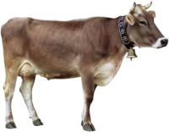
Production Animals
Raised for slaughter
Include cattle, swine, poultry and sheep
Fun Fact:
Scientific research has proven that cows have regional accents just like humans

Slide 25
The Humane Slaughter Act
Prevents suffering by stunning animals into unconsciousness prior to slaughter
Ensures slaughter is done in humane manner
Excludes animals slaughtered in accordance with religious law

Slide 26
The 28 Hour Law
Addresses transporting animals across state lines, especially those raised for food production
Requires that animals may not be transported for more than 28 consecutive hours without being unloaded for five hours, allowing for rest, water and food
Excludes travel by air or water
Main Menu

Slide 27
Marine Animals
Main Menu

Slide 28
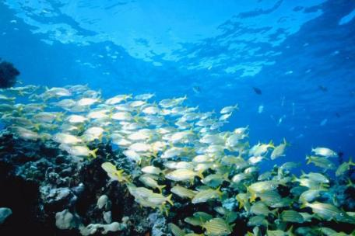
Marine Animals
Inhabit the sea
Include over 215,000 different species of animals

Slide 29
The Marine Mammal Protection Act
Is a regulatory act which protects marine mammals including whales, dolphins and seals
Prohibits the removal of marine mammals from U.S. waters or by U.S. citizens in the high seas as well as the importation of marine mammals and marine mammal products
Fun Fact:
Dolphins sleep with one eye open

Slide 30
The Fur Seal Act
Prohibits taking, transporting, importing or possessing fur seals and sea otters
Entitles the Pribilof Islands as a special reservation for the conservation, protection and management of the North Pacific fur seal and other wildlife
Indians, Aleuts and Eskimos dwelling on the coasts of the North Pacific Ocean are exempt from this law as they use the animals for subsistence purposes
Aleuts – Native American people inhabiting the Aleutian Islands and coastal regions in southwest Alaska
Main Menu

Slide 31
Research Animals
Main Menu

Slide 32
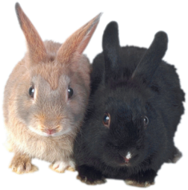
Research Animals
Are used for scientific experiments
Include many different species of animals, including mice, dogs, cats and rabbits

Slide 33
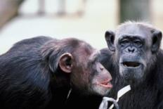
The Chimpanzee Sanctuary Act
Secures lifetime care for the retirement of chimpanzees which were used, purchased or bred for research at:
National Institutes of Health
Food and Drug Administration
other U.S. agencies

Slide 34
The Public Health Service Policy (PHSP)
Consists of nine principles established by the U.S. government, said to be the foundation of humane care and use of research animals
Is not federal law, but organizations must comply with it in order to receive funding from PHSP member agencies, which include the Food and Drug Administration and the Center for Disease Control and Prevention
Main Menu

Slide 35
Endangered Animals
Main Menu

Slide 36
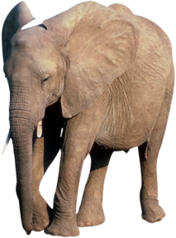
Endangered Animals
Are faced with the threat of extinction
Become endangered due to excessive hunting as well as environmental or biological changes

Slide 37
The Endangered Species Act
Lists endangered species, including the following:
bald eagle
grizzly bear
gray whale
whooping crane
Offers protection for animals and their habitats to prevent extinction
Is enforced by the Fish and Wildlife Service

Slide 38
The Great Apes Conservation Act
Includes:
chimpanzee
gorilla
orangutan
gibbon
Provides financial assistance to countries home to great apes with conservation programs

Slide 39
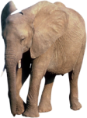
Elephant Conservation Acts
Reaffirm the endangered status of African and Asian elephants
Allot money toward conservation practices
Fun Fact:
An elephant can be pregnant for up to two years

Slide 40
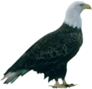
The Bald Eagle Protection Act
Is an extremely comprehensive act which prohibits the possession, sale, purchase, barter and offer to sale, purchase, barter, import or export the endangered bald eagle
Now includes gold eagles, which were hunted and often led to the accidental killing of bald eagles
Can be excluded by Native Americans, who may receive a permit to use bald eagles in religious ceremonies
Fun Fact:
A bald eagle can reach a speed of up to 200 miles per hour when diving

Slide 41
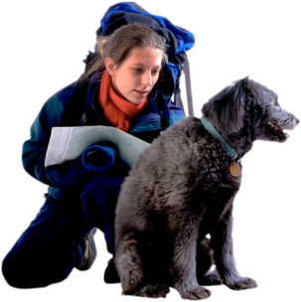
Animal Service Careers
Include the following:
veterinarians
game wardens
animal control
researchers
pet store operators
zookeepers

Slide 42
Veterinarians
Study, control and treat animal diseases and injuries by obtaining history of an animal followed by a physical examination
Obtain their license from the state they will practice in
Fun Fact:
There are only 27 veterinary schools in the United States

Slide 43
Legal Limitations
Occur when a client finds fault with the veterinarian’s work, which may lead to legal action over the following:
malpractice: improper or unethical conduct by the holder of a professional position
negligence: failure to execute the degree of care considered reasonable and leading to an unintended injury to another party
intentional infliction of emotional distress: actions are intentionally taken against animals which cause a strong reaction in owner

Slide 44
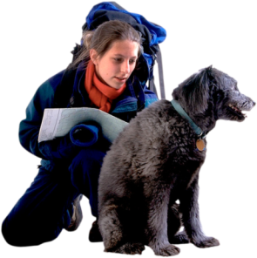
Legal Limitations
May result in losing veterinarian’s license
Include passing both the national and state veterinary medical board exams

Slide 45
Game Wardens
Are also known as Wildlife Officers
Arrest poachers, check for hunting licenses and write citations to hunters which break the law
Manage game populations such as deer
Develop conservation programs for game animals
Return wild animals which may wander into cities back to natural habitats

Slide 46
Legal Limitations
Many states require a civil service test and graduation from a resident police academy before warden service begins
Some states include making sure that illegal fishing, hunting or trapping is occurring before entering private property
Information acquired on private property without the written consent of the owner must be kept confidential

Slide 47
Animal Control Workers
Handle animals under investigation of abuse
Obtain abandoned, dangerous or stray animals
Inspect animal licenses and institutions housing animals for compliance with laws
Euthanize rabid, unclaimed and seriously injured animals

Slide 48
Legal Limitations
Include complying with the Companion Animals Act
Set standards for the obtaining and treatment of stray, rabid, neglected and abused animals
Vary from each city and state, so animal control workers must consult the laws in their city in order to know what action to take

Slide 49
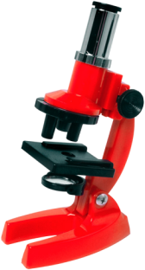
Scientific Researchers
Make extensive investigations using animals as test subjects
Use a variety of animals depending on the research which is being completed

Slide 50
Legal Limitations
Include complying with the Animal Welfare Act
Set up standards for humane treatment and care for research animals

Slide 51
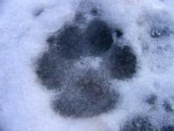
Pet Store Operators
Sell animals to the public
Offer advice and knowledge concerning pet care and training
Care for animals in store
Fun Fact:
Dogs only have sweat glands on their feet

Slide 52
Legal Limitations
Must comply with the Companion Animals Act
Do not operate under the provisions of the Animal Welfare Act
Operate under local animal control laws concerning the housing, treatment and care of animals

Slide 53
Zookeepers
Care for animals in zoos
Observe animal behavior
Provide information on animals and conservation to the public
Fun Fact:
The San Diego Zoo is the largest zoo in the world with over 4,000 animals

Slide 54
Legal Limitations
Consist of ensuring the zoo is in compliance with the Animal Welfare Act
Include adhering to all local, state, national and international laws concerning the trade and exhibiting of animals
In the form of anti-cruelty laws have been passed in every state

Slide 55
ASSESSMENT

Slide 56
Assessment
1. Who of the following was the initial chairman of the National Animal Control Association?
A. Henry Bergh
B. Ingrid Newkirk
C. Mike Burgwin
D. Fred Meyers
2. In addition to the bald eagle, the Bald Eagle Protection Act also includes protection of which of the following?
A. White-tailed eagle
B. Gold eagle
C. Greater spotted eagle
D. Imperial eagle

Slide 57
Assessment
3. Which of the following career options involves arresting of poachers, checking for hunting licenses and developing conservation programs for game animals?
A. Zookeeper
B. Game warden
C. Animal control
D. Veterinarian
4. Which of the following career options involves obtaining abandoned, dangerous or stray animals?
A. Zookeepers
B. Game wardens
C. Animal control
D. Veterinarians

Slide 58
Assessment
5. In what year was the Humane Society of the United States founded?
A. 1950
B. 1954
C. 1966
D. 1974
6. Which of the following is responsible for enforcing the Endangered Species Act?
A. U.S. Fish & Wildlife Service
B. PETA
C. The Humane Society of the United States
D. National Fish and Wildlife Foundation

Slide 59
Assessment
7. Which of the following addresses transporting animals across state lines?
A. The Lacey Act
B. The 28 Hour Law
C. The Pets Evacuation and Transportation Standards Act
D. The Companion Animals Act
8. The Companion Animals Act requires retailers to wait five days before selling a found animal.
A. True
B. False

Slide 60
Assessment
9. The Public Health Service Policy is a federal law.
A. True
B. False
10. Wild horses may be sold at any age.
A. True
B. False

Slide 61
Resources
The Humane Society of the United States
www.hsus.org
National Marine Fisheries Service
www.nmfs.noaa.gov
New Mexico Department of Game and Fish
www.wildlife.state.nm.us
Michigan State University College of Law
www.animallaw.info
U.S. Fish and Wildlife Service
www.fws.gov

Slide 62
Acknowledgements
Project Coordinator:
Meghan Blanek
Production Manager:
Dusty Moore
Production Coordinator:
Brandon O’Quinn
Executive Producers:
Gordon Davis, Ph.D.,
Jeff Lansdell
Graphic Designer:
Ann Adams
© MMVIII
CEV Multimedia, Ltd.

