Slide 1
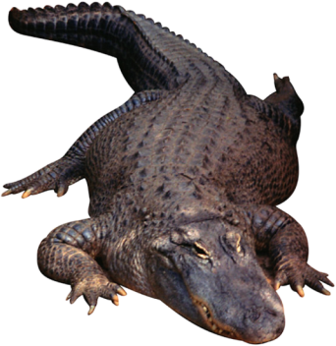

Slide 2
Objectives
1. To describe the different types of humane societies and analyze their contributions to animals.
2. To show the responsibilities of animal control organizations and assess their role in helping animals and humans.
3. To illustrate the importance of groups working toward the protection, safety and health of animals.

Slide 3
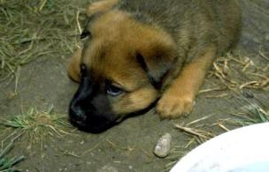
Humane Societies
Are organizations devoted to promoting humane ideas, especially with reference to the treatment of animals
Differ in each community to meet specific needs
Act independently from each other as there is no centrally organized branch outside the state level
Include grassroots humane groups, non-sheltering humane organizations and, specifically, the Humane Society of the United States

Slide 4
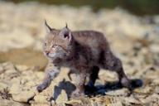
Grassroots Humane Groups
Are primarily run by volunteers
Are often involved in community outreach and child education programs as well as providing information on animals to the public
May offer a network of foster homes for abandoned animals, some focusing on a certain breed and others on a certain shelter or region
Include organizations such as Best Friends Animal Society, a sanctuary in Utah whose goal is reduce the number of homeless pets
Grassroots –involving the common people creating a fundamental political and economic group

Slide 5
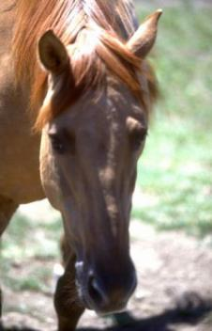
Non-Sheltering Humane Organizations
Do not run an animal housing facility
Are more involved in educating people about animals, foster care, spay/neuter services and animal placement
May be informal grassroots groups or large non-profit organizations

Slide 6
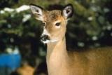
The Humane Society of the United States (HSUS)
Was founded in 1954
Is the largest animal protection organization in the nation, committed to protecting animals through litigation, legislation, investigation, education, advocacy and field work
Is comprised of more than seven million members and constituents
Constituent – a citizen who is represented in government by elected officials

Slide 7
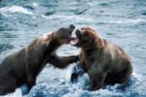
Protecting Animals in the Courtroom
Incorporates both:
litigation: a legal proceeding in court to determine and enforce legal rights
legislation: the act of making or enacting laws
Secures and enumerates the rights of animals through many HSUS led or supported legal cases, including the following subjects:
ending horse slaughter for human consumption
conserving endangered species
providing proper care and treatment for research animals
prohibiting animal fighting

Slide 8
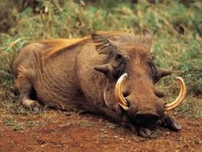
Protecting Animals Through Education
Involves publishing books and pamphlets on many subjects, including the following:
recommended shelter adoption standards
suggested treatment of animals in research laboratories
use of animals in high school science classes and fairs
alternatives to animals in research

Slide 9
Protecting Animals Through Investigation
Involves the HSUS sending members into laboratories, zoos, shelters and other institutions housing animals to ensure all standards are met and laws enforced

Slide 10
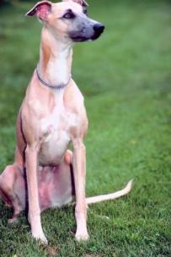
Saving Animals Through Field Work
Inspired the HSUS to join forces with the American Red Cross to aid animals in disasters
Led to creating the Rural Area Vet Services, a program which allows animals in remote areas to receive veterinarian assistance at no cost to their owner

Slide 11
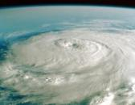
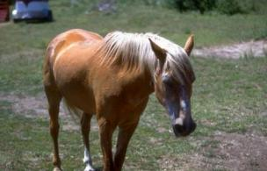
Saving Animals Through Field Work
Established two emergency animal shelters along the Gulf Coast after Hurricane Katrina hit, allowing for the rescue and shelter of an estimated 10,000 animals
Organized a hay drop for nearly 300 starving horses trapped by heavy snows in Nevada in 1969
Hurricane Katrina – Category five hurricane which hit the United States’ Gulf Coast in August 2005 and caused over $125 billion in economic damages

Slide 12
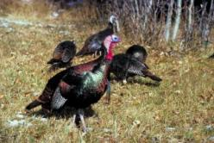
Local Humane Societies
May or may not operate under the HSUS, which runs a network of sanctuaries across the nation
Are part of HSUS and receive the following:
national guidelines for housing animals
training programs
outreach to help citizens find local shelters
disaster assistance
financial assistance in the form of scholarships and grants

Slide 13
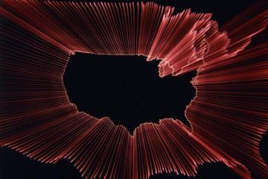
The Humane Society of the United States
Is based in Washington, D.C.
Has seven regional offices:
Northern Rockies
New England
Mid-Atlantic
Central States
Southeast
Southwest
West Coast

Slide 14
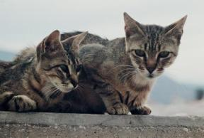
Animal Control
Workers aim to serve the public in protecting the health and safety of both humans and animals
Programs focus on public health and safety, law enforcement, protecting pets and people by providing education and prevention, and communicating safe practices to the community
Laws and policies vary in cities and states

Slide 15
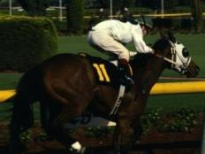
Health & Safety
In animals and humans is maintained through the following:
seizing and/or euthanizing of rabid or dangerous animals
seizing stray animals
investigating bites and attacks
encouraging spaying and neutering of animals
Euthanasia – to put to death painlessly

Slide 16
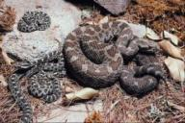
Law Enforcement
Includes upholding local city ordinances, the most common of which include the following:
prohibiting the running at large of animals, specifically cats and dogs
limiting the number of animals a resident may own
restricting the ownership of poisonous or dangerous animals such as certain snakes and spiders
controlling animal noise such as barking dogs
Ordinance – law or portion of larger code set in place by a city council, county board of commissioners or other municipal representatives

Slide 17
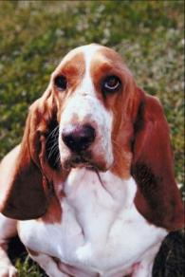
Educational Information
Is available through each city’s animal control center
Is often given to community groups, schools and other agencies concerning bite and attack prevention training, the importance of spay/neuter programs and registration of animals

Slide 18
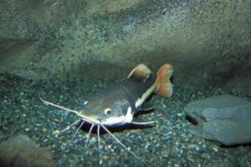
The National Animal Control Association
Assists in training and relaying information to animal control officers
Allows for a constant line of communication between members across the nation
Is not required by law, but is recommended

Slide 19
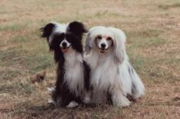
The American Society for the Prevention of Cruelty to Animals
Often works with city animal control agencies to remove stray animals
Regularly rescues animals from abuse and neglect
Frequently aids shelters across the nation with resources to improve care and treatment of animals

Slide 20
Assessment

Slide 21
Assessment
1. Which of the following humane groups/organizations are more involved in educating people about animals and animal management?
A. Grassroots humane groups
B. Non-sheltering humane organizations
C. Sheltering humane organizations
D. Animal shelters
2. In what year was the Humane Society of the United States (HSUS) founded?
A. 1952
B. 1954
C. 1975
D. 1981

Slide 22
Assessment
3. Where is the home office of the Humane Society of the United States?
A. New York, NY
B. Arlington, VA
C. Los Angeles, CA
D. Washington, D.C.
4. Which of the following was created to allow animals in remote areas to receive veterinarian assistance at no cost to their owner?
A. Humane Society of the United States
B. Rural Area Vet Services
C. Animal Welfare Act
D. The National Animal Control Association

Slide 23
Assessment
5. The Humane Society of the United States is divided into eight regions.
A. True
B. False
6. Animal control laws are the same in every state.
A. True
B. False

Slide 24
Assessment
7. The Final Round campaign promotes the use of animal fighting.
A. True
B. False
8. Animal control officers encourage the spaying/neutering of animals.
A. True
B. False

Slide 25
Assessment
9. An organization involving the common people creating a fundamental political and economic group is known as which of the following?
A. Mudroots
B. Constituents
C. Grassroots
D. Ordinance
10. The act of making or enacting laws is known as which of the following?
A. Litigation
B. Legislation
C. Leadership
D. Lobbying

Slide 26
Resources
National Animal Control Association
www.nacanet.org
The Humane Society of the United States
www.hsus.org
Michigan State University of Law
www.animallaw.info
The American Society for the Prevention of Cruelty to Animals
www.aspca.org

Slide 27
Acknowledgements
Project Coordinator:
Meghan Blanek
Production Manager:
Dusty Moore
Production Coordinator:
Brandon O’Quinn
Executive Producers:
Gordon Davis, Ph.D.,
Jeff Lansdell
Graphic Designer:
Ann Adams
© MMIX
CEV Multimedia, Ltd.

