Slide 1
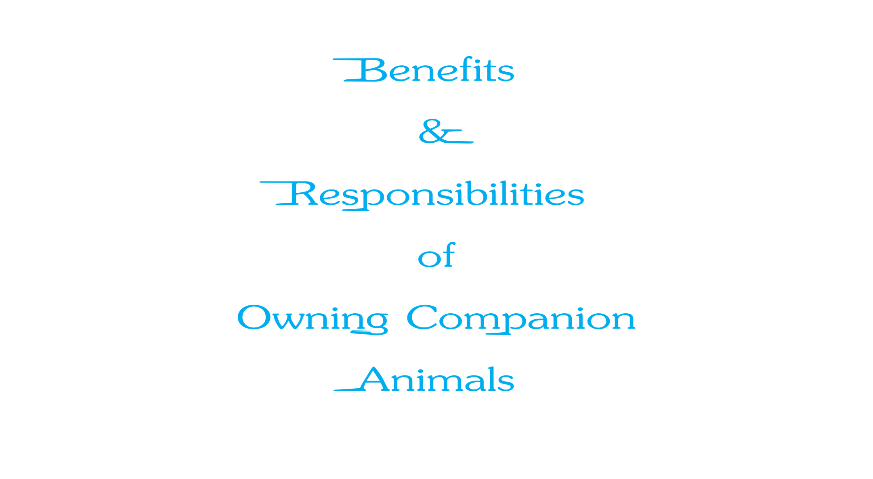

Slide 2
Objectives
1. To describe the problems, causes and solutions of animal overpopulation.
2. To discuss the human-animal bond and its affects on human health and emotion.
3. To explore different roles of animals in society.
4. To locate and provide informational materials on animal-related topics and issues.

Slide 3
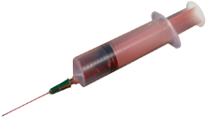
Overpopulation
Begins with millions of unwanted cats and dogs
Result in the following factors:
six to eight million cats and dogs are placed into animal shelters each year
15 million healthy cats and dogs are euthanized each year
Euthanize: to kill an incurably ill or injured animal to relieve suffering

Slide 4
Causes of Overpopulation
Include biological characteristics such as:
earlier puberty
shorter pregnancies
multiple births
Result from neglectful owners

Slide 5
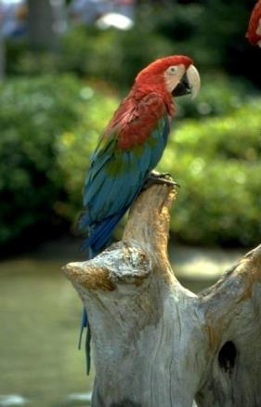
Reasons For The Relinquishment Of Pets In The United States
Include the following:
owners move
landlord does not allow pets
too many pets in the household
lack of finances for proper pet maintenance
inadequate facilities for pets
Relinquish: to abandon something

Slide 6
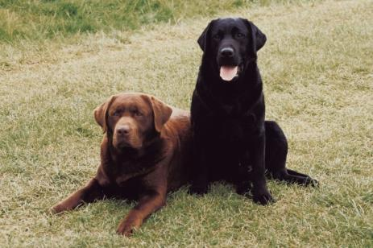
Solutions to Overpopulation
Is to prevent millions of unnecessary deaths of cats and dogs each year
Must be implemented to reduce overpopulation
Consist of spaying and neutering dogs and cats
Include purchasing pets from an animal shelter where cats and dogs will be euthanized if they are not adopted

Slide 7
Spaying & Neutering of Animals
Include sterilizing dogs and cats so animals are not able to reproduce
Spaying is the surgical removal of the uterine organs to prevent impregnation
Neutering is the removal of the testicles through castration, making the male incapable of inseminating the female

Slide 8
Benefits of Spaying & Neutering
Include the following:
number of unwanted cats and dogs will decrease dramatically
increases lifespan
reduces health problems
prevents uterine or ovarian cancer
reduces the risk for breast cancer

Slide 9
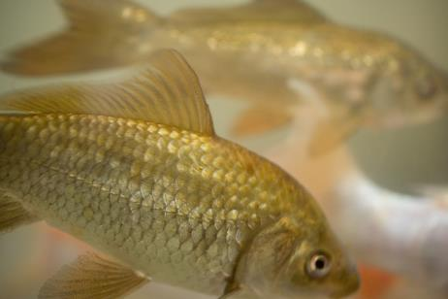
Laws Concerning Overpopulation
Have passed through legislation in 30 states requiring the sterilization of all dogs and cats adopted from a community animal shelter
Charge pet owners a sizeable financial penalty for not sterilizing companion animals
Can save people up to $300 in tax dollars per animal by preventing having to shelter, euthanize and dispose of pets properly

Slide 10
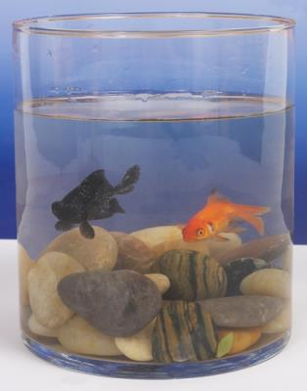
Responsible Questions to Consider for Pet Owners
Am I willing to purchase my pet from an animal shelter instead of a breeder?
Am I financially capable of providing veterinary services including having my pet spayed or neutered?
Will I have adequate time to spend taking care of my pet?
If “No” is the answer to any of these questions, a person should not own a pet

Slide 11
Pet Owners
Must be responsible for all aspects of caring for their pet
Should be aware of the following factors for owning a pet:
potential costs and expenses of the pet
basic grooming, nutrition and exercise needs
routine veterinary services including spaying and neutering
proper housing and shelter

Slide 12
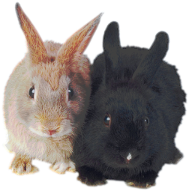
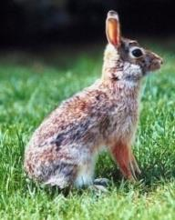
Rabbits
Need unlimited quality hay as well as fresh water which can be administered through a water bottle or sturdy bowl
Must have time out of the cage to get proper exercise
Can cost up to $450 annually for
basic care
Should be spayed or neutered to prevent overpopulation
Did you know: Over seven million dogs, cats and rabbits are euthanized each year in animal shelters across the U.S.

Slide 13
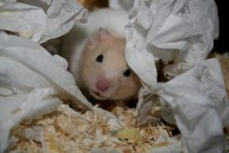
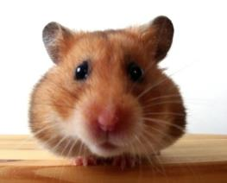
Hamsters & Gerbils
Are nocturnal and make noise throughout the night
Have a tendency to bite when woken up during the day often making them a problem for young kids
Can cost up to $225 per year for basic care
Eat mostly pellets with fresh fruits and vegetables along with hay
Fun Fact:
The word hamster comes from “hamstern,” which means “hoard” (or store) which is what they do with extra food.
Nocturnal- active at night

Slide 14
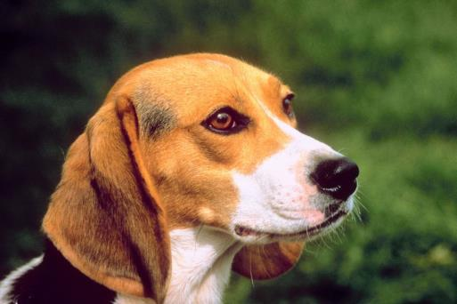
Dogs
Can cost as much as $1,071 per year for basic care
Should be spayed or neutered to help prevent overpopulation
Require multiple trips to the veterinarian each year
Should have nails clipped at least six times per year
Need basic grooming and exercise on a regular basis

Slide 15
Cats
Can cost up to $835 per year for basic care
Should be spayed or neutered to help prevent overpopulation
Require multiple trips to the veterinarian each year as well as anti-furball medication
Should have nails clipped at least six times per year
Need a litter box with clean litter if kept indoors

Slide 16
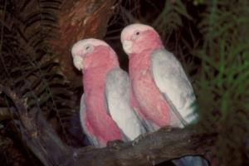
Birds
Cost up to $550 annually for basic care
Need a caged environment with the following accessories:
horizontal bars to climb as well as perches which can be attached inside the cage
food and water dish aligned at the same height as a perch
paper with non-toxic ink to line the bottom of the cage
a 25 inch by 25 inch cage which should be placed near sun light but away from any drafts which could cause the bird to get cold

Slide 17
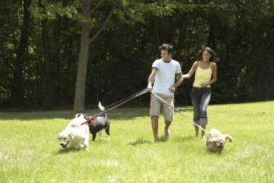
Bi-directional Relationship
Refers to the bond between humans and their pets which brings great benefit to the lives of both members (pet and pet owner)
Includes benefits to animals such as:
reliable food source
shelter
protection from predators
companionship

Slide 18
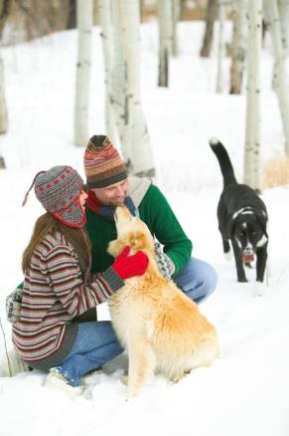
Human Health
Is improved by owning animals in the following ways:
ownership of dogs increases the likelihood for survival in people who have experienced a heart attack by 5 1/2 percent
have lower cholesterol levels
decreased blood pressure and reduced stress
increase level of physical activity by the owner

Slide 19
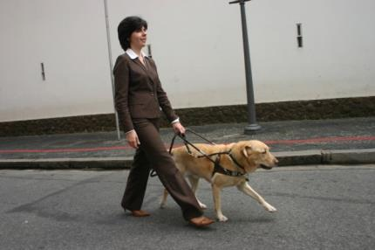
Animal Roles in Society
Impact people in many ways such as filling the following roles:
hearing dogs
guide animals for the blind
alert dogs
working dogs
provide companionship to people

Slide 20
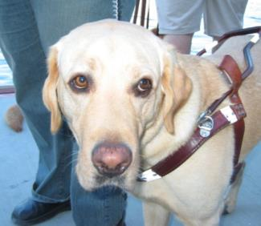
Hearing Dogs
Assist those who are deaf
Alert owners of certain sounds and possible dangers
Signal door bells, alarms and telephones among other sounds

Slide 21
Guide Animals for the Blind
Guide people who are blind
Navigate road and walkways
Warn owner of potential hazards and obstacles
Must disregard all distractions
Include mostly Labrador Retrievers and German Shepherds

Slide 22
Alert Dogs
Notify owner of a future seizure, giving the owner time to obtain medical help
Are trained to aid those with medical conditions such as diabetes
Assist in various physical needs such as:
open and close doors
pull wheelchairs

Slide 23
Working Dogs
Are used to detect drugs
Identify objects which may be explosive
Assist police in capturing criminals
Help with ranch work such as:
herding livestock
guarding and protecting livestock

Slide 24
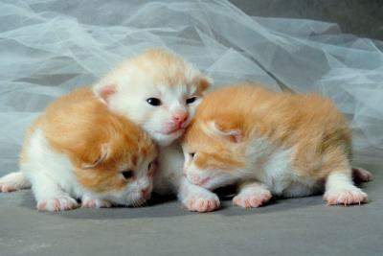
Informational Materials About Pets
Can be obtained from the following locations:
Companion Animal Over Population Facts:
http://www.idausa.org/facts/overpopulation.html
American Animal Welfare Society
http://www.americananimalwelfare.com/overpopulation.html

Slide 25
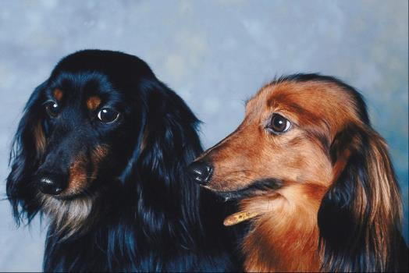
Informational Materials About Pets
Pet Education.com
www.peteducation.com
Program for Companion Animal Behavior, U.C. Davis
http://www.vetmed.ucdavis.edu/CCAB/

Slide 26
ASSESSMENT

Slide 27
Assessment
1. Which of the following is NOT a biological causes of overpopulation in companion animals?
A. Earlier puberty
B. Neglectful owners
C. Shorter pregnancies
D. Larger litters
2. Which of the following animals are considered to be nocturnal?
A. Rabbits
B. Gerbils
C. Dogs
D. Birds

Slide 28
Assessment
3. Which of the following animals are estimated to cost the most dollars annually?
A. Rabbits
B. Gerbils
C. Cats
D. Birds
4. Birds need how many hours of sunlight?
A. Five hours
B. Seven hours
C. 10 hours
D. 14 hours

Slide 29
Assessment
5. Which of the following breeds of dogs would most likely be a guide animal for the blind?
A. Labrador Retriever
B. Beagle
C. Siberian Husky
D. Yorkshire Terrier
6. Which of the following is NOT a benefit of the bi-directional relationship between humans and their pets?
A. Reliable food source
B. Protection from predators
C. Shelter
D. Independence

Slide 30
Assessment
7. Which of the following types of dogs assist the police in capturing criminals?
A. Alert dogs
B. Working dogs
C. Guide dogs
D. Hearing dogs
8. Which of the following is NOT a benefit of chew toys for dogs?
A. Keep teeth plaque free
B. Minimize bad breath
C. Keep entertained
D. Prevent obesity

Slide 31
Assessment
9. More than how many dogs, cats and rabbits are euthanized each year in animal shelters across the United States?
A. Five million
B. Six million
C. Seven million
D. Eight million
10. Which of the following animals need an unlimited supply of quality hay?
A. Rabbits
B. Gerbils
C. Dogs
D. Birds

Slide 32
Resources
Companion Animal Overpopulation Facts:
www.idausa.org
Adopt a pet.com
www.adoptapet.com
American Animal Welfare Society
www.americananimalwelfare.com
Spay/Neuter Ordinance Fact Sheet
www.idausa.org
Avian Welfare Resource Center
www.avianwelfare.org

Slide 33
Resources
House Rabbit Society
www.rabbit.org
Peta
www.helpinganimals.com
Pet Education.com
www.peteducation.com
Life Cycles
www.ritualwell.org
Regional Support Centre for Scotland North and East
www.rsc-ne-scotland.ac.uk

Slide 34
Resources
Program for Companion Animal Behavior, School of Veterinary Medicine UC Davis
www.vetmed.ucdavis.edu
Therapy and Service Animals
www.rsc-ne-scotland.ac.uk
The American Society for the Prevention of Cruelty to Animals (ASPCA)
www.aspca.org
British Columbia Society for the Prevention of Cruelty to Animals (BCSPCA)
www.spca.bc.ca
Pet Overpopulation Fact Sheet
www.learnnc.org

Slide 35
Acknowledgements
Project Coordinator:
Meghan Blanek
Production Manager:
Dusty Moore
Production Coordinator:
Layne Sheets
Executive Producers:
Gordon Davis, Ph.D.,
Jeff Lansdell
Graphic Designer:
Ann Adams
© MMIX
CEV Multimedia, Ltd.

