Slide 2
Objectives
To identify plant structures and functions.
To describe the structure of plant cells.
To explain the process of reproduction in plants.

Slide 3
Main Menu
Plant Cell Biology
Plant Structures
Roots
Stems
Flowers
Leaves
Fruit
Seeds

Slide 5
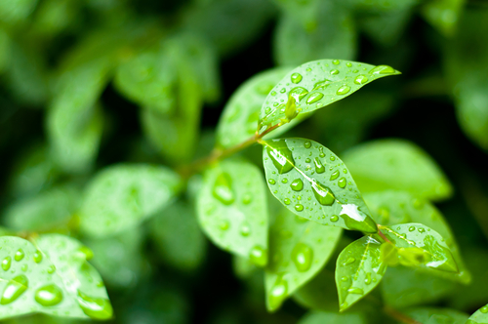
Plants
Plants
are multicellular organisms
are incapable of movement
produce food through photosynthesis

Slide 6
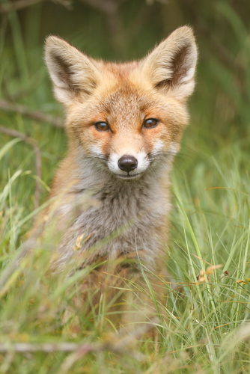
Animals
Animals
are multicellular organisms
are capable of movement, on their own
cannot produce their own “food”
Ingest food from
surroundings

Slide 7
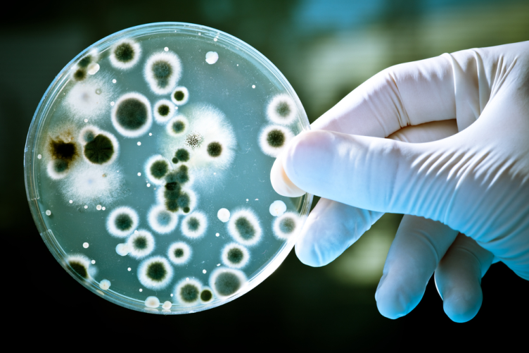
Cell Types
Include:
Prokaryotic
pro = before; karyon = nucleus
found in bacteria
do not contain a nuclei
lack membrane-bound organelles
Fun Fact: Since viruses are acellular – they contain no organelles and cannot grow and divide – they are considered neither prokaryotic or eukaryotic.

Slide 8
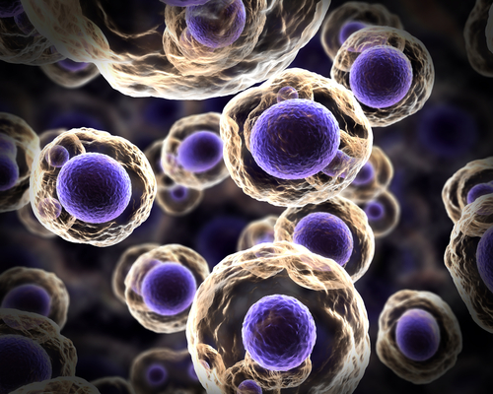
Cell Types
Include:
Eukaryotic
eu = good; karyon = nucleus
found in plants and animals
contain a nucleus
contain membrane-bound organelles

Slide 9
Cell Membrane
Surrounds the cell as a thin layer of protein (about eight-millionths of a millimeter thick)
Can be found inside the cell wall
Allows some substances to pass into the cell while blocking others

Slide 10
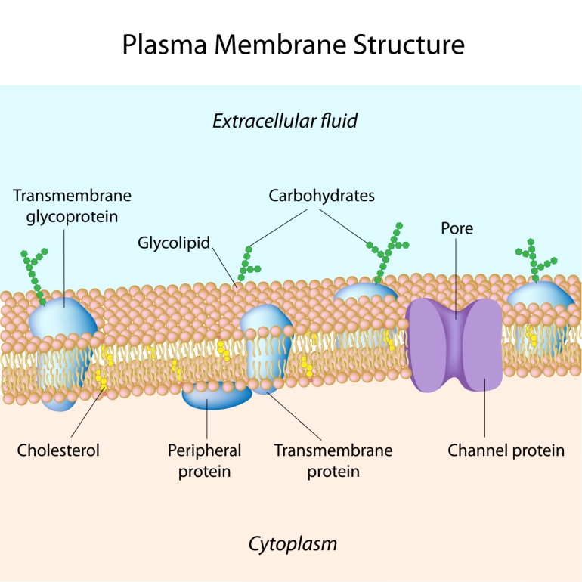
Cell Membrane
Is also known as the plasma membrane
Is involved in cellulose production for the assembly of cell walls
Is composed of highly
structured proteins
and phospho-lipids

Slide 11
Cell Wall
Are found only in plants
Surrounds the cell
Provides structural support and protection
Bonds with other cell walls to create plant structure

Slide 12
Chloroplast
Is an elongated organelle containing chlorophyll
Converts light and carbon dioxide to usable energy
Organelle: specialized part of a cell which has a specific function

Slide 13
Cytoplasm
Is a gel-like material outside the nucleus, but inside cell membrane
Contains the cytoskeleton, cytosol and the organelles
Fun Fact: substance of a living cell, including the cytoplasm and nucleus, is known as the protoplasm.

Slide 14
Golgi Apparatus
Is a flat, layered organelle (dictyosomes) which resembles a stack of pancakes
Is located near the nucleus
Packages proteins and carbohydrates for export from the cell
Modifies proteins and lipids before distributing them

Slide 15
Mitochondria
Is the powerhouse of the cell
Are spherical, rod-shaped organelles
Have a double membrane
Converts energy stored in glucose to ATP for the cell (Respiration)
ATP: adenosine triphosphate, the molecule which provides the energy in the cells of all living things

Slide 16
Nucleus
Controls functions of the cell
Contains DNA in chromosomes
Is surrounded by the nuclear membrane
Chromosome: structure of nucleic acids and proteins which carries genetic information in the form of genes

Slide 17
Ribosomes
Are small organelles found in large numbers in the cytoplasm
Create proteins from amino acids
Can only be seen
with an electron
microscope
Composed of two
subunits containing
RNA and proteins

Slide 18
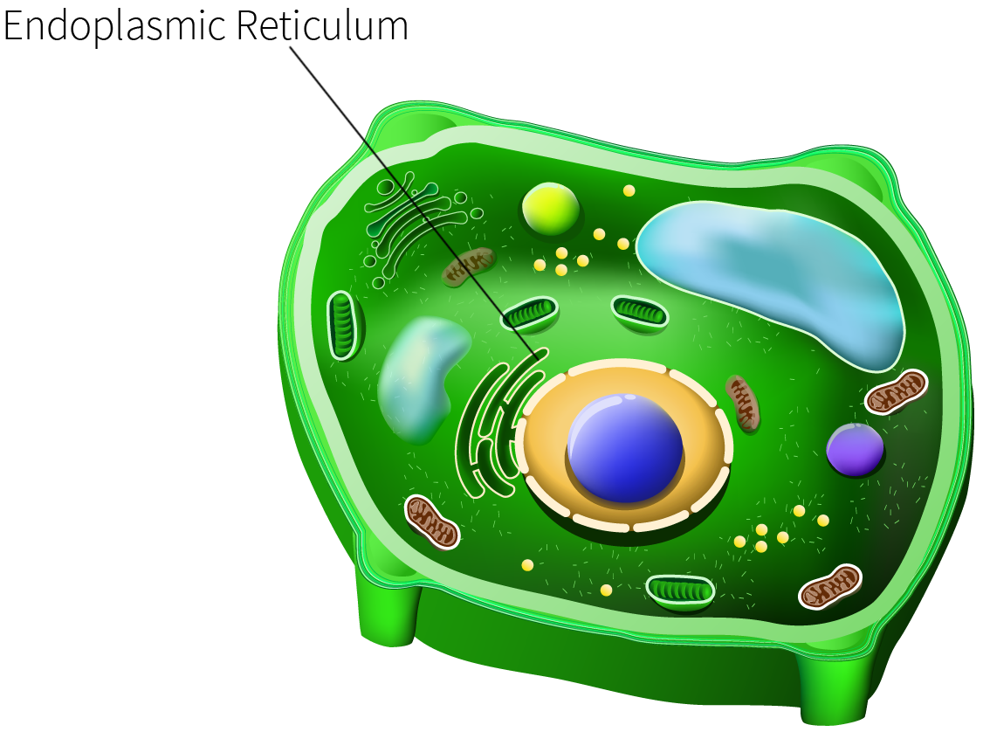
Rough Endoplasmic Reticulum
Is located in the cytoplasm
Is covered with ribosomes which give it a rough appearance
Transports materials through the cell, secretes,
stores and creates proteins

Slide 19
Smooth Endoplasmic Reticulum
Is located in the cytoplasm
Transports materials through the cell
Contains enzymes
Produces and digests lipids and membrane proteins
Enzymes: proteins which assist chemical reactions in living cells

Slide 20
Vacuole
Is surrounded by a membrane
Is filled with fluid
Takes up most of the cell
Maintains the shape of the cell
Is the “cell trash can”

Slide 21
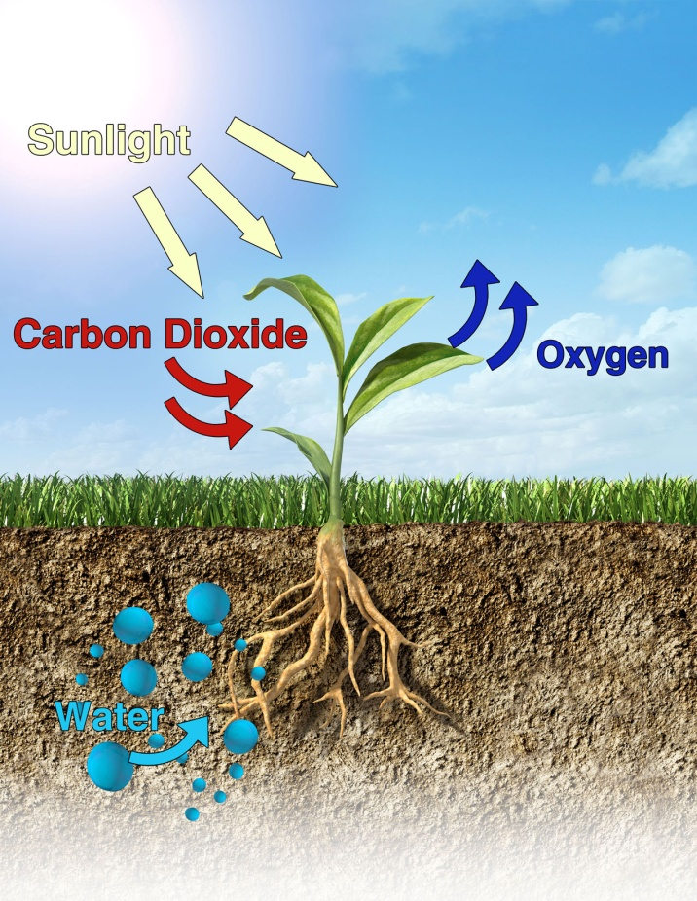
Photosynthesis
Is the process of converting light energy to chemical
energy
Takes place in the chloroplasts using chlorophyll

Slide 23
Assessment
1. Which of the following is NOT a characteristic of plants?
A. Creates food through photosynthesis
B. Are multicellular organisms
C. Are incapable of movement
D. Are capable of moving by themselves
2. What type of cells are found in bacteria?
A. Eukaryotic
B. Prokaryotic
C. Neither eukaryotic and prokaryotic
D. Both eukaryotic and prokaryotic

Slide 24
Assessment
3. Which part of the plant cell surrounds the cell as a thin layer of lipids and proteins?
A. Cell membrane
B. Golgi apparatus
C. Cell wall
D. Chloroplasts
4. Which part of the plant cell provides the structural support and protection?
A. Cell membrane
B. Cell wall
C. Cytoplasm
D. Chloroplasts

Slide 25
Assessment
5. Which cell structure contains the cytoskeleton, cytosol and the organelles?
A. Cell membrane
B. Cell wall
C. Cytoplasm
D. Chloroplasts

