Slide 2
Hamsters
Breeds of Companion Animals: Exotics
Notes:
2

Slide 3
Hamsters
Are short tailed, burrowing rodents
Include the following breeds:
Chinese
Dwarf Campbells Russian
Dwarf Winter White Russians
Roborovski
Syrian
Notes:
3

Slide 4
Hamster Behavior
Includes the following:
gentle
affectionate
social (with owners)
solitary
fearful
Notes:
4

Slide 5
Chinese
Come in either a combination of brown and black or white, brown and black with occasional variations
Look to similar to mice without a long tail and softer hair

Slide 6
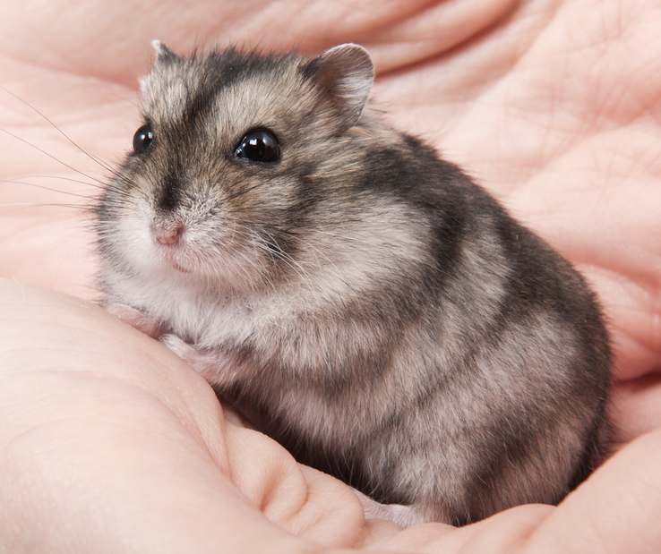
Dwarf Campbells Russian
Are generally gray-brown in color with other color varieties common through breeding
Unlike most other breeds, are generally social with their own species if introduced at a young age

Slide 7
Dwarf Winter White Russian
Are a generally a combination of white, black and gray with other color varieties common through breeding
May require aquarium housing as they may be too small for traditional hamster habitats

Slide 8
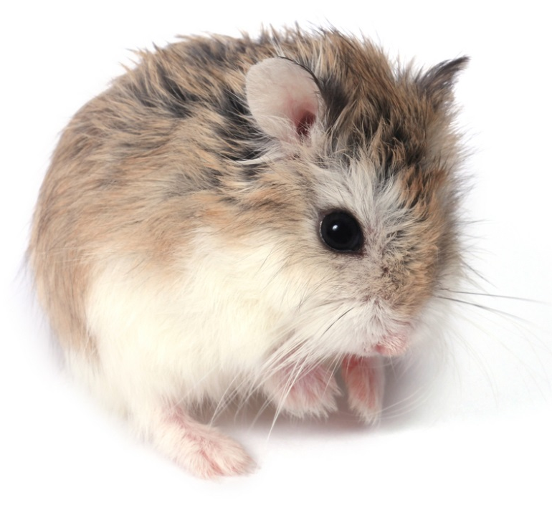
Roborovski
Are a generally a combination of golden brown with a white stomach and other color varieties common through breeding

Slide 9
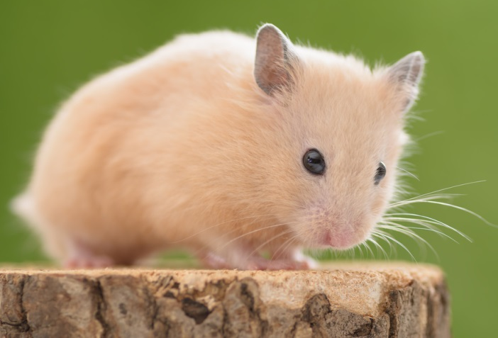
Syrians
Come in a wide variety of colors and color patterns with long and soft hair
Should be kept in groups until eight weeks of age to avoid fighting

Slide 10
Rabbits
Breeds of Companion Animals: Exotics
Notes:
10

Slide 11
Rabbits
Are any variety of small hares which possess soft fur and large ears
Vary in color and size depending on breed
May be solid colored or possess spots or stripes
Some common varieties include:
Angora
Californian
Flemish Giant
Himalayan
Lop
Notes:
11

Slide 12
Common Rabbit Behavior
Is characterized by the following:
good natured
affectionate
lively
gentle
easily trained
Notes:
12

Slide 13
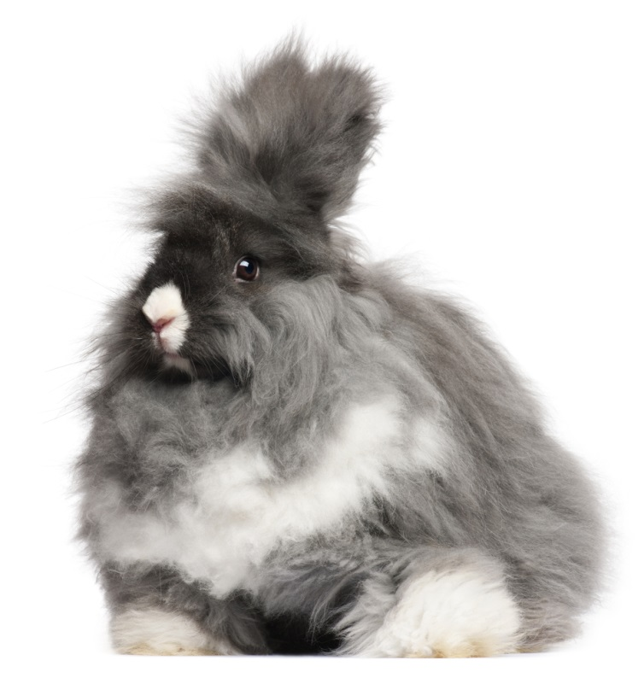
Angora
Thick white or cream colored wool covers most varieties of Angora
Require special grooming and diets

Slide 14
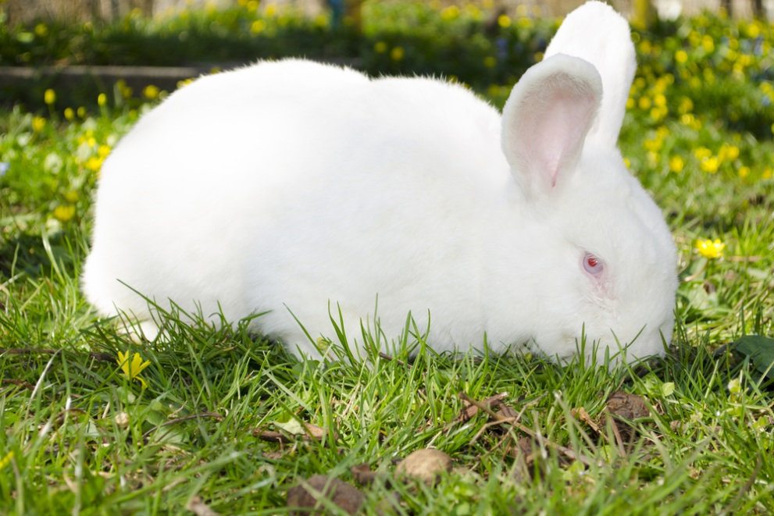
Californian
Are white with black ears, nose, tail and feet
Are popular at breed shows and county fairs for their excellent physical traits

Slide 15
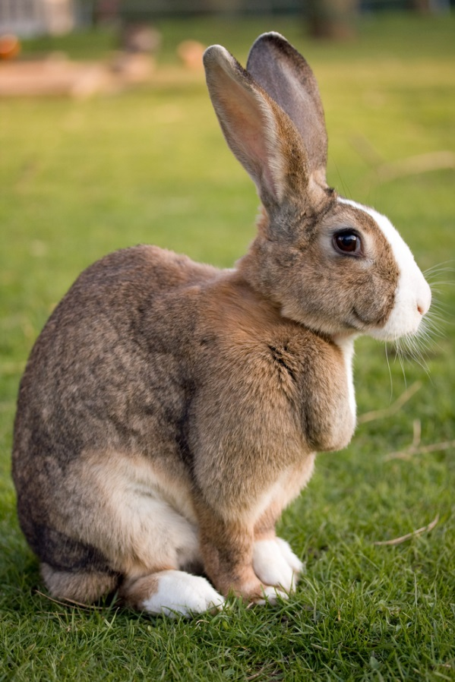
Flemish Giants
Come in a variety of colors and patterns
Are the largest breed of rabbits with males growing well above 14 pounds in weight and one or more feet in length

Slide 16
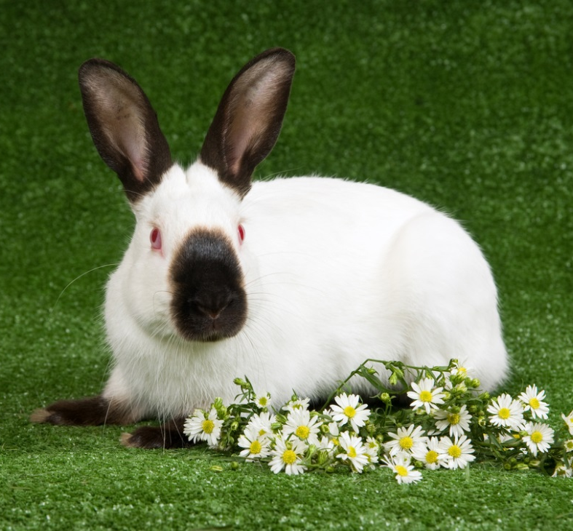
Himalayan
Are white with black, blue, lilac or chocolate colored feet, ears, nose and tail
Have shorter ears and narrower bodies than most other breeds

Slide 17
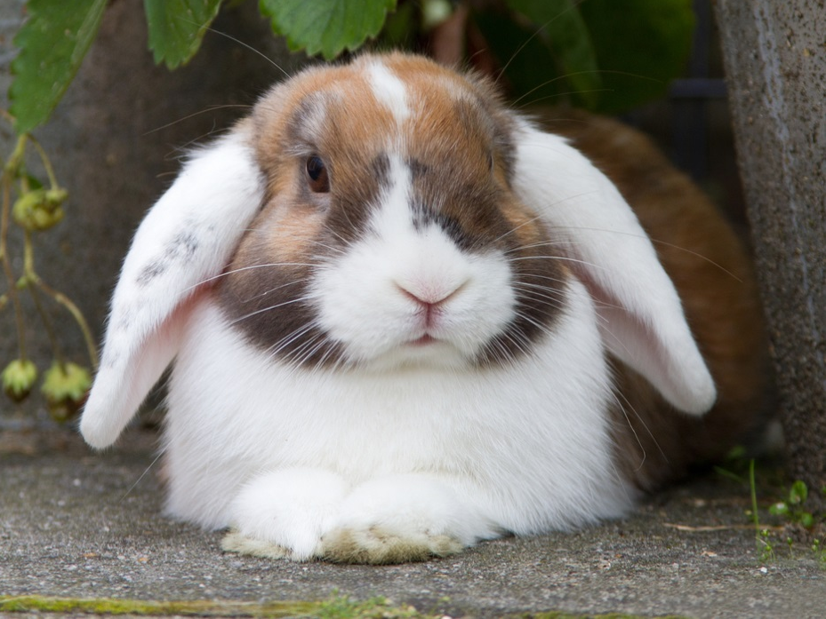
Lops
Come in a large variety of colors
Include several different varieties developed in different areas for different purposes over time
Are known for their distinctive lopped ears known to reach the ground beneath them

Slide 18
Amphibians
Breeds of Companion Animals: Exotics
Notes:
18

Slide 19
Amphibians
Are cold blooded animals with smooth skin which may live on land or in water
Are usually green or brown in color
May possess dark spots or stripes
Can usually be kept with fish
Notes:
19

Slide 20
Amphibian Behavior
Is characterized by the following:
hardy
solitary
easy to care for
Notes:
20

Slide 21
Common Amphibian Pet Breeds
Include the following:
African Dwarf Frogs
American Green Tree Frogs
Oriental Fire Bellied Toads
Tiger Salamanders
Notes:
21

Slide 22
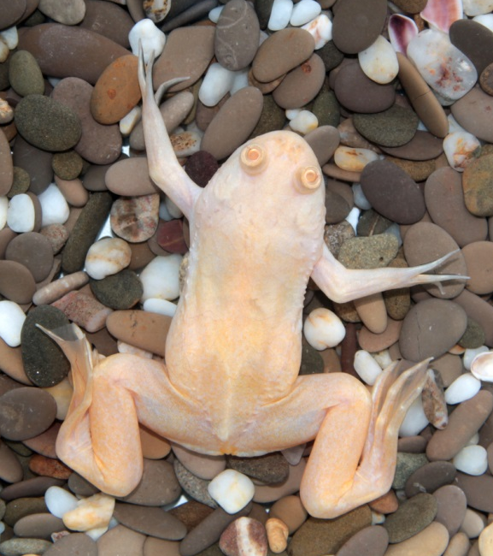
African Clawed Frogs
Come in a variety of colors often complimenting a grey or brown body
Are very hardy, with the ability to live for several years in good environmental conditions

Slide 23
American Green Tree Frogs
Come in a bright and appealing grass-green color
Require a steady diet of flies, moths, crickets and weekly vitamin supplement

Slide 24
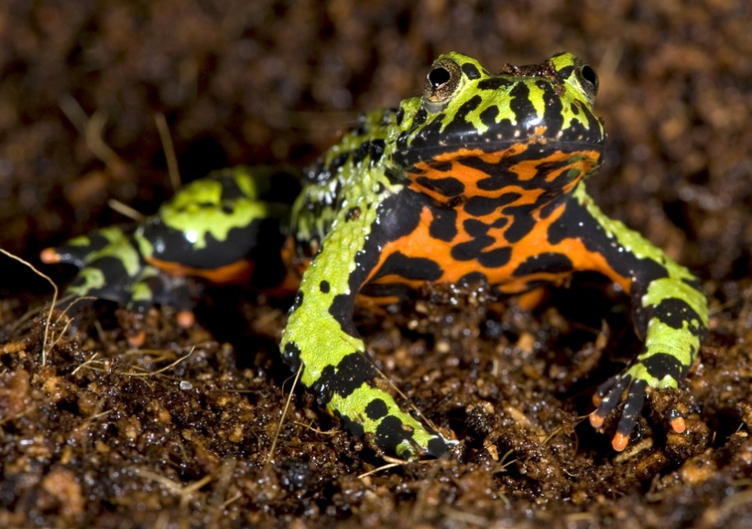
Oriental Fire Bellied Toads
Are bright green and black on their back and even brighter orange and black on their underside
Are known to live for 10 to 15 years if properly cared for

Slide 25
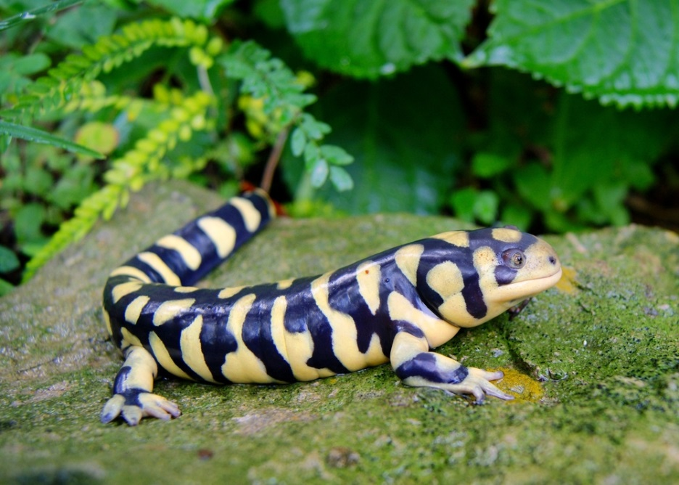
Tiger Salamanders
Come in a large variety of colors with distinctive patterns giving the appearance of tiger fur
Are disappearing rapidly in the wild

Slide 26
Reptiles
Breeds of Companion Animals: Exotics
Notes:
26

Slide 27
Reptiles
Are cold blooded animals with an external covering of scales or horny plates
Are usually green, brown, tan, gray or orange
Generally molt, or shed their outer layer of skin, as they grow
Notes:
27

Slide 28
Common Reptile Behavior
Includes the following:
solitary
territorial
gentle
trainable
easily tamed
Notes:
28

Slide 29
Common Reptile Pet Breeds
Include the following:
Ball Pythons
Bearded Dragons
Box Turtles
Geckos
Green Iguanas
Tortoise
Notes:
29

Slide 30
Ball Pythons
Are most often covered in varying shades of brown markings and lighter shades of brown spots
Are docile and occasionally social if properly cared for

Slide 31
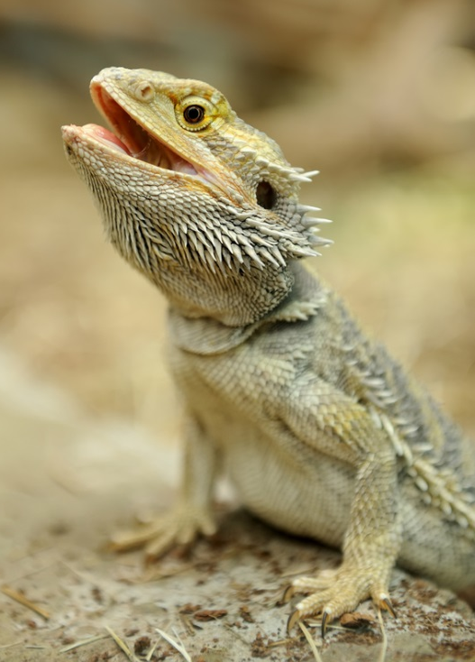
Bearded Dragons
Are most often a tan and sand color with rough scales for blending in with native environments
Thrive on a diet of vegetables and insects such as crickets

Slide 32
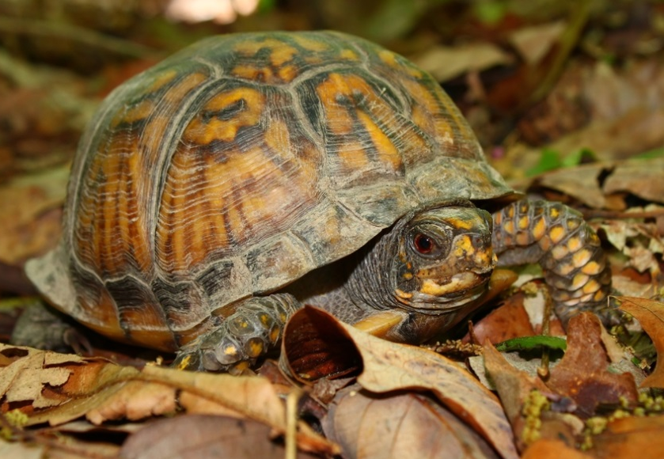
Box Turtles
Are usually dark brown or olive in color with bright orange and yellow patterns
Are native to North America with four subspecies appearing in the United States and two appearing in Mexico

Slide 33
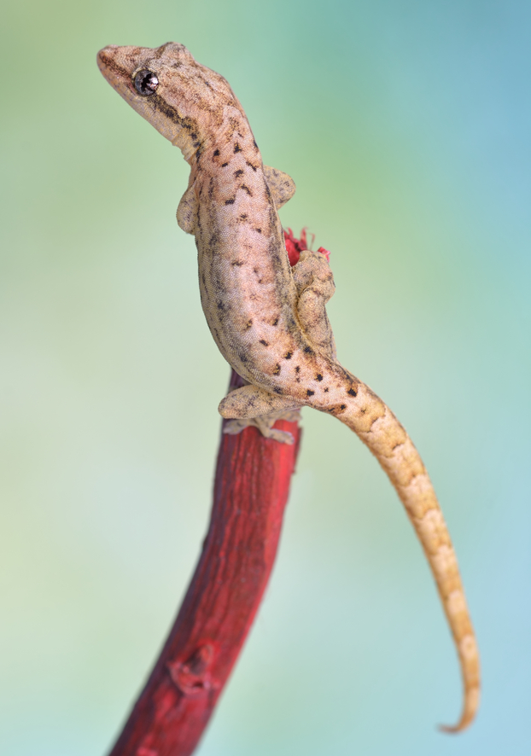
Gecko
Come in wide variety of colors depending on the climate and environment in which they reside
Are known for their ability to walk up vertical surfaces

Slide 34
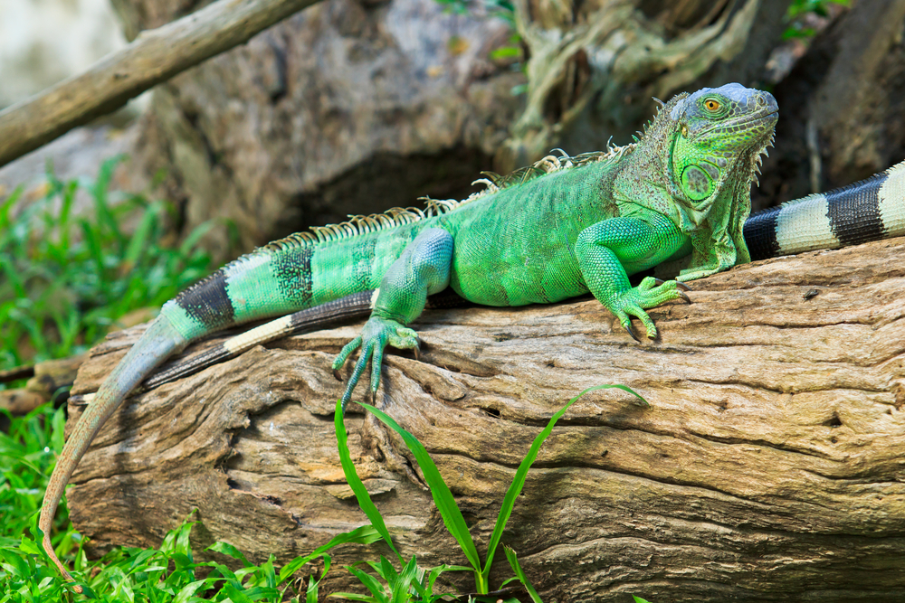
Green Iguanas
Are variable in color, usually between different shades of green and brown
Are known to live up to 20 years if properly cared for

Slide 35
Tortoises
Come in a variety of colors, often green, gray, tan or a combination
Are known to grow as large as dogs, depending on the species, diet and environment

Slide 36
Hamsters
Breeds of Companion Animals: Exotics
Notes:
36

Slide 37
Hamsters
Are short tailed, burrowing rodents
Include the following breeds:
Chinese
Dwarf Campbells Russian
Dwarf Winter White Russians
Roborovski
Syrian
Notes:
37

Slide 38
Hamster Behavior
Includes the following:
gentle
affectionate
social (with owners)
solitary
fearful
Notes:
38

Slide 39
Chinese
Come in either a combination of brown and black or white, brown and black with occasional variations
Look to similar to mice without a long tail and softer hair

Slide 40
Dwarf Campbells Russian
Are generally gray-brown in color with other color varieties common through breeding
Unlike most other breeds, are generally social with their own species if introduced at a young age

Slide 41
Dwarf Winter White Russian
Are a generally a combination of white, black and gray with other color varieties common through breeding
May require aquarium housing as they may be too small for traditional hamster habitats

Slide 42
Roborovski
Are a generally a combination of golden brown with a white stomach and other color varieties common through breeding

Slide 43
Syrians
Come in a wide variety of colors and color patterns with long and soft hair
Should be kept in groups until eight weeks of age to avoid fighting

Slide 44
Rabbits
Breeds of Companion Animals: Exotics
Notes:
44

Slide 45
Rabbits
Are any variety of small hares which possess soft fur and large ears
Vary in color and size depending on breed
May be solid colored or possess spots or stripes
Some common varieties include:
Angora
Californian
Flemish Giant
Himalayan
Lop
Notes:
45

Slide 46
Common Rabbit Behavior
Is characterized by the following:
good natured
affectionate
lively
gentle
easily trained
Notes:
46

Slide 47
Angora
Thick white or cream colored wool covers most varieties of Angora
Require special grooming and diets

Slide 48
Californian
Are white with black ears, nose, tail and feet
Are popular at breed shows and county fairs for their excellent physical traits

Slide 49
Flemish Giants
Come in a variety of colors and patterns
Are the largest breed of rabbits with males growing well above 14 pounds in weight and one or more feet in length

Slide 50
Himalayan
Are white with black, blue, lilac or chocolate colored feet, ears, nose and tail
Have shorter ears and narrower bodies than most other breeds

Slide 51
Lops
Come in a large variety of colors
Include several different varieties developed in different areas for different purposes over time
Are known for their distinctive lopped ears known to reach the ground beneath them

Slide 52
Amphibians
Breeds of Companion Animals: Exotics
Notes:
52

Slide 53
Amphibians
Are cold blooded animals with smooth skin which may live on land or in water
Are usually green or brown in color
May possess dark spots or stripes
Can usually be kept with fish
Notes:
53

Slide 54
Amphibian Behavior
Is characterized by the following:
hardy
solitary
easy to care for
Notes:
54

Slide 55
Common Amphibian Pet Breeds
Include the following:
African Dwarf Frogs
American Green Tree Frogs
Oriental Fire Bellied Toads
Tiger Salamanders
Notes:
55

Slide 56
African Clawed Frogs
Come in a variety of colors often complimenting a grey or brown body
Are very hardy, with the ability to live for several years in good environmental conditions

Slide 57
American Green Tree Frogs
Come in a bright and appealing grass-green color
Require a steady diet of flies, moths, crickets and weekly vitamin supplement

Slide 58
Oriental Fire Bellied Toads
Are bright green and black on their back and even brighter orange and black on their underside
Are known to live for 10 to 15 years if properly cared for

Slide 59
Tiger Salamanders
Come in a large variety of colors with distinctive patterns giving the appearance of tiger fur
Are disappearing rapidly in the wild

Slide 60
Reptiles
Breeds of Companion Animals: Exotics
Notes:
60

Slide 61
Reptiles
Are cold blooded animals with an external covering of scales or horny plates
Are usually green, brown, tan, gray or orange
Generally molt, or shed their outer layer of skin, as they grow
Notes:
61

Slide 62
Common Reptile Behavior
Includes the following:
solitary
territorial
gentle
trainable
easily tamed
Notes:
62

Slide 63
Common Reptile Pet Breeds
Include the following:
Ball Pythons
Bearded Dragons
Box Turtles
Geckos
Green Iguanas
Tortoise
Notes:
63

Slide 64
Ball Pythons
Are most often covered in varying shades of brown markings and lighter shades of brown spots
Are docile and occasionally social if properly cared for

Slide 65
Bearded Dragons
Are most often a tan and sand color with rough scales for blending in with native environments
Thrive on a diet of vegetables and insects such as crickets

Slide 66
Box Turtles
Are usually dark brown or olive in color with bright orange and yellow patterns
Are native to North America with four subspecies appearing in the United States and two appearing in Mexico

Slide 67
Gecko
Come in wide variety of colors depending on the climate and environment in which they reside
Are known for their ability to walk up vertical surfaces

Slide 68
Green Iguanas
Are variable in color, usually between different shades of green and brown
Are known to live up to 20 years if properly cared for

Slide 69
Tortoises
Come in a variety of colors, often green, gray, tan or a combination
Are known to grow as large as dogs, depending on the species, diet and environment

