Slide 1
Breeds of Companion Animals: Exotics
Notes:
1

Slide 2
Objectives
To examine popular species of other and exotic companion animals.
To identify the characteristics of common companion breeds.
To understand which breeds are appropriate for different settings and uses.
Notes:
2

Slide 3
Other Companion Animals
Include the following:
birds
fish
guinea pigs
hamsters
rabbits
amphibians
reptiles
Notes:
3

Slide 4
Birds
Breeds of Companion Animals: Exotics
Notes:
4

Slide 5
Birds
Are warm-blooded, egg laying, feather covered vertebrates
Commonly used as pets include the following breeds:
African Grey Parrots
Amazon Parrots
Canaries
Cockatiels
Cockatoo
Macaws
Parakeets
Notes:
5

Slide 6
Bird Behavior
Is characterized by the following:
easily tamed
intelligent
social
responsive
strong personalities
Notes:
6

Slide 7
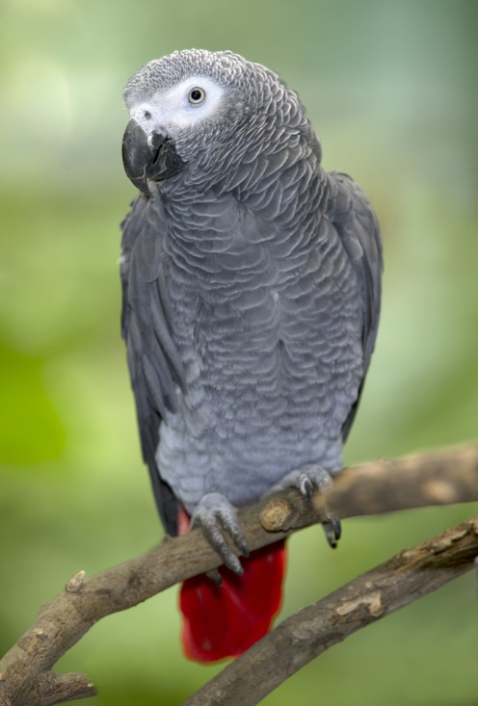
African Grey
Comes in several shades of grey feathers with other colors often mixed in
Are intelligent birds with observant qualities utilized for understanding their environment

Slide 8
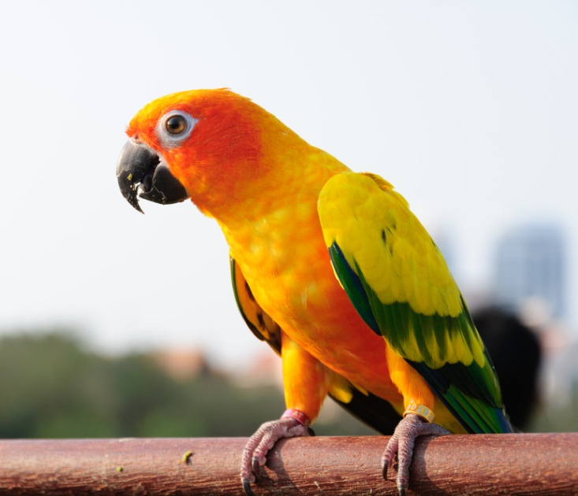
Amazon Parrots
Are covered in predominantly green feathers with other colors on various parts of their body
Are intelligent and playful

Slide 9
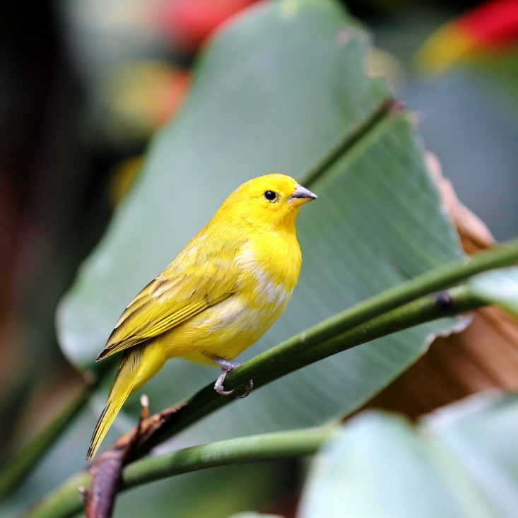
Canaries
Come in an array of brightly colored feathers
Are noted for their desire to sing on a regular basis

Slide 10
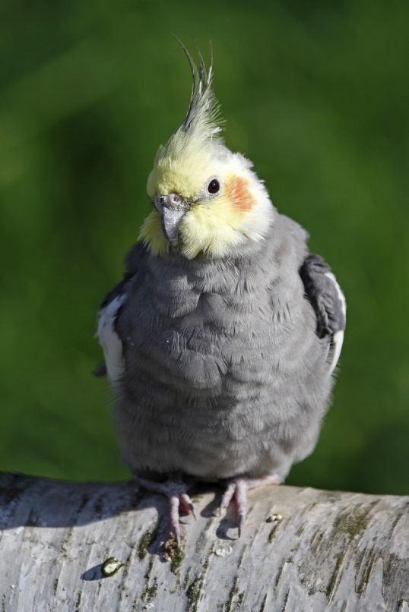
Cockatiels
Have mostly gray feathers, with distinct orange circles on their faces and additional coloring on males
Are sociable and intelligent birds needing adequate attention from their owners

Slide 11
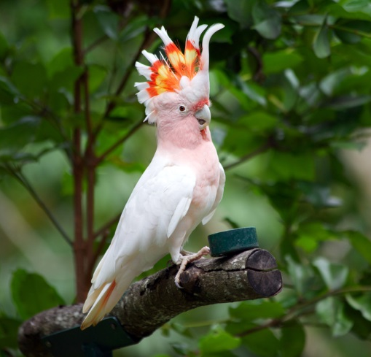
Cockatoos
Come in a wide variety of colors, with white being the most common
Are very lively and affectionate birds known to live for more than 40 years if cared for properly

Slide 12
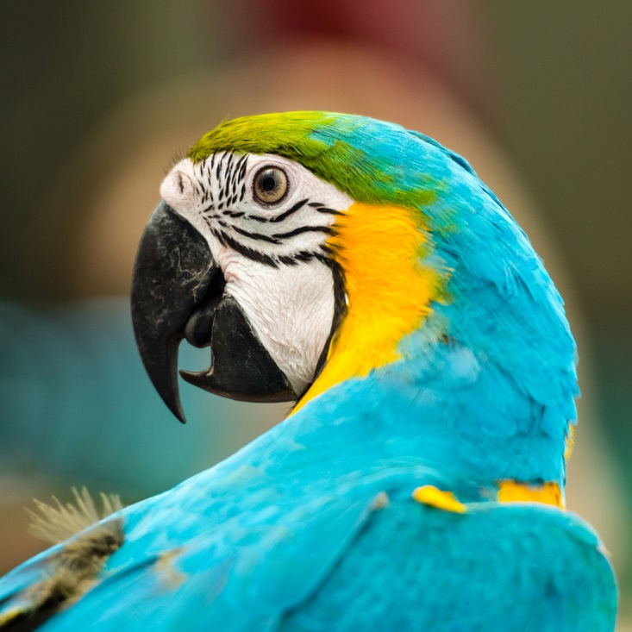
Macaws
Have brightly colored feathers which can be red, blue, yellow and green
Are one of the most popular and expensive exotic birds
Include several of the most endangered species on earth

Slide 13
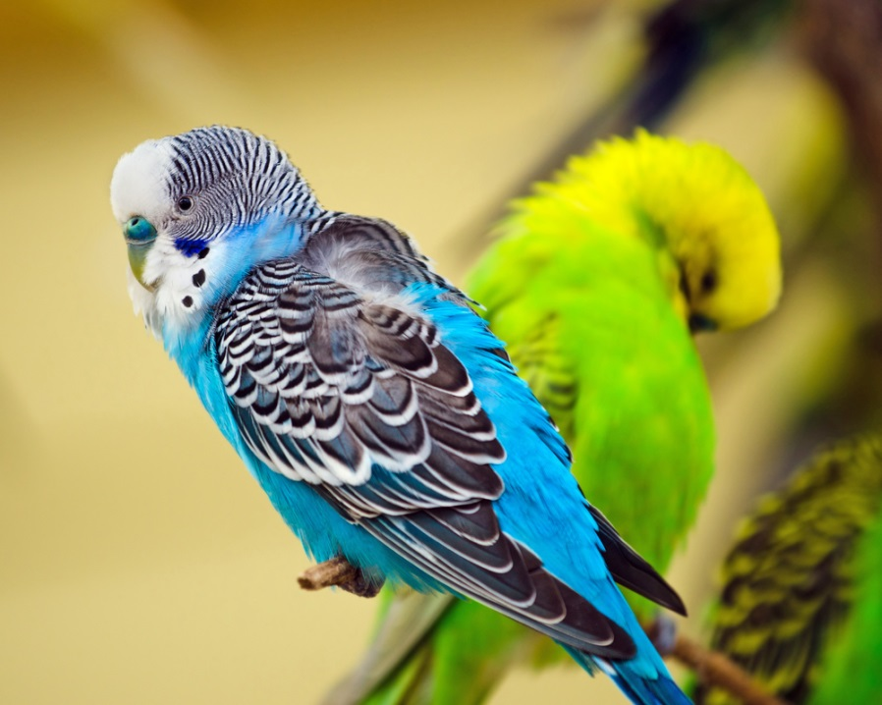
Parakeets
Come in a large variety of colors
Are highly active birds found throughout the world

Slide 14
Fish
Breeds of Companion Animals: Exotics
Notes:
14

Slide 15
Fish
Vary greatly in size and color
Behavior depends on the breed, though most are calm and responsive
Are often chosen as pets due to their low maintenance
Notes:
15

Slide 16
Fish
Are cold-blooded aquatic vertebrates
Used as pets include the following species:
freshwater
Betta
Cichlids
Goldfish
Gourami
Guppies
Mollies
Tetra
saltwater
Angelfish
Butterfly
Clownfish
Puffers
Seahorse
Tang
Notes:
16

Slide 17
Freshwater Fish
Live in freshwater the majority or entirety of their lives
Thrive in a large variety of environments with larger numbers in tropical areas
Inhabit lakes, ponds, streams, rivers, wetlands, marshes and more
Notes:
17

Slide 18
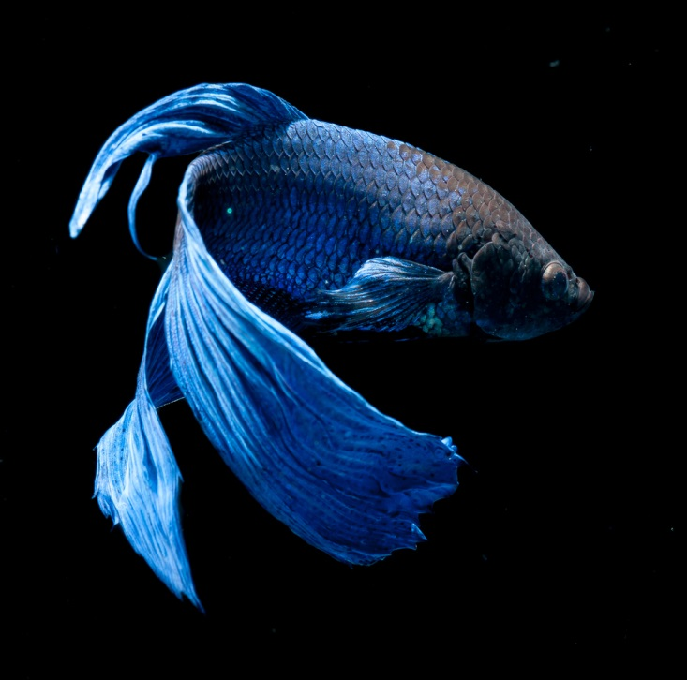
Bettas
Come in a wide variety of bright colors
Are also known as Siamese Fighting Fish because of their aggressive nature towards other fish, including other bettas

Slide 19
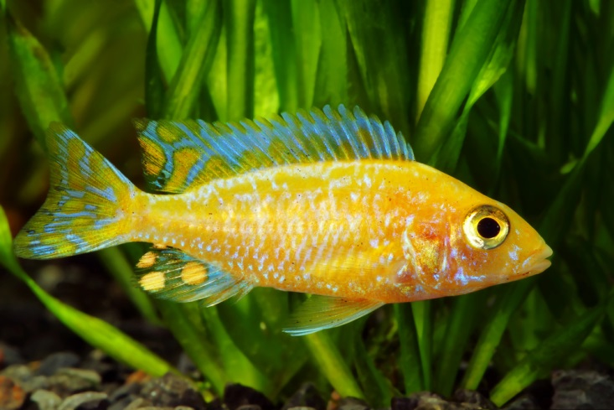
Cichlids
Include more than 1,000 species identified around the world
Most often come in bright colors and thrive in tropical areas

Slide 20
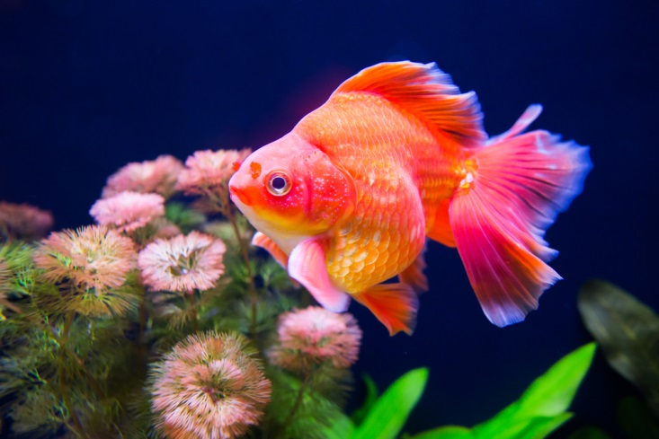
Goldfish
As their name implies, are often golden in color, with others coming in white, black and combinations
Are descendants of wild carp

Slide 21
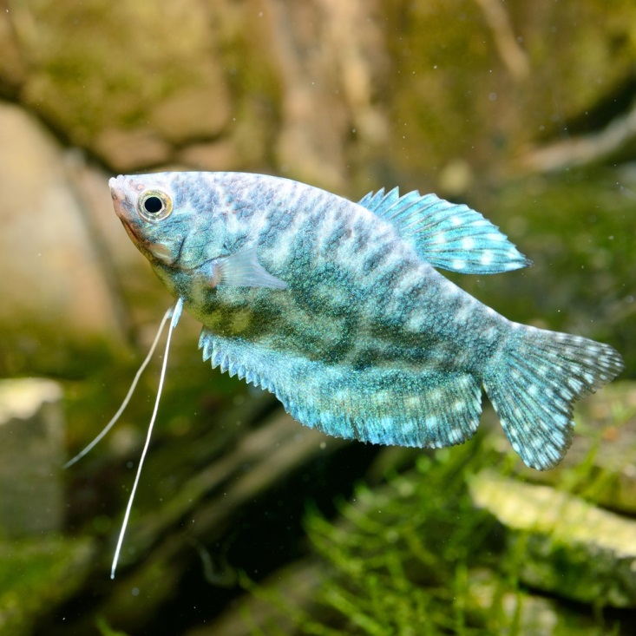
Gourami
Come in a wide variety of colors, sizes and patterns
Are known for their unique physical features including “kissing” Gourami which feed and breathe in a manner giving the impression of kissing

Slide 22
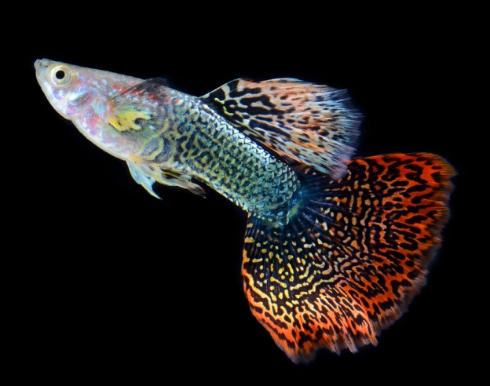
Guppies
Come in a large variety of colors
Include more than 300 different varieties of fish, native primarily to South and Central America

Slide 23
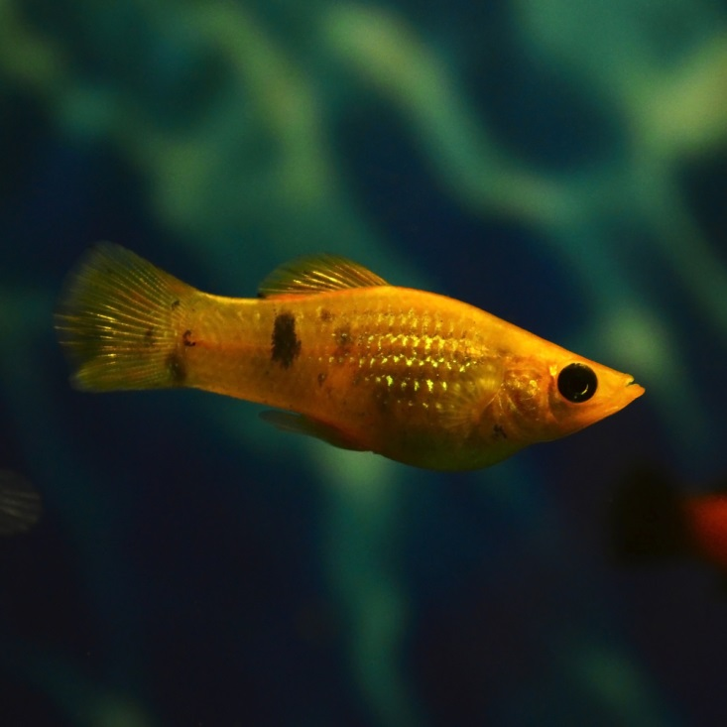
Mollies
Are live-bearers which come in large varieties of colors and patterns
Include two different varieties: sailfin and short finned

Slide 24
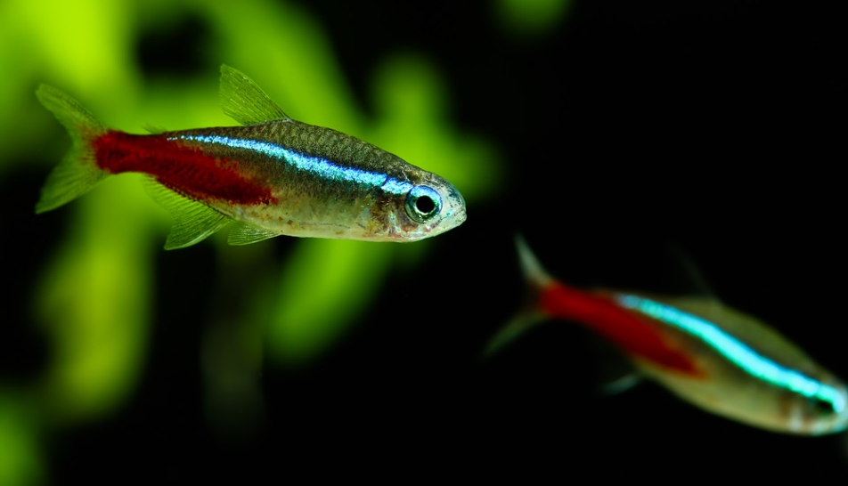
Tetra
Come in a large variety of colors with a shiny silver body often dominating their appearance
Are active schooling fish in need of a peaceful aquarium environment

Slide 25
Saltwater Fish
Live in saltwater the majority or entirety of their lives
Thrive in a large variety of environments with larger numbers in tropical areas
Inhabit oceans, seas and saltwater lakes
Notes:
25

Slide 26
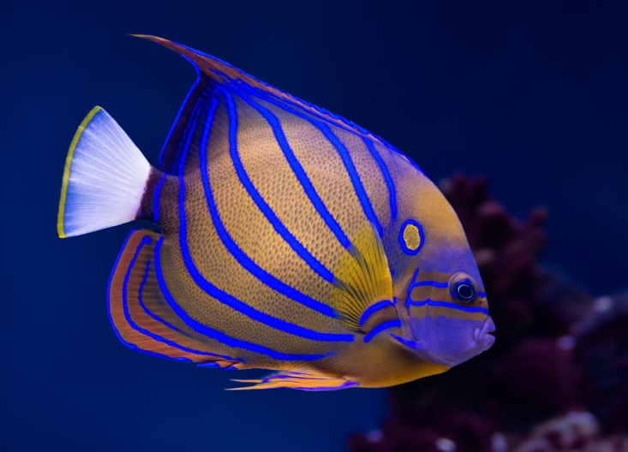
Angelfish
Are brightly colored fish coming in a large variety of colors and patterns
Come in more than 85 different varieties and species

Slide 27
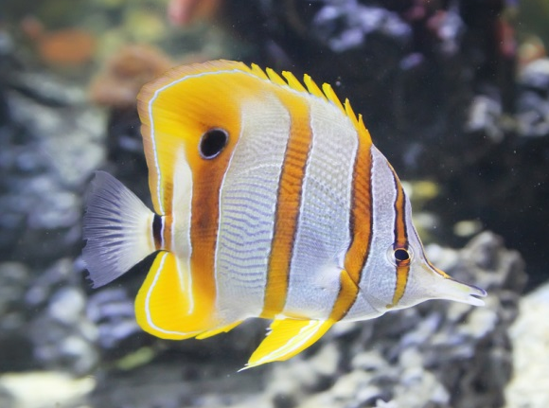
Butterfly
Is a brightly colored fish best known for its distinct linear body patterns and narrow mouth which is used for siphoning food from crevices in coral reefs
Are currently endangered due to habitat destruction, pollution and increased predation

Slide 28
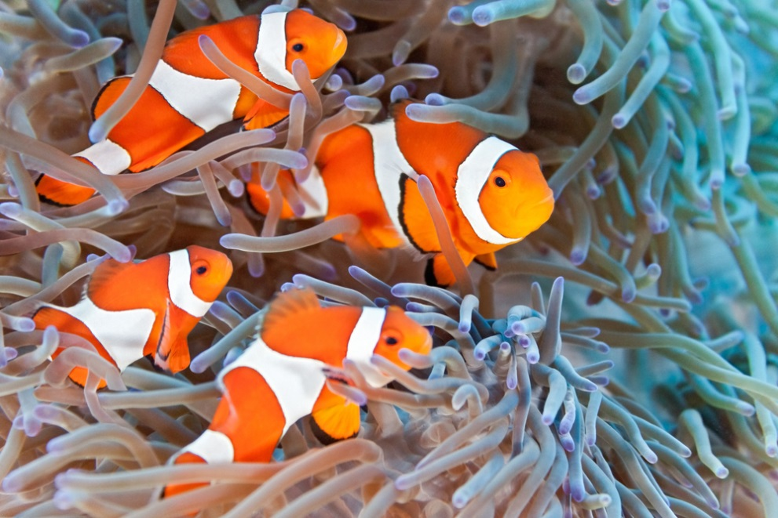
Clownfish
Is a brightly colored fish most recognized for its orange color, white vertical body stripes and black fin tips
Create a symbiotic bond with dangerous sea anemones for protection from predators

Slide 29
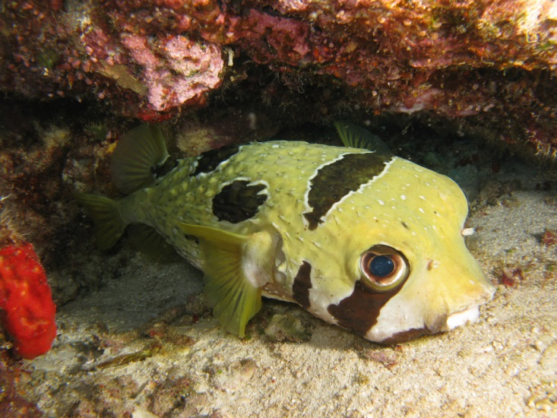
Puffers
Include several species whom come in mostly tan and sandy colors with a wide variety of markings and patterns
Are primarily native to tropical areas
Are known for their unique defense mechanism which allows them to swell with water when threatened

Slide 30
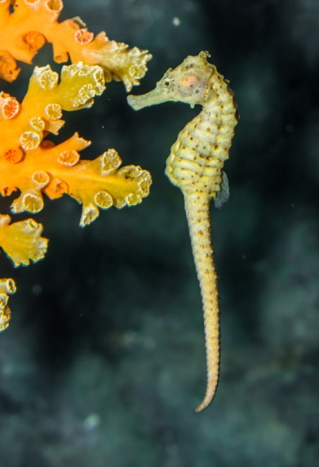
Seahorse
Are unique fish coming in a variety of colors with thick scales and long snake-like tails
Males give birth to live young, something unique to their genus

Slide 31
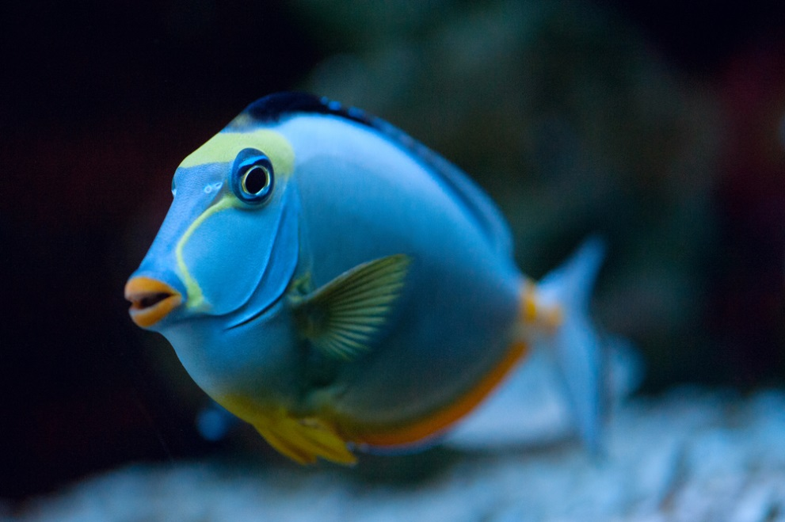
Tang
Come in a large variety of colors, often very bright in appearance
Are heavily reliant upon coral reef environments

Slide 32
Guinea Pigs
Breeds of Companion Animals: Exotics
Notes:
32

Slide 33
Guinea Pigs
Are small rodents native to South America
Include the following breeds:
Abyssinian
American
Coronet
Peruvian
Silkie
Skinny
Teddy
Texel
White crested

Slide 34
Guinea Pig Behavior
Includes the following:
active
territorial
affectionate
observant
alert
emotional

Slide 35
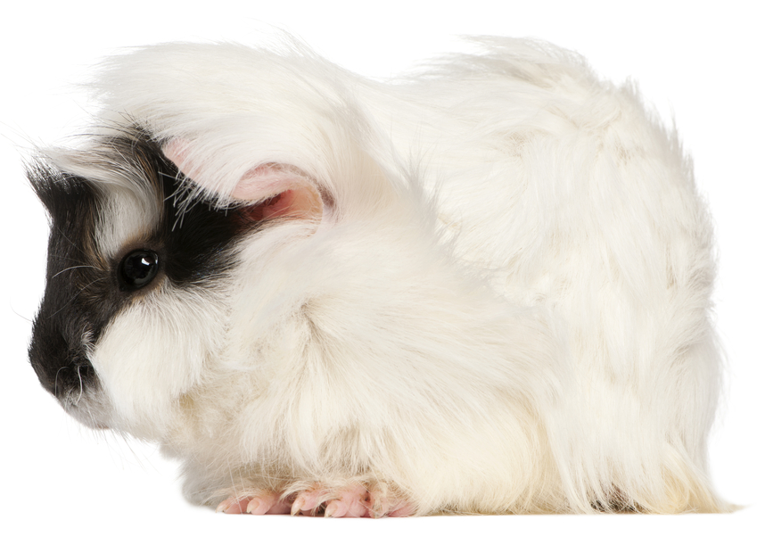
Abyssinians
Come in a wide variety of colors and color patterns with eight patterns called rosettes appearing symmetrically throughout the coat

Slide 36
American
Come in a wide variety of color options and coat patterns
Are the most common guinea pigs found in stores

Slide 37
Coronet
Come in a wide variety of colors and coat patterns
Have long and flowing hair, strongly desired at breed shows

Slide 38
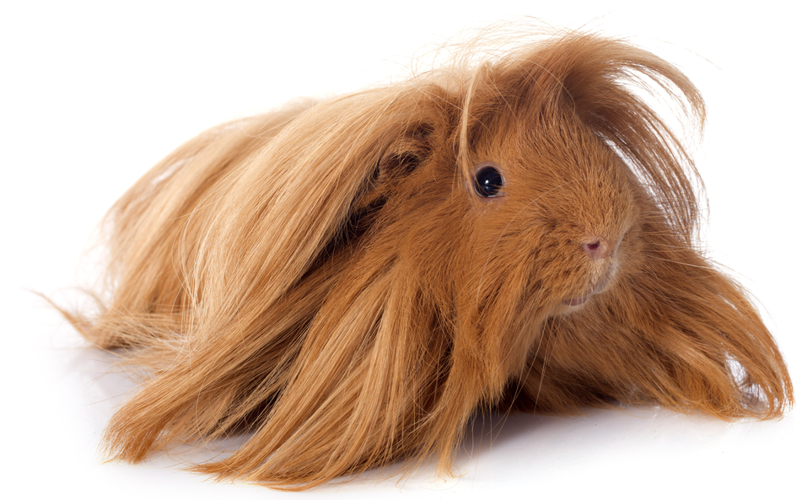
Peruvian
Come in a wide variety of color options and coat patterns
Hair grows forward over their head and down their back, giving them a circular appearance from above

Slide 39
Silkie
Come in a wide variety of mostly light color options and color patterns
Have long flowing hair with a soft and flowing texture identified by breeders and enthusiasts as “silky”

Slide 40
Skinny
Are mostly hairless guinea pigs with soft pink skin and black patterns covering various parts of their body
Are more susceptible to environmental extremes such as temperature and weather

Slide 41
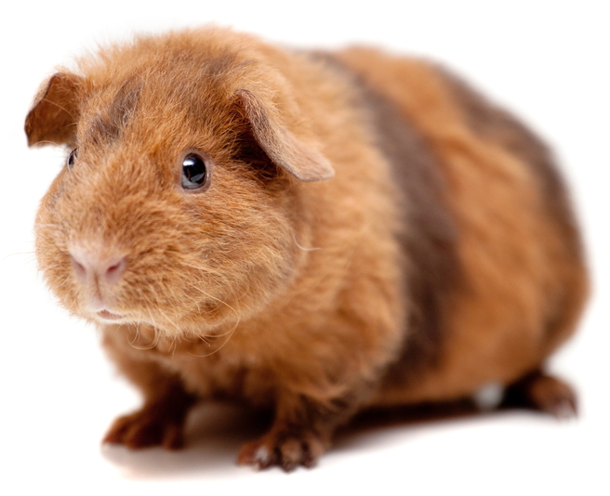
Teddy
Come in wide variety of color options and color patterns with wiry and dense hair
Have resilient coats adapted for tough weather conditions

Slide 42
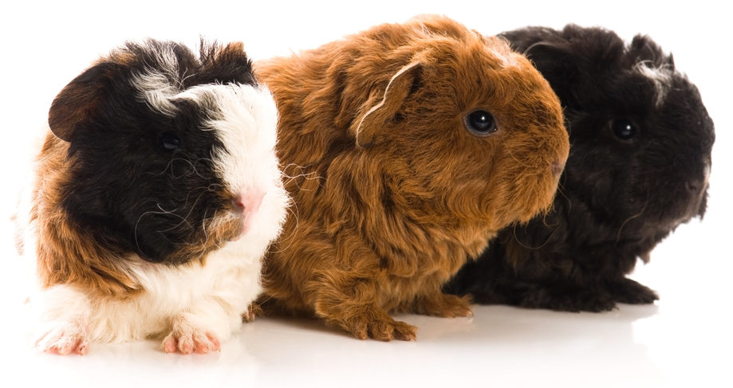
Texel
Come in a wide variety of mostly light color options and color patterns
Have long and soft hair that is formed into curls or ringlets

Slide 43
White Crested
Are most often tan in color with a breed-specific white rosette located on the top of their head

