Slide 1
Breeds of Companion Animals: Cats
Notes:
1

Slide 2
Objectives
To examine the popular species of companion cats.
To identify the characteristics of common companion cat breeds.
To understand which breeds are appropriate for different settings.
Notes:
2

Slide 3
Cats
Include the following breeds:
Abyssinians
American Shorthairs
Birman
Burmese
Himalayan
Maine Coon
Manx
Oriental
Persians
Ragdoll
Russian Blue
Siamese
Siberian
Somali
Sphynx
Tonkinese
Turkish Angora
Notes:
3

Slide 4
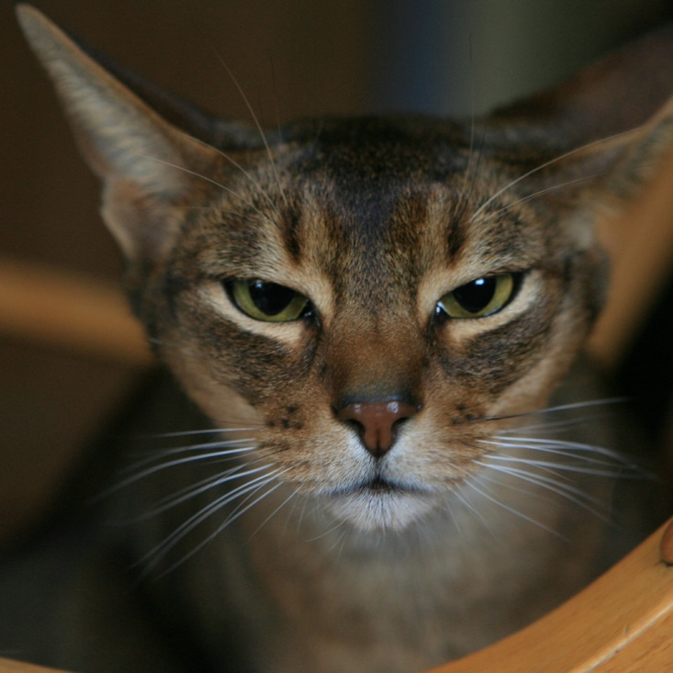
Abyssinians
Grow soft, silky hair which is medium in length
May be ruddy, red, blue or fawn
Are ticked with many different colors throughout the coat
Notes:
4

Slide 5
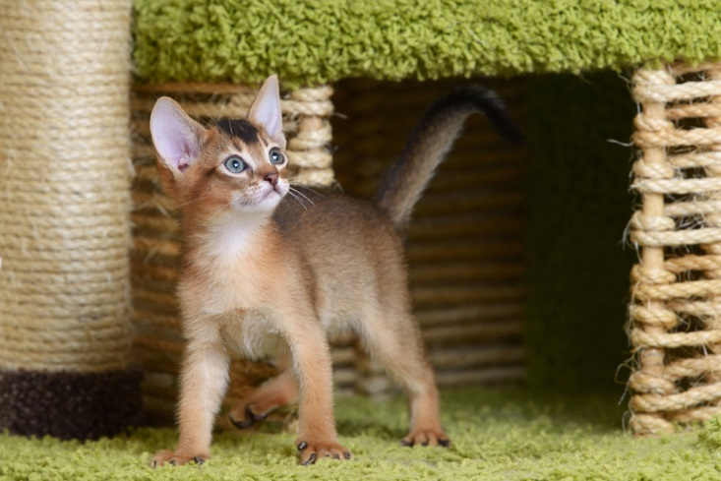
Abyssinian Behavior
Is characterized by the following:
active
busy
playful
loving
Notes:
5

Slide 6
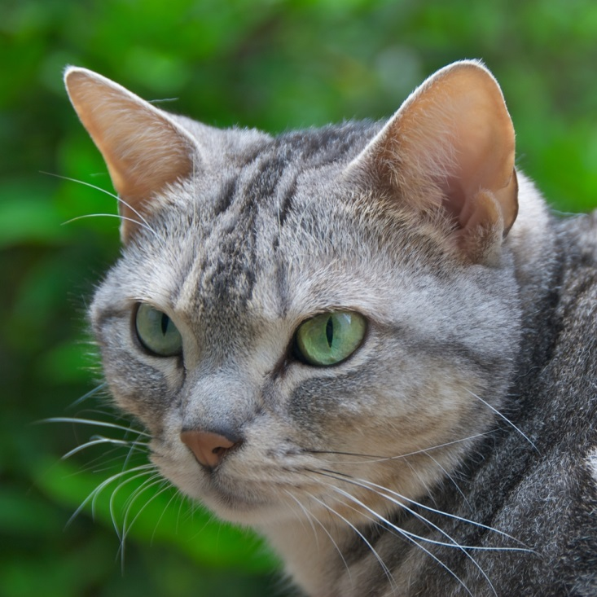
American Shorthairs
Grow short, thick hair
Are broken into four color categories:
solid
particolors
shaded and smoked colors
tabby
Notes:
6

Slide 7
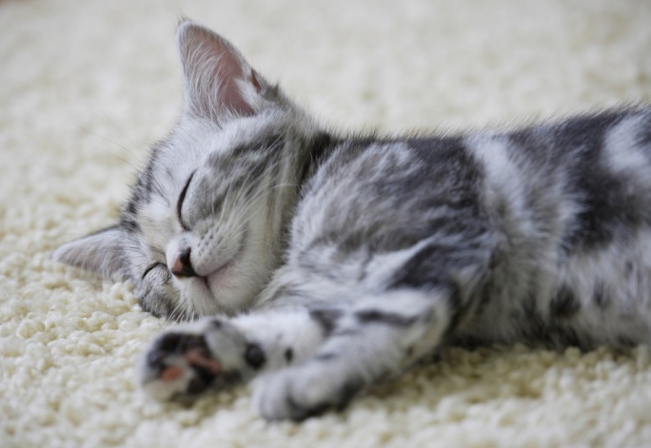
American Shorthair Behavior
Is characterized by the following:
loving
quiet
gentle
good with children
good hunters
Notes:
7

Slide 8
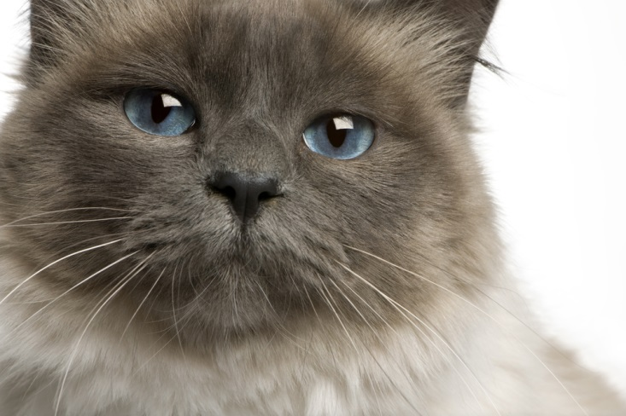
Birmans
Grow a plush single-length coat in various colors
Develop their color as they mature

Slide 9
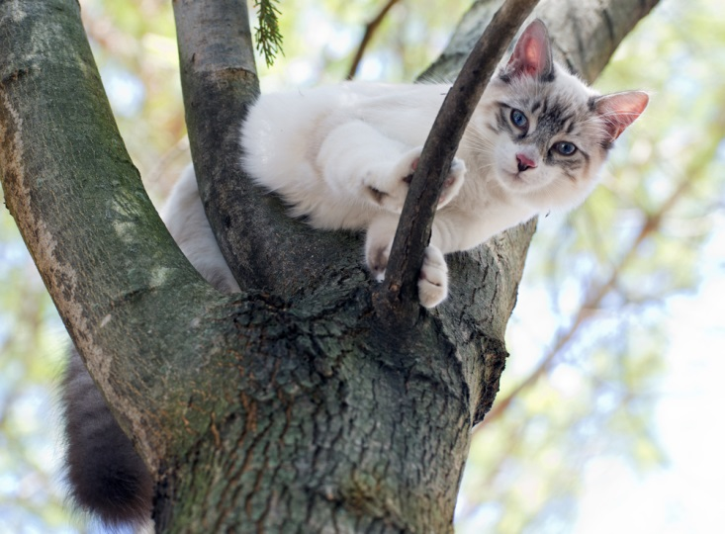
Birman behavior
Is characterized by the following:
sociable
loving
soft-spoken
quiet
gentle
companionable

Slide 10
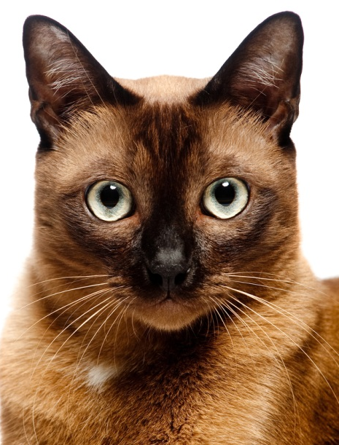
Burmese Cats
Grow short hair
May be sable, champagne, blue or platinum in color
Have yellow eyes
Notes:
10

Slide 11
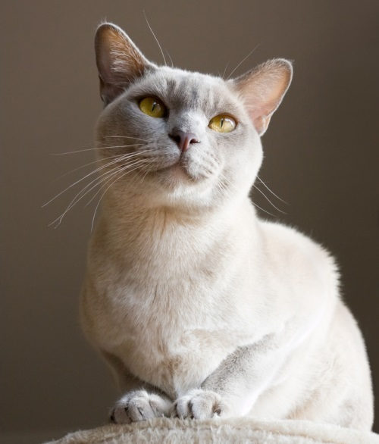
Burmese Behavior
Is characterized by the following:
affectionate
active
playful
vocal
trusting
Notes:
11

Slide 12
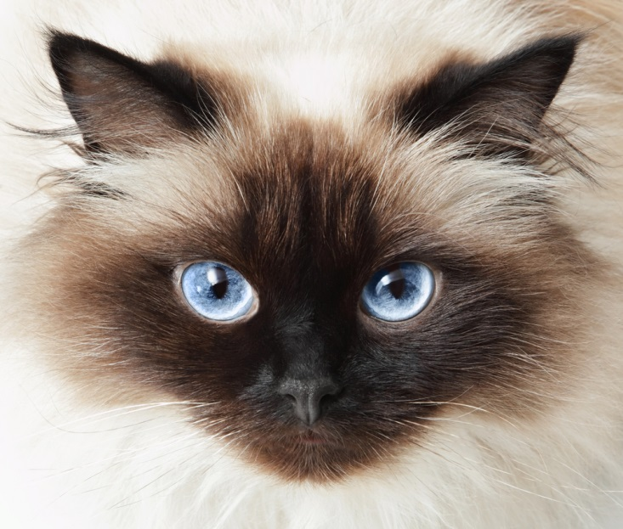
Himalayans
Grow long thick coats which can be almost any color
Is a crossbreed of the Siamese and Persian cat

Slide 13
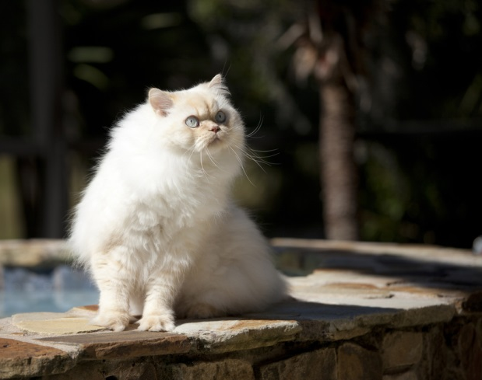
Himalayan Behavior
Is characterized by the following:
sweet
docile
quiet
discriminating
content
independent

Slide 14
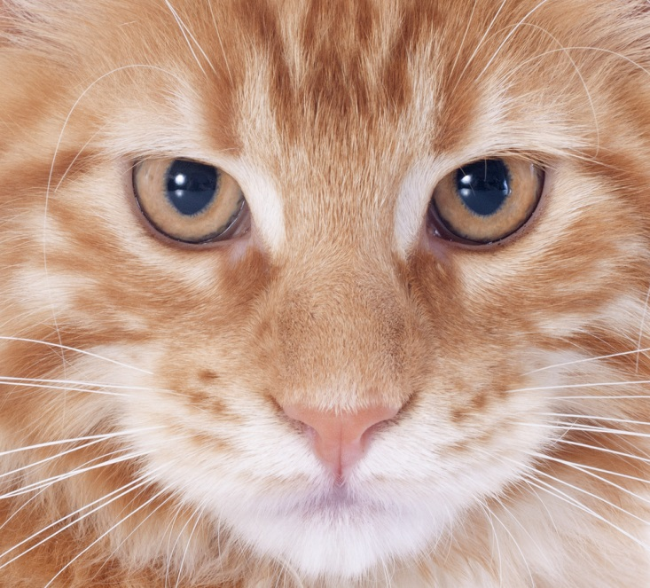
Maine Coons
Grow long hair in various colors
Can withstand warm and cold climates
Are one of the largest cat breeds
Notes:
14

Slide 15
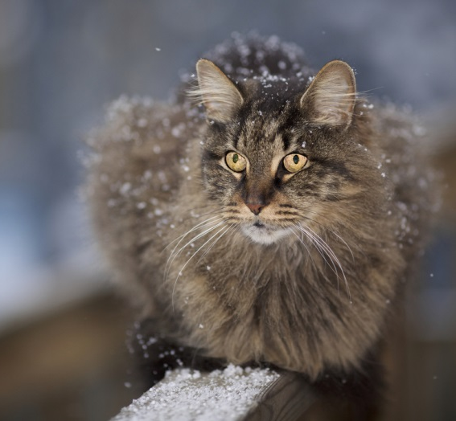
Maine Coon Behavior
Is characterized by the following:
loyal
fun loving
good natured
great with children
social
Notes:
15

Slide 16
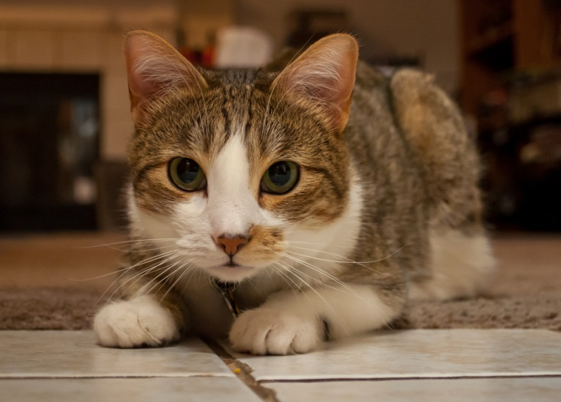
Manx Cats
Grow a short, dense double coat
May be any color
Have a rounded back and shortened tail
Notes:
16

Slide 17
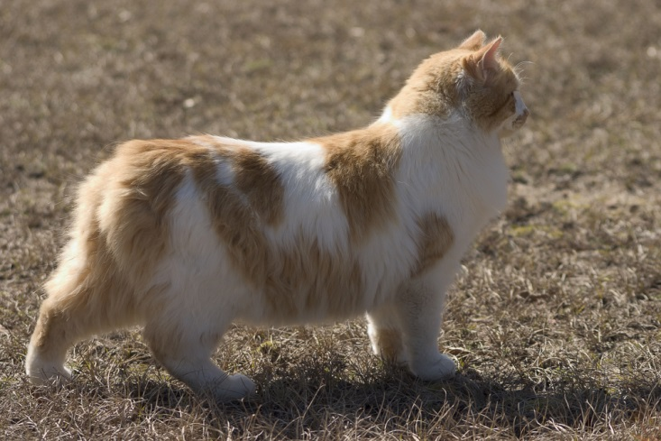
Manx Behavior
Is characterized by the following:
intelligent
playful
loving
great with children
great with other pets
Notes:
17

Slide 18
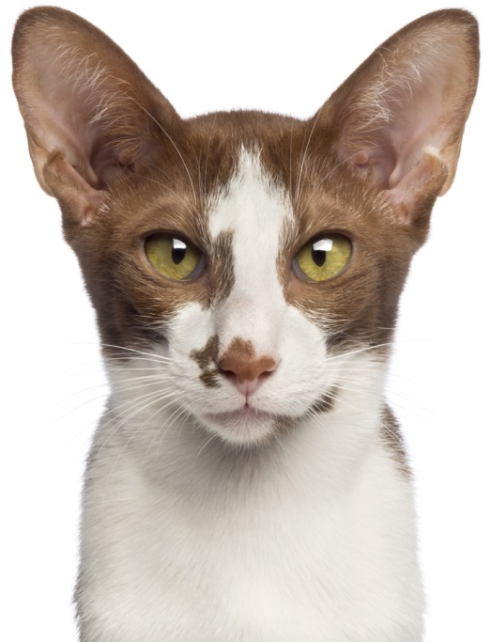
Orientals
Grow either short or long hair
May be one of any 300 color combinations
Have pointed ears and extremely long tails
Notes:
18

Slide 19
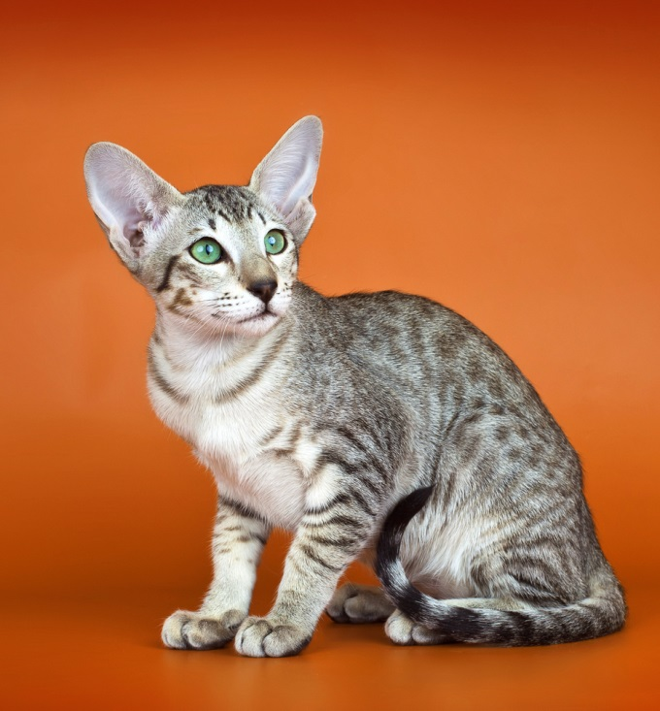
Oriental Behavior
Is characterized by the following:
sweet natured
affectionate
loyal
social
playful
Notes:
19

Slide 20
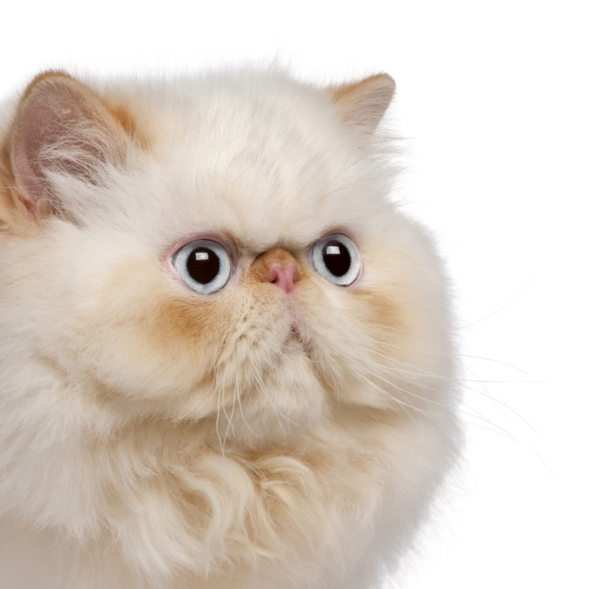
Persians
Grow long, fluffy hair
May be white, black, orange or a combination of these colors
Are the most popular cat breed
Notes:
20

Slide 21
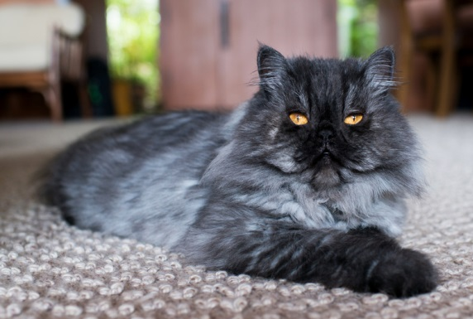
Persian Behavior
Is characterized by the following:
affectionate
loyal
laid back
needs a comfortable environment
needs to feel secure
Notes:
21

Slide 22
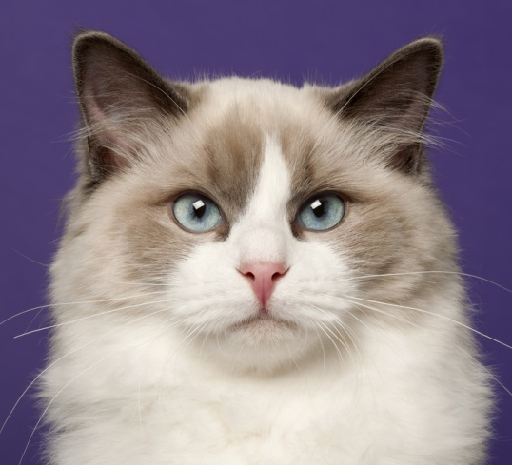
Ragdolls
Grow a semi-long coat which can be several different colors
Are abnormally fond of humans and human attention
Are the largest non-exotic cat breed

Slide 23
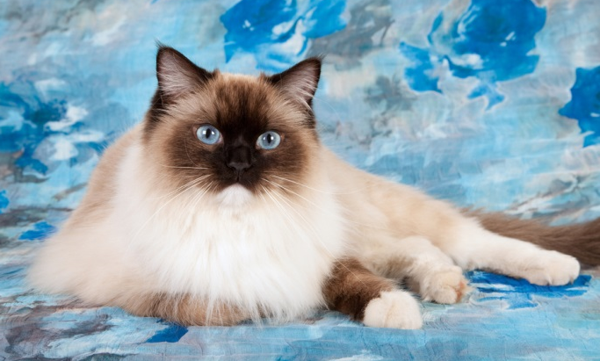
Ragdoll Behavior
Is characterized by the following:
loving
loyal
well-behaved
trainable
gentle

Slide 24
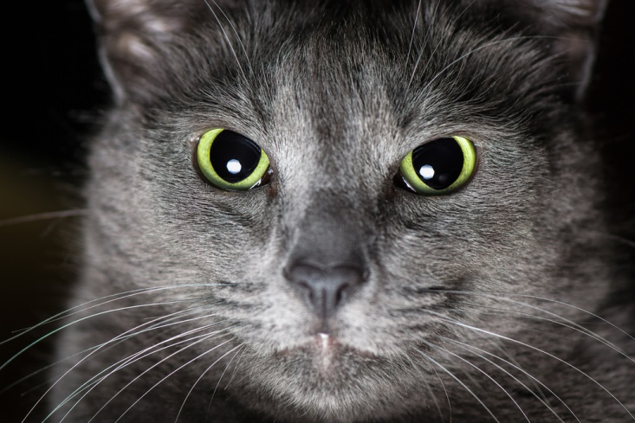
Russian Blues
Grow short and thick double coats which feel soft and silky
May be blue to bluish gray
Possess green or dark colored eyes
Notes:
24

Slide 25
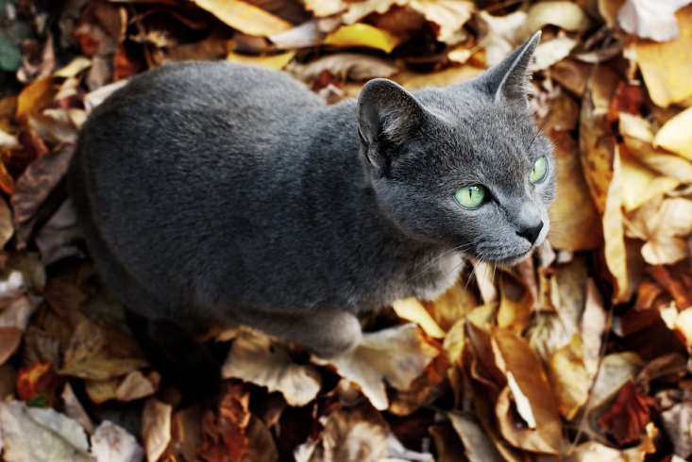
Russian Blue Behavior
Is characterized by the following:
intelligent
independent
playful
bonds with owner
Notes:
25

Slide 26
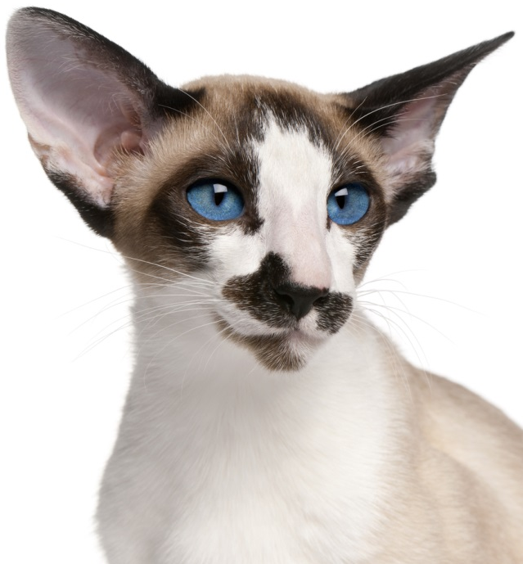
Siamese Cats
Grow short hair
Have slender bodies and large ears
Possess almond shaped slanted eyes
Notes:
26

Slide 27
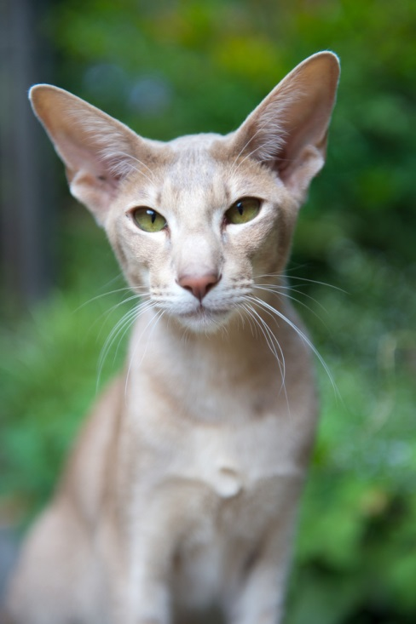
Siamese Behavior
Is characterized by the following:
athletic
intelligent
loving
communicative
needs to be center of attention
Notes:
27

Slide 28
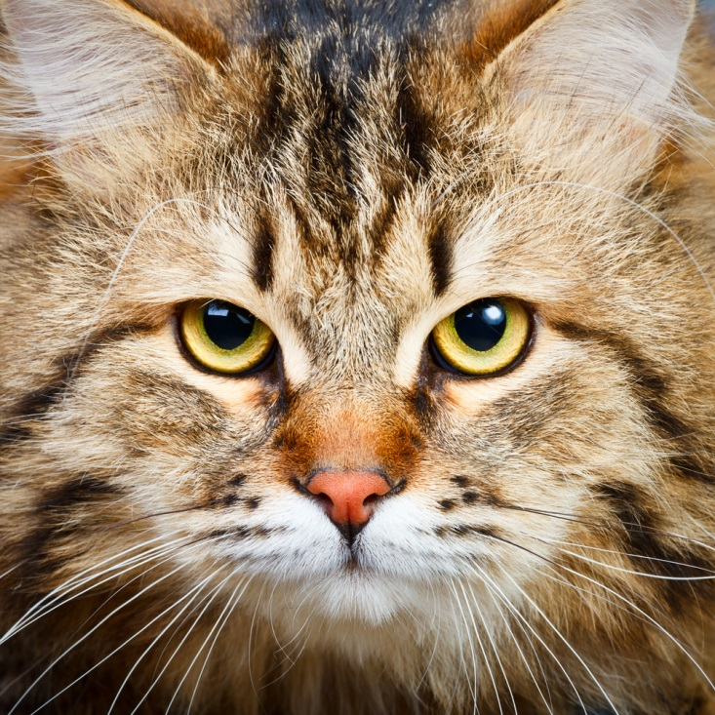
Siberians
Grow long and thick hair which can be almost any color
Are larger than most breeds
Notes:
28

Slide 29
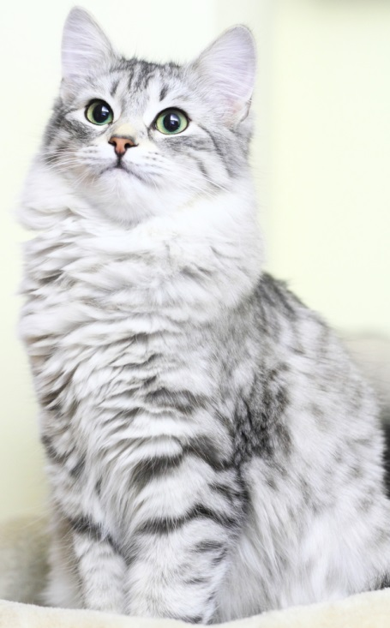
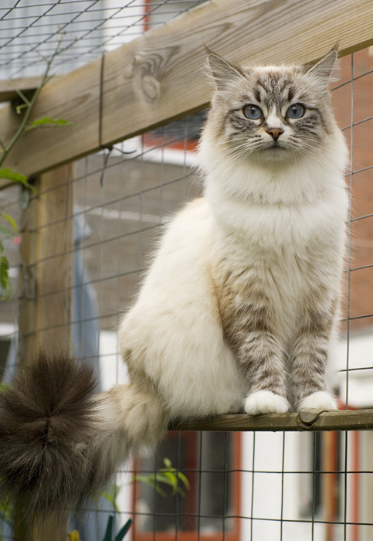
Siberian Behavior
Is characterized by the following:
intelligent
loyal
affectionate
playful
Notes:
29

Slide 30
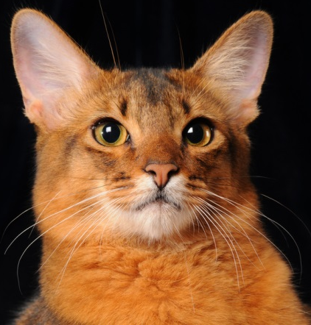
Somali Cats
Grow long and thick hair coming in different varieties and shades of red, brown and black
Are close relatives of Abyssians

Slide 31
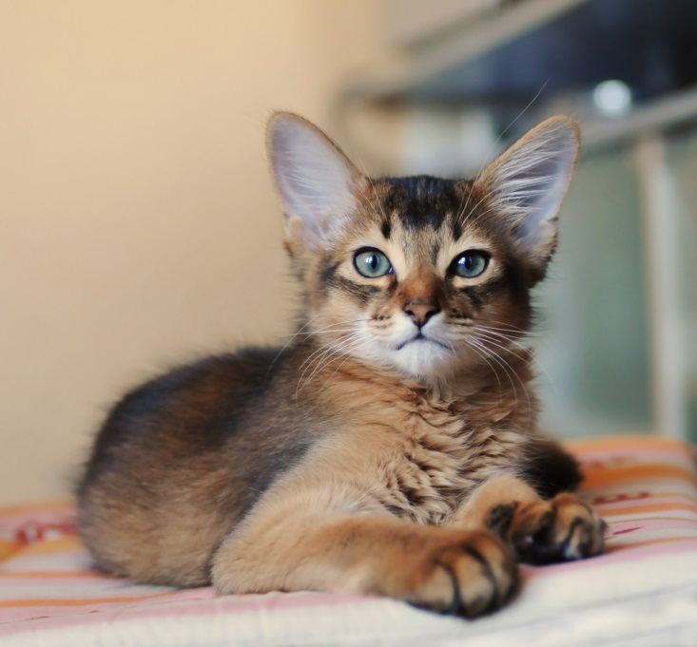
Somali Behavior
Is characterized by the following:
affectionate
intelligent
playful
active
adaptable

Slide 32
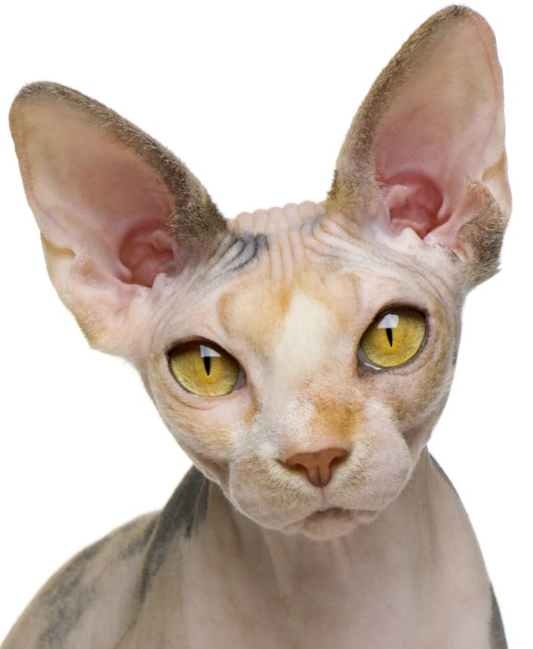
Sphynx Cats
Appear hairless, with small amounts of barely visible hair
May be any color
Are colored on their skin rather than their fur
Notes:
32

Slide 33
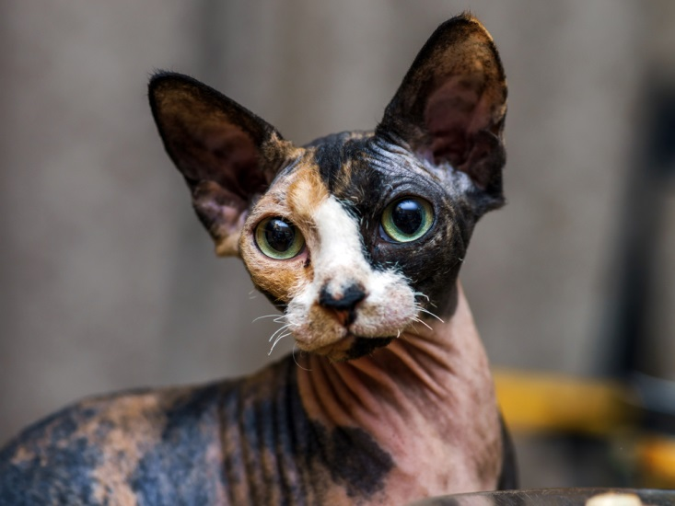
Sphynx Behavior
Is characterized by the following:
athletic
lively
loyal
loving
demand attention
Notes:
33

Slide 34
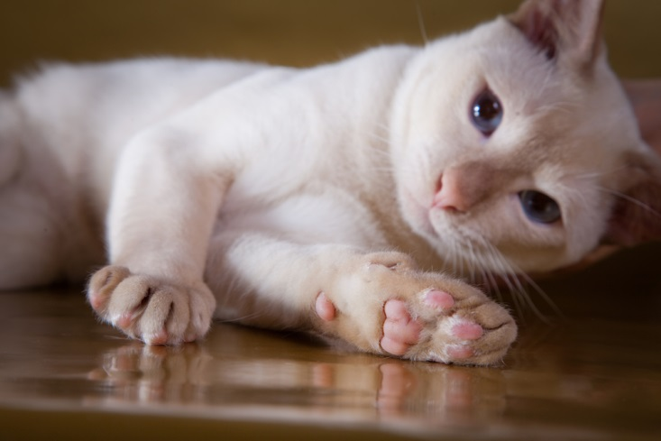
Tonkinese Cats
Grow soft, silky hair which is short to medium length
May be mink, champagne mink, blue mink or platinum mink
Have almond shaped aqua eyes
Notes:
34

Slide 35
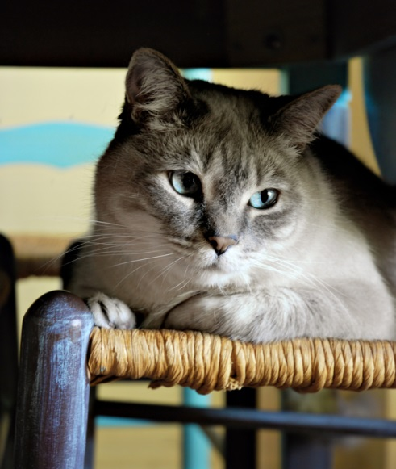
Tonkinese Behavior
Is characterized by the following:
affectionate
highly intelligent
very alert
playful
fast and sneaky
Notes:
35

Slide 36
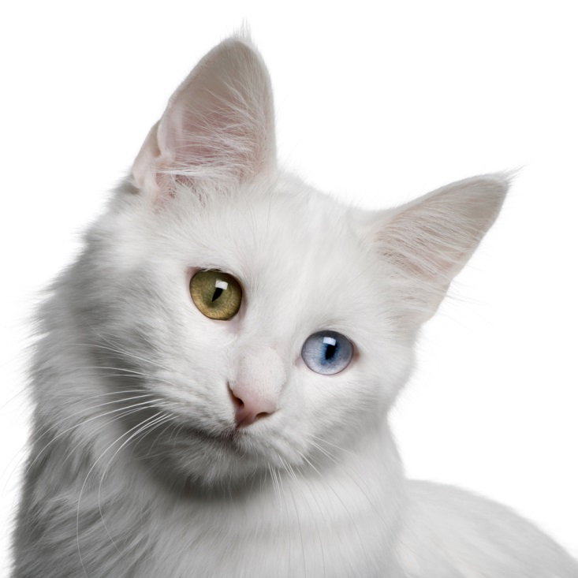
Turkish Angora Cats
Grow long and silky hair which is most often white
Are known as very independent and stubborn cats, with affection offsetting any difficulties with owners

Slide 37
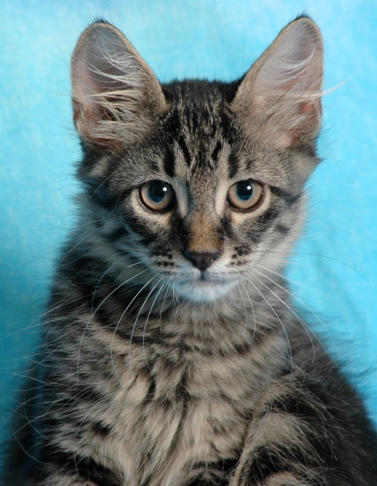
Turkish Angora Behavior
Is characterized by the following:
independent
affectionate
playful
gentle

Slide 38
Breeds of Companion Animals: Cats
ASSESSMENT

Slide 39
Assessment
1. Which of the following is NOT a breed of cat?
A. Tonkinese
B. Calico
C. Ragdoll
D. Maine Coon
2. Which of the following accurately describes the hair of the American Shorthair?
A. Long and thin
B. Short and thin
C. Short and thick
D. Long and thick

Slide 40
Assessment
3. Which of the following accurately describes Burmese eye color?
A. Purple
B. Black
C. Red
D. Yellow
4. Which of the following is the result of crossbreeding Siamese and Persian cats?
A. Maine Coon
B. American Shorthair
C. Himalayan
D. Manx

Slide 41
Assessment
5. Which of the following does NOT accurately describe the behavior of the Maine Coon?
A. Shy
B. Good natured
C. Great with children
D. Social
6. Which of the following is the most popular cat breed?
A. Maine Coon
B. Tonkinese
C. Manx
D. Persian

Slide 42
Assessment
7. Which of the following is the largest cat breed?
A. Ragdoll
B. Maine Coon
C. Sphynx
D. Tonkinese
8. Which of the following accurately describes Russian Blue hair?
A. Long and thick
B. Long and thin
C. Short and thick
D. Short and thin

Slide 43
Assessment
9. Which of the following accurately describes the shape of the Siamese cat’s eye?
A. Pearl-shaped
B. Almond-shaped
C. Square-shaped
D. Pecan-shaped
10. Which of the following does NOT accurately describe Siberian behavior?
A. Solitary
B. Loyal
C. Affectionate
D. Playful

Slide 44
Assessment
11. Which of the following breeds is a close relative of the Abyssinian?
A. Turkish Angora
B. Somali
C. Ragdoll
D. Russian Blue
12. Which of the following breeds is hairless?
A. Somali
B. Maine Coon
C. Oriental
D. Sphynx

Slide 45
Assessment
13. Which of the following accurately describes Tonkinese fur?
A. Soft and thin
B. Soft and silky
C. Rough and thin
D. Rough and silky
14. Which of the following does NOT accurately represent Tonkinese behavior?
A. Affectionate
B. Alert
C. Playful
D. Quiet

Slide 46
Assessment
15. Which of the following breeds are known as independent and stubborn? A. Turkish Angora
B. Somali
C. Abyssinian
D. American Shorthair

Slide 47
Resources
Cat Breed Info Center - List of All Cat Breeds by Type, Traits & Characteristics. (n.d.). CatTime. Retrieved July 10, 2014, from http://cattime.com/cat-breeds/
Cats. (n.d.). . Retrieved July 10, 2014, from http://www.animalnetwork.com
Cat Breeds. (n.d.). . Retrieved July 3, 2014, from http://www.pet-directory.net
Cat Breeds - List of Cat Breeds - Cat Breed Information. (n.d.). Cat Breeds - List of Cat Breeds - Cat Breed Information. Retrieved July 10, 2014, from http://www.catchannel.com/breeds/

Slide 48
Acknowledgements
Executive Producer
Gordon W. Davis, Ph.D.
Production Coordinator
John L. Hawley
Graphic Designer
Melody Rowell
Technical Writer
Jessica Odom
V.P. of Brand Management
Clayton Franklin
© MMXIV
CEV Multimedia, Ltd.
Notes:
48

