Slide 1
Small Animal Management

Slide 2
Objective
I will learn
ways to train and create behavior management
Housing, boarding, and transporting options
Breeding options
Feeding and nurturing options
Management of health conditions
How to match animal type/breed and owner lifestyle
Including living conditions, geographic location, and number and age of family members

Slide 3
Training methods
What small animals can be trained?
All of them
Positive reinforcement
Negative reinforcement

Slide 4
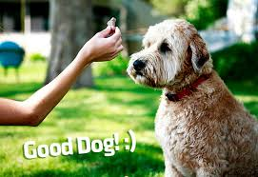
Positive reinforcement
Praise and/or treats to reward your animal for doing something you want him or her to do.
One of the most powerful tools for shaping or changing your dog’s behavior

Slide 5
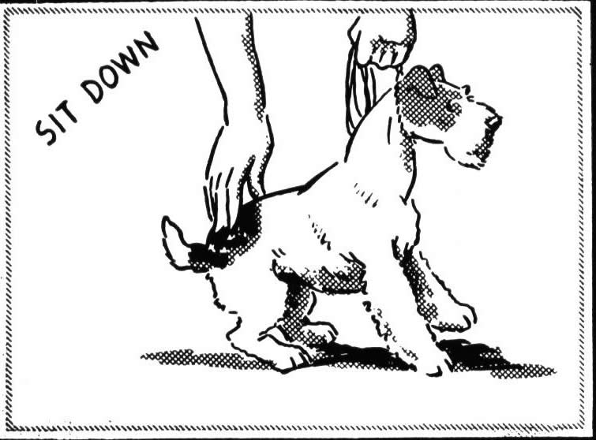
Negative Reinforcement
Occurs when a certain stimulus is removed after a particular behavior is exhibited.
Not punishment

Slide 6
Punishment
Adding something aversive in order to decrease a behavior
Ex. Getting a spanking

Slide 8
Training commands
Sit, Down, Stay
Stop Jumping
House training
Biting
Tricks
Roll over, play dead, and beg

Slide 9
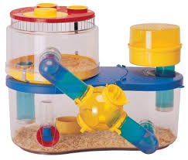
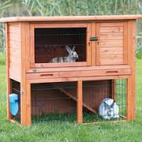
Housing
Different animals have different needs
Rabbits outdoor cages
Mice indoor cages
Hamsters indoor cages
Dogs?
Cats?
Snakes?
Birds?

Slide 10
Boarding
http://waggingtailresort.com/resortactivities.html
Pay to have pet kept
Most of the time they can supply food.
They play with your pet

Slide 11
Transporting
Can transport in your personal vehicle, plane, train, boat.
Planes have certain things you have to do.
Only fly a pet if absolutely necessary
Amtak doesn’t accept pets
Only a few ships

Slide 12
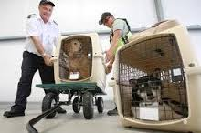

Slide 13
Breeding
In-breeding
Line-breeding
Out-crossing
Out-breeding
AI
Natural

Slide 14
Inbreeding
Mating of two animals that are closely related to each other
Siblings or cousins
Many breeds of pedigree dogs would not exist today
Increased likely hood of undesirable traits being inherited
Increased chances of recessive mutations occurring

Slide 15
Line Breeding
Mating of animals that have many common ancestors or mating to a slightly removed relative
More consistent offspring

Slide 16
Out crossing
Mating of two animals that are the products of line breeding of two distinctly separate lines
Used to bring traits into to line

Slide 17
Out breeding
Mating of two animals who not only are of the products of two distinctly separate lines, but on top are not the products of line breeding.
Breed from parents not closely related

Slide 18
AI breeding
Increase quality of a breed by over coming limitations of both time and space.

Slide 19
Feeding and nurturing
We will cover in depth later

Slide 20
Management of health conditions
Different pets require different management

Slide 21
Matching a pet to you
http://www.animalplanet.com/pets/pet-picker-quiz/
Can you commit?
Time to walk your dog? exercise your cat?
Will your pet fit your lifestyle?
Don’t choose on how popular or cute it is
Make your home pet friendly
Choose an age and breed appropriate food
Be prepared for an adjustment period
Train your pet

Slide 22
Cont.
Select appropriate pet treats and toys
Consider spaying and neutering
Outfit your pet with proper ID

