Slide 1
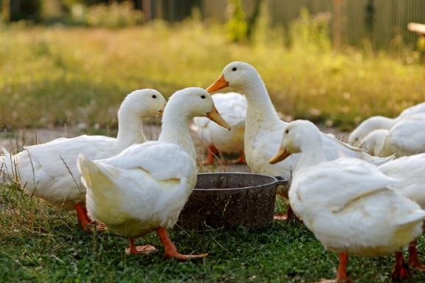
Avian Digestive System
Differs highly from the previous digestive systems because bird have no teeth
Is made up of the esophagus which empties directly into the crop, where the food is stored and then grinded by the gizzard with stones or grit
Is a very fast process

Slide 2
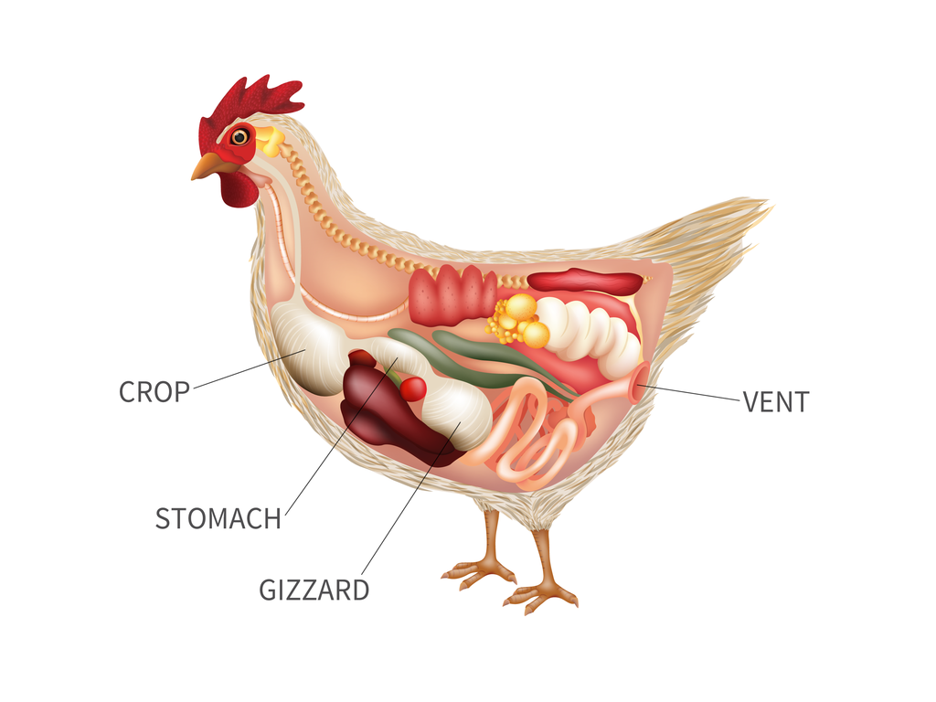
Avian Digestive System

Slide 3
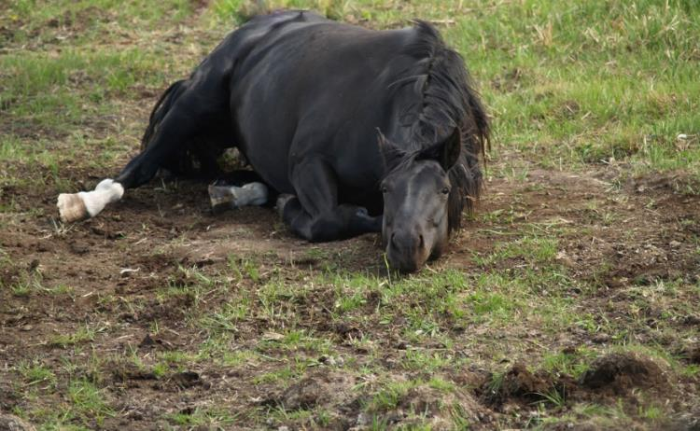
Digestive System
Common conditions or diseases include:
colitis
colic
gastroenteritis

Slide 4
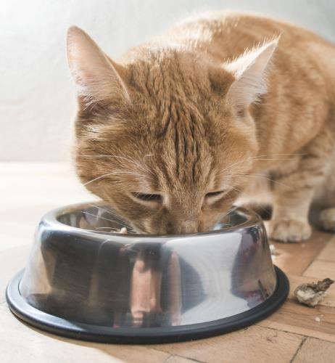
Colitis
Is an acute or chronic inflammation of the membrane lining the colon
Is most commonly caused by parasites, tumors, a change in food, allergies or swallowing of foreign objects

Slide 5
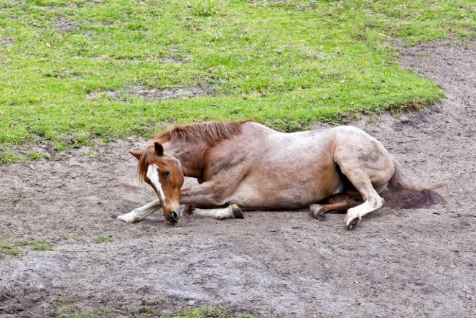
Colic
Is defined as abdominal pain and causes problems to the digestive system
Is the number one cause of death in horses
Is caused by different types of conditions, such as gas or impaction

Slide 6
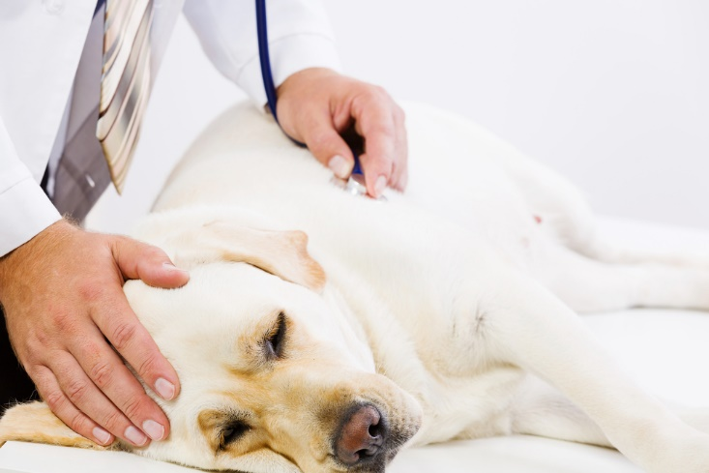
Gastroenteritis
Is the infection or inflammation of the stomach and intestines
Causes diarrhea, nausea, vomiting and cramping abdominal pain

Slide 7
Endocrine System
Produces hormones which regulate metabolism, growth and development, tissue and sexual function, reproduction, sleep and mood
Is made up of the pituitary gland, thyroid gland, parathyroid glands, adrenal glands, pancreas, ovaries and testicles

Slide 8
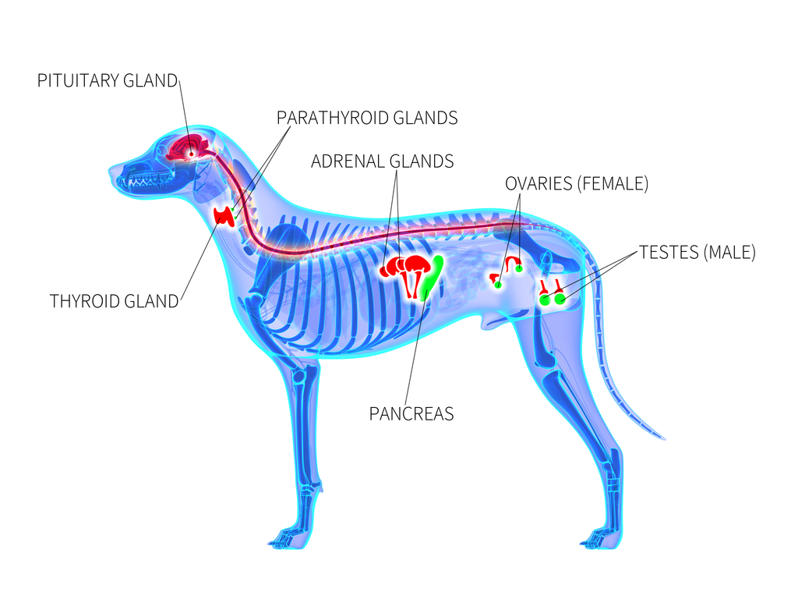
Endocrine System

Slide 9
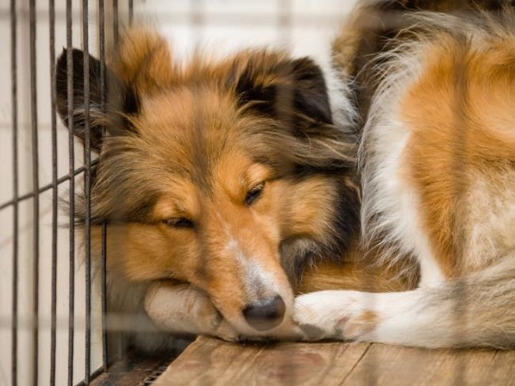
Endocrine System
Common conditions or diseases include:
hyperfunction or hypofunction
hyperthyroidism
fatty liver disease

Slide 10
Hyperfunction or Hypofunction
Is caused by an imbalance in an animal’s hormone levels
glands which produce too much hormone are known as “hyper”
glands which do not produce enough hormone are known as “hypo”

Slide 11
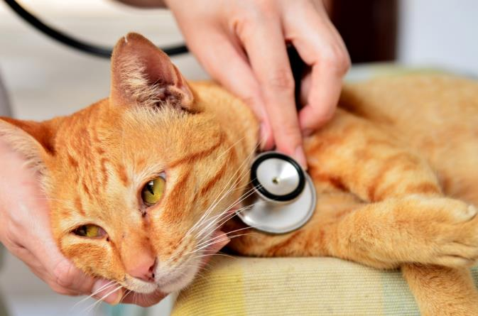
Hyperthyroidism
Is caused by a tumor of the thyroid gland which produces excess thyroid hormone
Causes abnormal bone development and young animals to grow at an irregular rate
most affected animals will not survive through adulthood

Slide 12
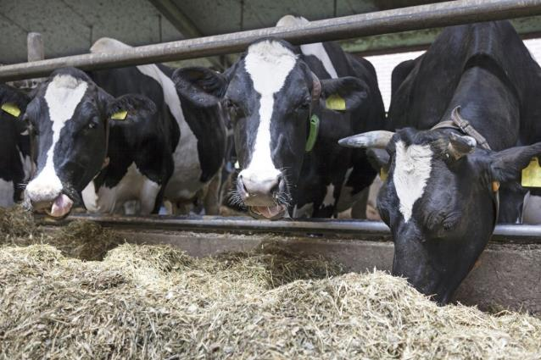
Fatty Liver Disease
Occurs when cattle break down too much fat for the liver to process properly
Causes fat which is broken down to convert back to fat in the liver which then becomes toxic to the animal and decreases the cattle’s body condition

Slide 13
Immune System
Defends the body against infectious organisms and other invaders
Attacks organisms and substances which invade an animal’s system and causes diseases
Is made up of lymph nodes, cells, proteins, tissues and organs
Common condition or disease includes:
autoimmune disease

Slide 14
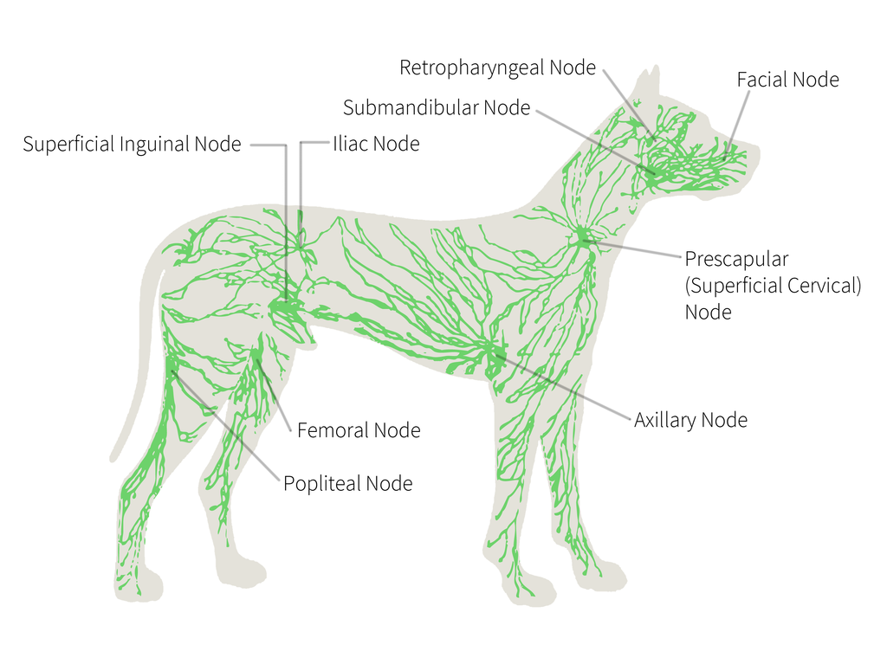
Immune System

Slide 15
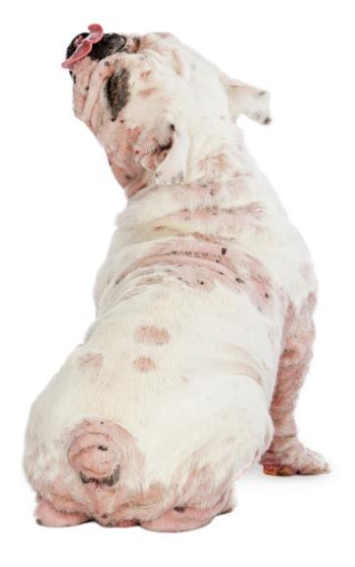
Autoimmune Disease
Occurs when the immune system fails to recognize itself and begins to attack and reject the body’s own tissue as a foreign object
Causes:
soreness
itching
flaky skin
inflamed ears
excessive licking
swelling

Slide 16
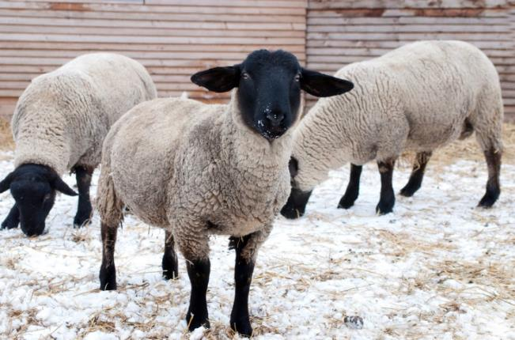
Integumentary System
Protects the animal’s body from disease by providing a barrier to viruses and bacteria
Protects the body from dehydration, overheating or freezing

Slide 17
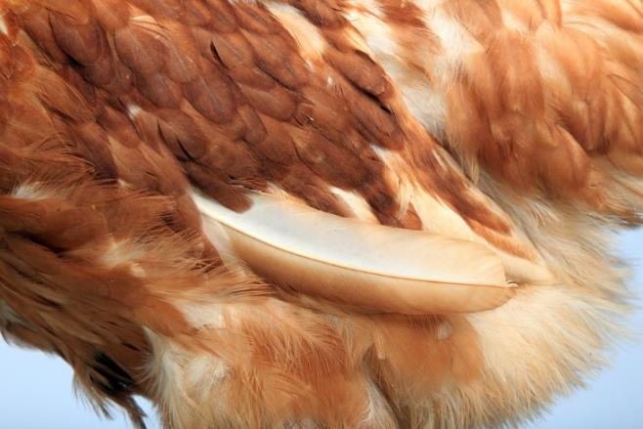
Integumentary System
Is the largest organ in the body and includes the following:
hair
feathers
scales
nails
hooves
horns
skin

Slide 18
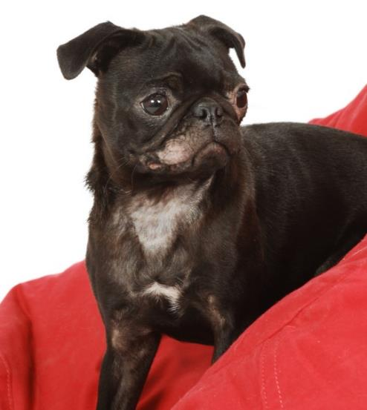
Integumentary System
Common conditions or diseases include:
mange
rainrot
ringworm

Slide 19
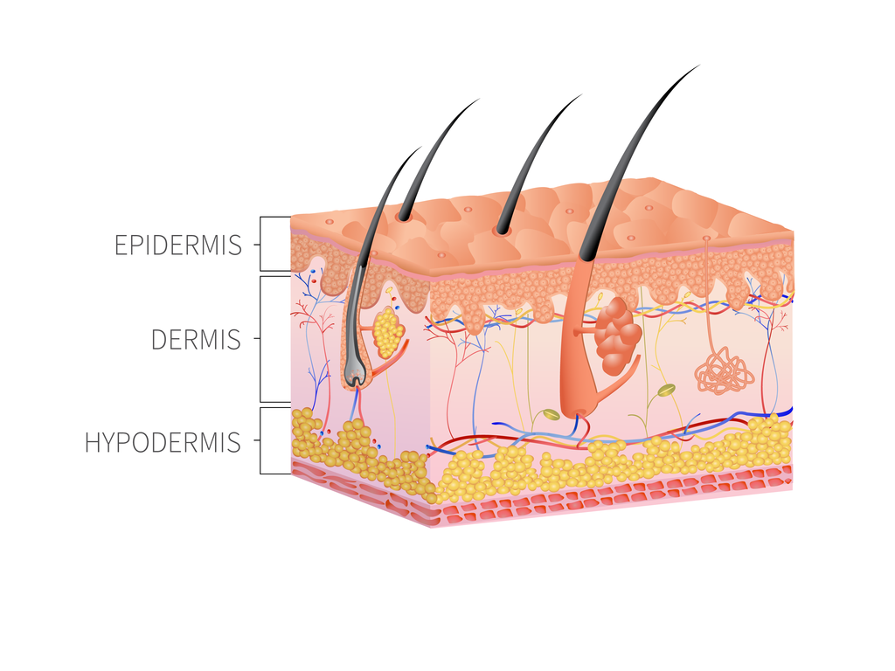
Integumentary System

Slide 20
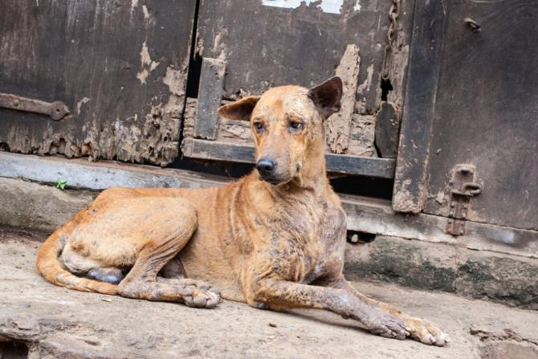
Mange
Is a skin disease which is caused by parasitic mites
Causes:
severe itching
hair loss
scabs and lesions

Slide 21
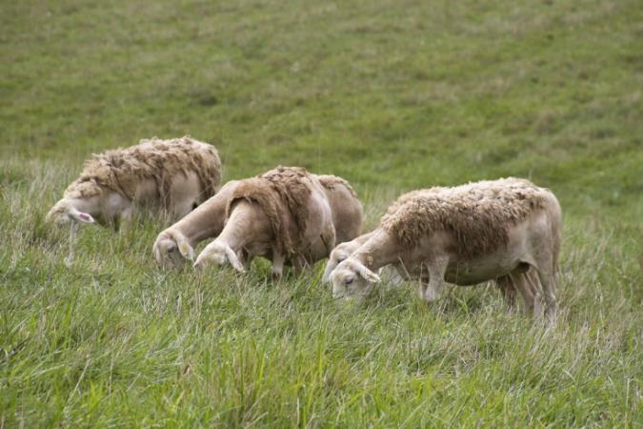
Rainrot
Is a bacterial infection which multiplies in a moist environment
Causes scabby crusts which form raised bumps on matted hair

Slide 22
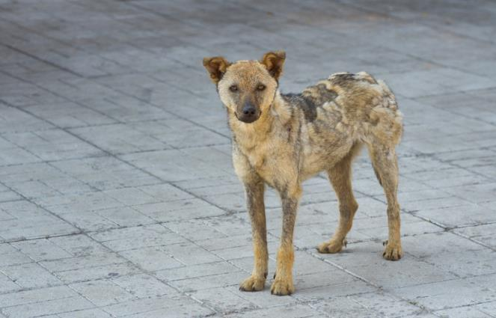
Ringworm
Is a highly contagious and infectious skin disease caused by fungi
Causes:
grey-white areas of skin
raised circular outlines
lesions

Slide 23
Nervous System
Transmits signals to different parts of the animal’s body and operates basic body functions like breathing and digestion
Includes:
the central nervous system, which is the brain and spinal cord
the peripheral nervous system, which is made up of the nerves and ganglia

Slide 24
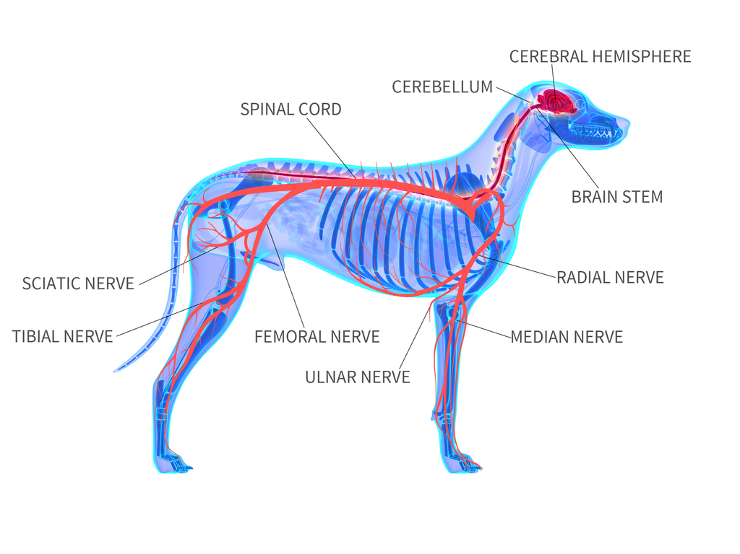
Nervous System

Slide 25
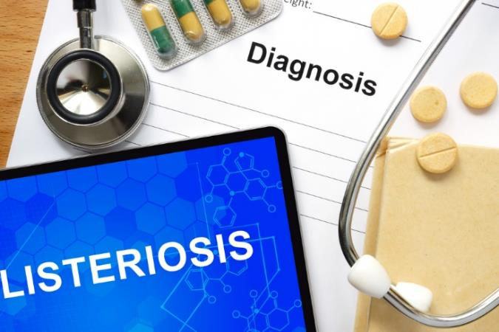
Nervous System
Common conditions or diseases include:
peripheral neuropathy
equine protozoal myeloencephalitis (EPM)
listeriosis

Slide 26
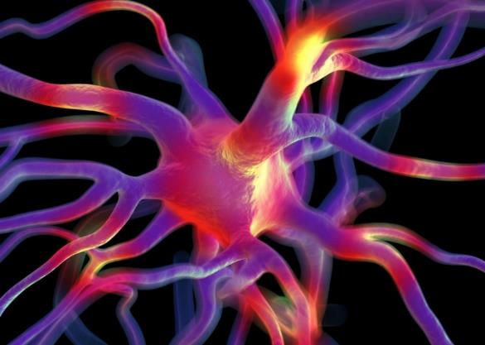
Peripheral Neuropathy
Is a nerve disorder which affects the peripheral nerves
Causes loss of electrical signals in the nerves, impairs function and causes degeneration and deterioration

Slide 27
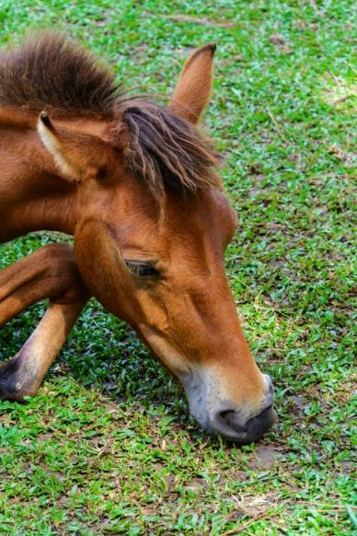
Equine Protozoal Myeloencephalitis (EPM)
Is caused by horses ingesting feces of opossums which contain protozoa
Causes lesions on the spinal cord and brain stem and neurologic damage
Causes:
loss of coordination
stumbling
soreness
muscle atrophy
weakness
head tilt

Slide 28
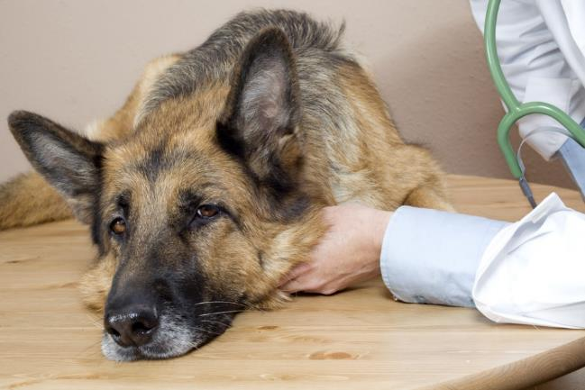
Listeriosis
Is a bacterial disease which causes uncoordinated movements, leaning against objects and paralysis
Can result in death within two to three days after the onset of symptoms

Slide 29
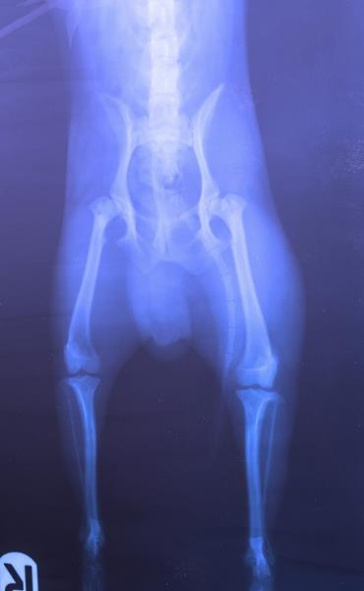
Skeletal System
Protects and supports the body tissues and internal organs
Is made up of bones and other connective tissues
Common conditions or illnesses include:
osteochondrosis
hip dysplasia
fractures

Slide 30
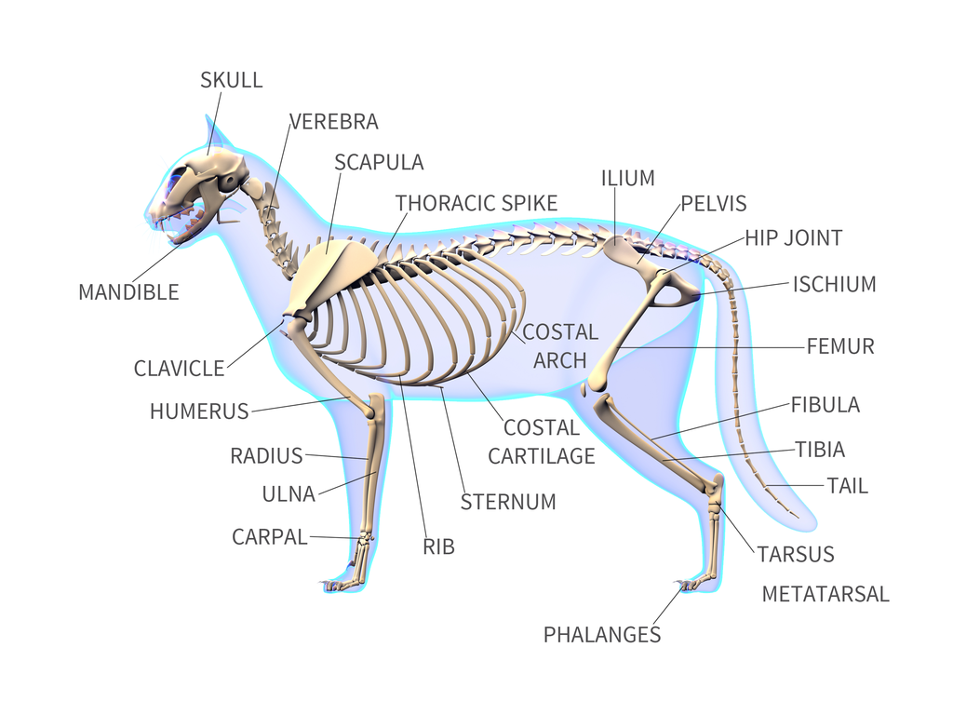
Skeletal System

Slide 31
Osteochondrosis
Is a disease which can affect a variety of joints of a young, growing animal
Causes irregular bone growth which can lead to painful lesions within the joints

Slide 32
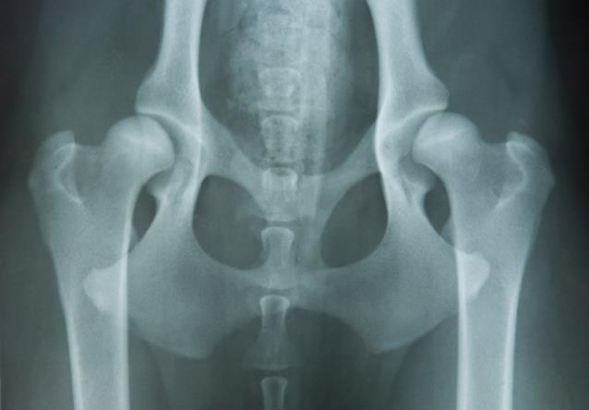
Hip Dysplasia
Is an inherited condition which is caused by a hip joint which has not formed properly
Causes a joint to be loose and allows the leg bone to move too much which results in painful deterioration

Slide 33
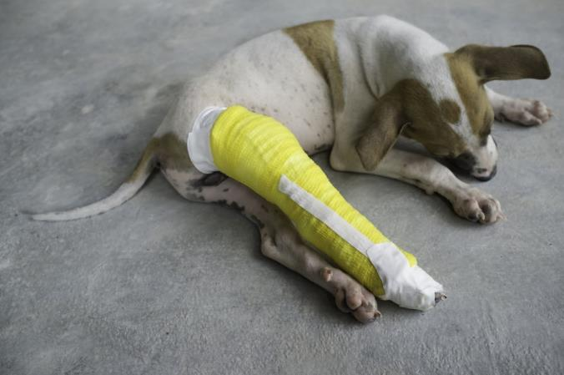
Fractures
Are also known as a break in bones
Often occur due to accidents or incidents such as falls
Require immediate care to reduce pain and proper healing

Slide 34
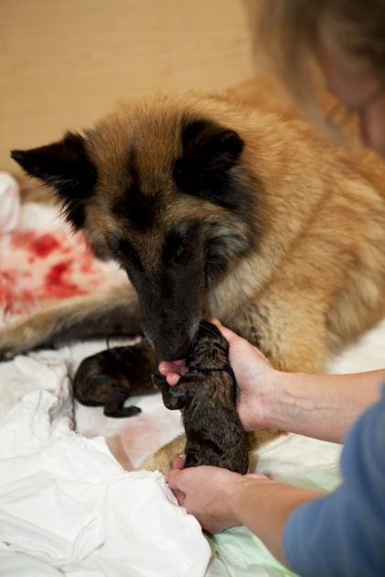
Reproductive System
Consists of sex organs within animals which work together for the purpose of sexual reproduction
Female anatomy includes:
ovaries
uterus
vagina
vulva
utter
Male anatomy includes:
penis
testes

Slide 35
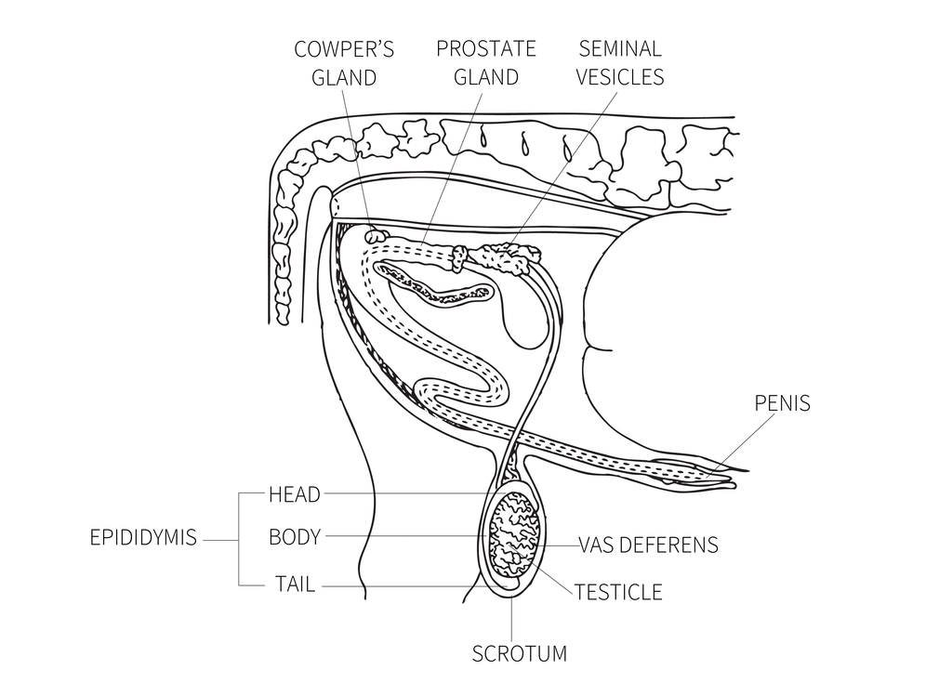
Male Reproductive System

Slide 36
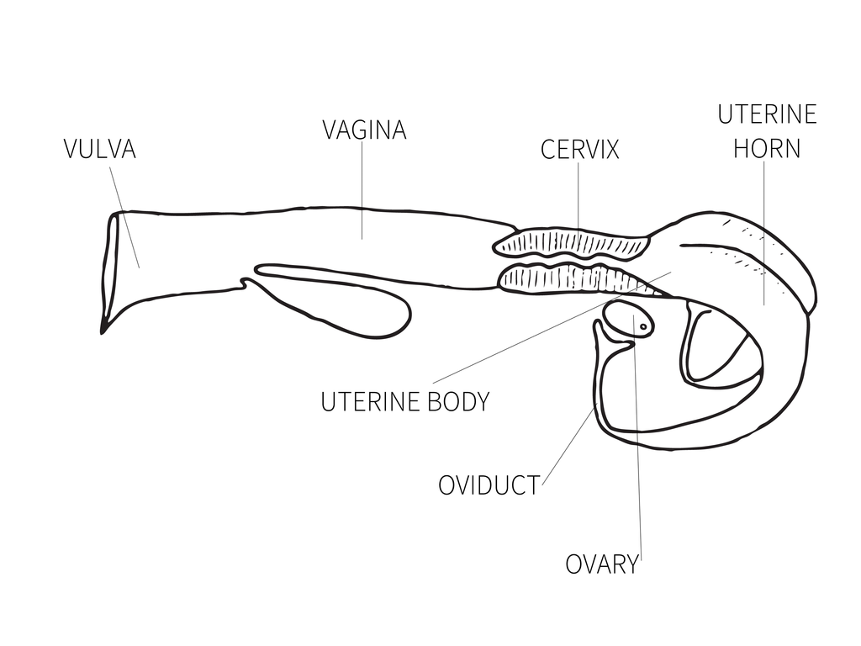
Female Reproductive System

Slide 37
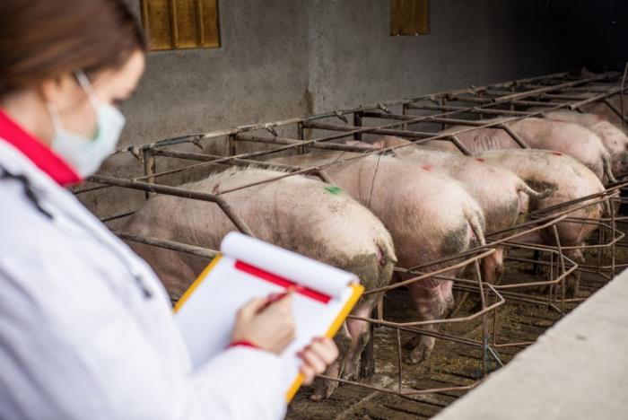
Reproductive System
Common conditions or diseases include:
infertility
dystocia

Slide 38
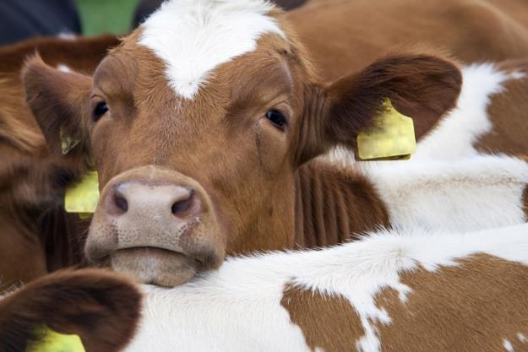
Infertility
Is the inability to conceive or carry a pregnancy
Can affect animals of all ages but tends to more commonly affect older animals

Slide 39
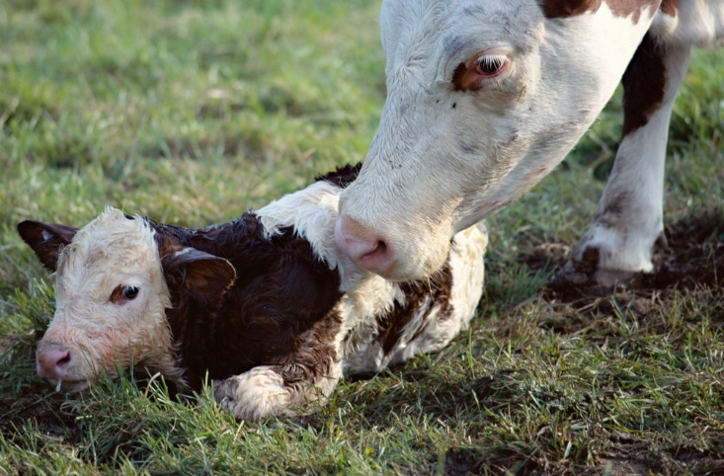
Dystocia
Is defined as difficult birthing
May occur because of maternal difficulties or the position of the fetus within the uterus

Slide 40
Common Veterinary Terms & Abbreviations

Slide 41
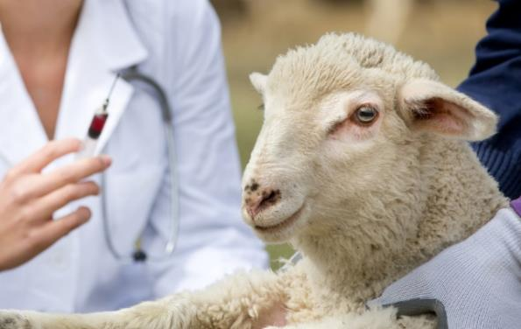
Common Veterinary Terms
Can be grouped in the following categories:
species specific terms
physical examinations
animal handling
injections
blood sampling
laboratory procedures

Slide 42
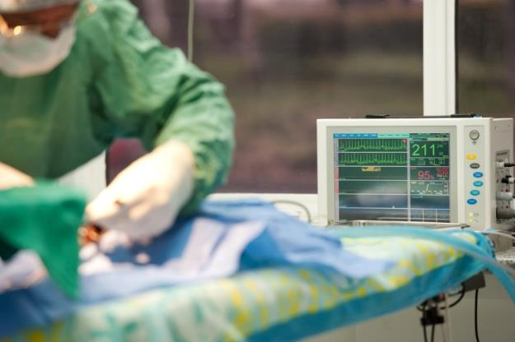
Common Veterinary Terms
Can be grouped in the following categories:
hospital procedures
surgical procedures
veterinary medical equipment
pharmacology
common veterinary abbreviations
common veterinary symbols

Slide 43
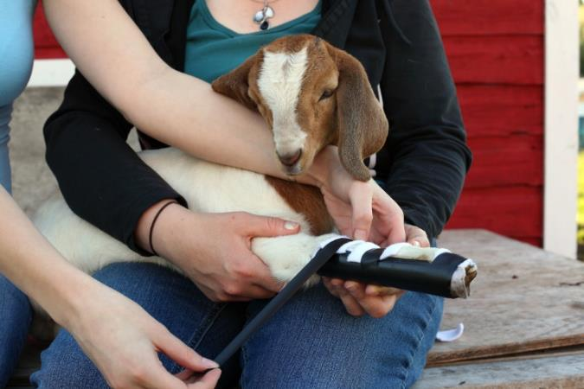
Species Specific Terms
Include the following:
cat terms
dog terms
horse terms
swine terms
cattle terms
sheep terms
goat terms

Slide 44
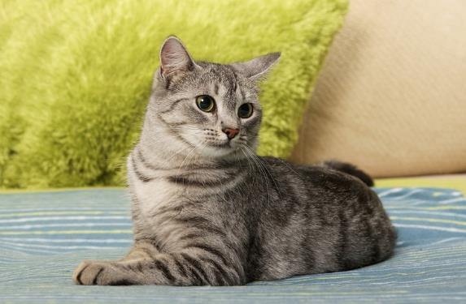
Cat Terms
Include:
tom - intact male
neutered - castrated male
queen - intact female
spayed - sterilized female
kitten - young cat
queening - giving birth
litter - a group of offspring born at the same time

Slide 45
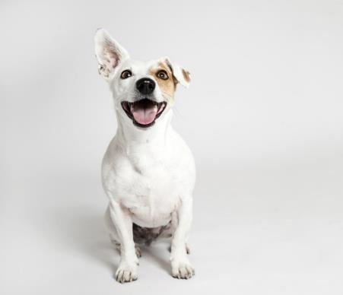
Dog Terms
Include:
dog/stud - an intact male dog
neutered - castrated male dog
bitch - an intact female
spayed - sterilized female
whelp or puppy - a young dog
whelping - giving birth
pack - a group of dogs
litter - a group of offspring born at the same time

Slide 46
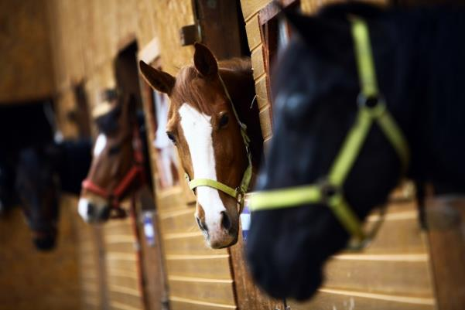
Horse Terms
Include:
stallion - an intact male more than four years old
colt - an intact male than four years old
mare - an intact female more than four years old
filly - an intact female less than four years old
gelding - a castrated male
foal - a young horse
foaling - giving birth

Slide 47
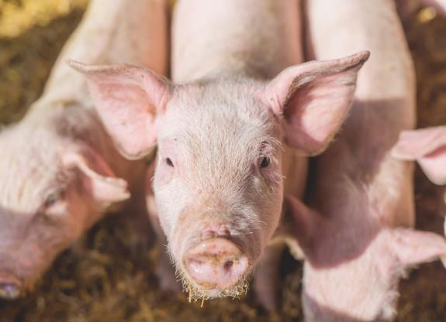
Swine Terms
Include:
boar - an intact male
sow - an intact female
barrow - a male who is castrated when young
gilt - a young female which has not given birth
pig or shoat - a young pig
farrowing - giving birth
herd - a group of pigs

Slide 48
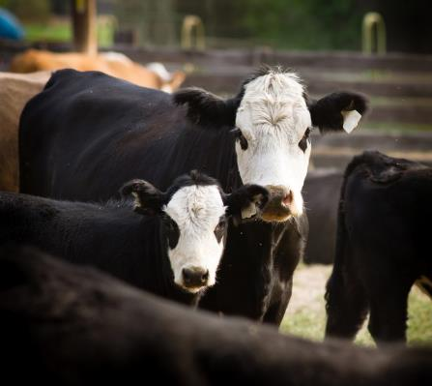
Cattle Terms
Include:
bull - an intact male
cow - an intact female
steer - a male bovine castrated when young
heifer - a young female bovine which has not given birth
calf - a young bovine
herd - a group of cattle
calving or freshening - giving birth

Slide 49
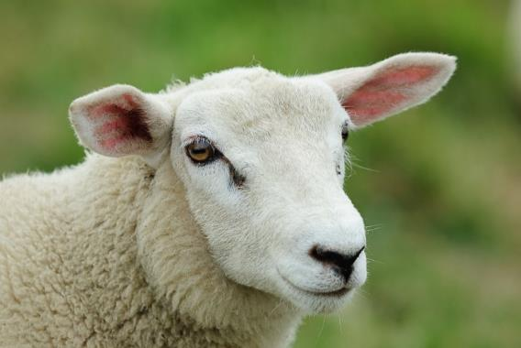
Sheep Terms
Include:
ram - an intact male
ewe - an intact female
wether - a castrated male
lamb - a young sheep
flock - a group of sheep
freshening or lambing - giving birth

Slide 50
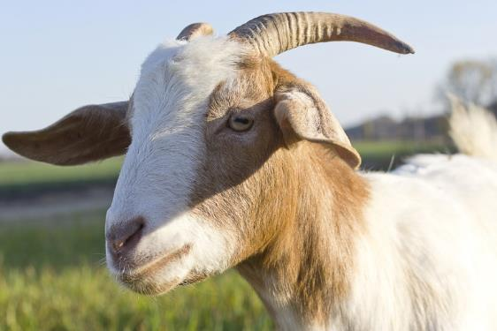
Goat Terms
Include:
buck - an intact male
doe - an intact female
wether - a castrated male
kid - a young goat
herd - a group of goats
freshening or kidding - giving birth

Slide 51
Physical Examinations
Are used to identify any abnormalities associated with the animal in an effort to make informed judgments about its’ health

Slide 52
Physical Examination Terms
Word | Meaning
Vital Signs | assess an animal’s health; includes pulse, respiration and temperature
Pulse | number of times the heart beats per minute
Respiration | breaths per minute
Temperature | degree of heat of a living body
Lymph Nodes | gland masses of tissue which contain cells
Capillary Refill Time | time it takes for blood to return to the tissue
Abnormalities | opposite of normal
Lethargic | not alert or active
Tartar | plaque build up on teeth

Slide 53
Physical Examination Terms
Word | Meaning
Plaque | growth of bacteria on teeth
Ophthalmoscope | instrument used when examining the eye
Palpate | examine by touching and feeling the area
Auscultation | listening with a stethoscope or other instrument
Murmur | abnormal sound within the heart
Arrhythmia | irregular rhythm in the heart
Diagnostics | identifying, characterizing or diagnosing a problem
Femoral Pulses | pulse found inside the thigh of the hind leg
Inflammation | redness, swelling or pain on an area of the body

Slide 54
Physical Examination Terms
Word | Meaning
Lesion | wound which causes pain or a change in the body
Orthopedic Exam | examining the skeletal system, structures, muscles and ligaments
Range of Motion | how far a joint may move freely and painlessly
Dehydration | loss of water from the body
Gut Motility | ability to pass material through the gut
Ambulating | to walk
Defecation | to have a bowel movement

Slide 55
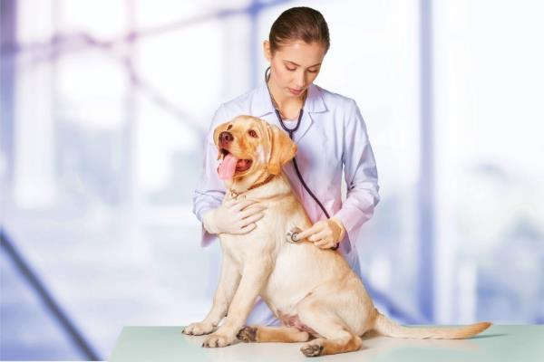
Animal Handling
Is a term used to describe the way veterinarians and staff work with, respond to and interact with animals in a clinical or field setting
Is crucial to the safety of the handler, owner and animal

Slide 56
Animal Handling
Term | Definition
Stress | state of mental or emotional strain
Abnormal Behavior | acting differently from normal or typical behavior
Adverse Behavior | behavior which is preventive or harmful
Submissive | passive, obedient or conforming
Slip Lead | rope or tether which is attached around the neck of the animal to help control and restrain
Muzzle | guard or strap which is fitted over an animal’s nose and jaw to prevent biting
Twitch | device used to distract horses during exams or procedures

Slide 57
Animal Handling
Term | Definition
Control Pole | device used for very aggressive dogs
Halter | form of restraint used to control large animals
Shoot | form of restraint used for cattle
Stocks | form of restrain used for horses
Fractious | irritable or angered
Tranquilizer | medicinal drug used to reduce tension or stress
Net | used for fractious cats or wild animals

Slide 58
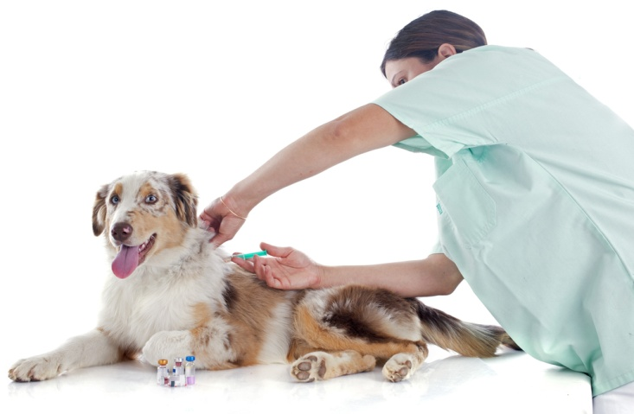
Injections
Are used to administer medication and vaccinations
Techniques differ based on the dosage and administration statements describing directions for use

Slide 59
Injections Terms
Word | Meaning
Intramuscular (IM) | injection of a substance directly into the muscle
Subcutaneous (Sub Q) | injection used to implant a drug into the tissue layer between the skin and the muscle
Intravenous (IV) | injection of a substance directly into the vein
Syringe Barrel | part of the syringe which holds the medicine
Syringe Plunger | placed tightly inside the barrel of the syringe; allows the applicator to push the medication through the syringe
Syringe Needle | mechanism through which the fluid is injected into the animal
Gauge | thickness, size or measure of an object

Slide 60
Injection Terms
Word | Meaning
Vaccinations | medicines which contain weakened or dead bacteria and/or viruses which are injected into an animal to allow their body to create antibodies against the disease
Antibodies | cells of the immune system which kill foreign objects in the body
Occlude | to close, shut or stop
Jugular | any of the three large veins in the neck
Lateral Saphenous | two large veins near the thigh on the hind leg
Cephalic | vein located on the front leg

Slide 61
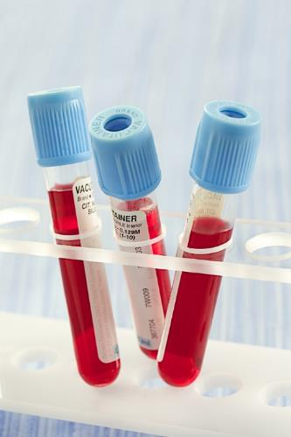
Blood Sampling
Is used in the diagnosis and monitoring of disease and infection in animals
Obtains an initial overview of the animal’s health, functionality of an organ or tests for a certain disease
Requires special equipment and training

Slide 62
Blood Sampling Terms
Word | Meaning
Complete Blood Count (CBC) | determines the number and type of blood cells present
Blood | specialized bodily fluid which performs many primary functions, including transportation, protection and regulation
Plasma | liquid portion of blood
Red Blood Cells | erythrocytes which carry oxygen from the lungs to the rest of the body
White Blood Cells | defends the body from invading organisms
Packed Cell Volume (PCV) Hematocrit (HCT) | determine the portion or percentage of the whole volume of blood occupied by red blood cells

Slide 63
Blood Sampling Terms
Word | Meaning
Anemia | deficiency of hemoglobin, reducing the number of red blood cells; causes body weakness
Red Count | number of red blood cells in a unit volume of blood; can be used to detect a problem with red blood cell production
Polycythemia | decreased blood flow
Hemoglobin | carries oxygen to the red blood cells and helps move them to other tissues
Bevel | small hole on the needle which allows the blood to blow into the syringe
Blood Clotting | prevents bleeding when a blood vessel is injured
Platelets | thrombocytes are responsible for clotting and increase with injury

Slide 64
Laboratory Procedures
Are a routine part of veterinary medicine and are conducted to establish baseline or “normal” values for healthy animal
Determine the presence of illness or disease in an animal
Help monitor a sick animal’s response to treatment
Determine the risks of complications before surgery

Slide 65
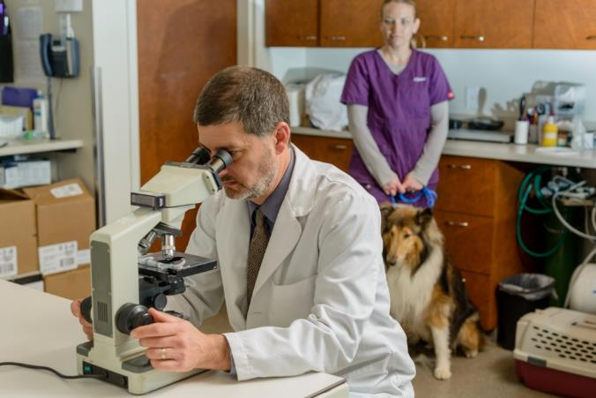
Laboratory Procedures
Commonly include:
blood examinations
fecal examinations
urine examination
culture and sensitivity tests

Slide 66
Laboratory Procedure Terms
Test | Purpose
SNAP® | quick convenient blood tests which detects multiple diseases
Complete Blood Count (CBC) | determines the number and type of blood cells present
Chemistry Profile | gives information on the electrolytes in the animal and organ functions
Microfilaria Smear | detects the microscopic version of heartworms
Fecal Flotation | detects internal parasites
Urinalysis | gives information on kidney function and detects urinary tract infections
Culture and Sensitivity Tests | identify the strain of bacteria or other pathogen and the most effective drug to inhibit the growth of the problem

Slide 67
Hospital Procedures
Are other common procedures performed within the clinic by veterinary medical staff
Include the following:
clinic protocol
emergency protocol and first aid
animal care skills
therapeutic care
reproductive and genetic evaluation
newborn, orphan and recumbent care

Slide 68
Hospital Procedures Terms
Procedure | Definition
Cardiopulmonary Resuscitation (CPR) | emergency procedure used to keep the heart pumping and oxygen flowing
Control of Bleeding | requires applying pressure and bandages to the wound and finding the source of the bleeding
Hypovolemic Shock Treatment | occurs when an animal’s blood volume is low; is treated by inserting IV fluids to keep the blood pressure up
Shock Treatment from Pain | requires administering medication to the animal to relieve pain
Clinic Protocol | guidelines which are followed by all veterinary staff to ensure safety within the clinic at all times
Dental Prophylaxis | procedure performed to clean an animal’s teeth
Zoonotic Diseases | are diseases which are communicable between humans and animals

Slide 69
Hospital Procedures Terms
Word | Meaning
Artificial Insemination | inserting sperm into a female’s uterus or cervix in order to achieve pregnancy
Morphology | study of the form of living organisms
Embryo Transfer | placing embryos into the uterus of a female in order to establish pregnancy
In Vitro Fertilization | process by which an egg is fertilized by sperm outside of the body before implantation
Enema | procedure which injects liquid into the rectum
Hydrotherapy | washing a wound with water
Neonate | newborn animal
Recumbent | laying down on the back or either side

Slide 70
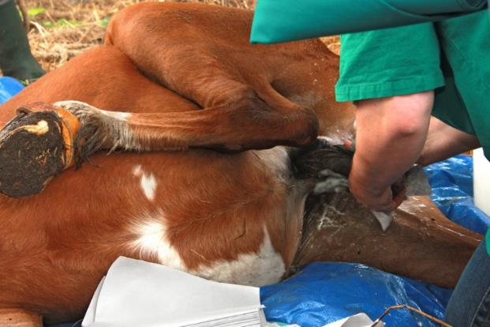
Surgical Procedures
Are complex operations performed by veterinarians and are used to benefit an animal’s health
Most commonly performed within the veterinary clinic include:
spaying
surgically removing a female’s ovaries and uterus
neutering
surgically removing a male’s testicles

Slide 71
Surgical Procedures Terms
Term | Definition
Excise | to cut out
Incise | to cut into
Ligate | to tie or bind with a ligature
Inversion | turning inward or inside out
Eversion | turning outward or inside out
Transect | to sever or cut across
Dissect | to cut apart or separate
Anesthesia | medication used primarily during surgery to minimize pain, discomfort and shock

Slide 72
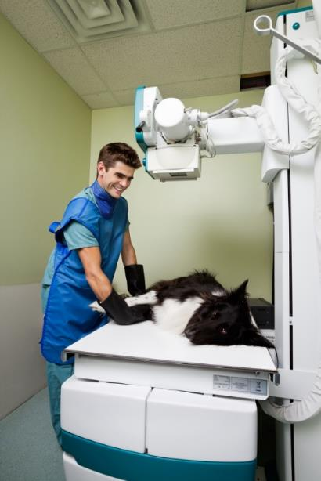
Veterinary Medical Equipment
Is used to perform surgical procedures, the determination of health in animals and to administer medication
Includes:
common electronic technology
common imaging equipment
common surgical instruments
common medication administration instruments

Slide 73
Common Electronic Technology
Is used daily in veterinary clinics to help determine illness and the overall health of animals
Electronic Technology | Use
Centrifuge | separation of fluids by spinning a vessel holding material at a high speed
Autoclave | decontaminates and sterilizes surgical instruments
Microscope | analyze blood, fecal, urine and sperm microscopically

Slide 74
Common Imaging Equipment
Has revolutionized veterinary medicine by allowing veterinarians to determine disease, illness and overall health of animals easily
Imaging Equipment | Use
Radiography | examine the body for injury or disease
Ultrasonography | creates images of body structures from a pattern of echoes reflected from the structures being imaged
Endoscopy | exams the esophagus, stomach, upper intestines, colon, cecum, large bowel and rectum
Electrocardiography (ECG or EKG) | records electrical activity of the heart over a period of time

Slide 75
Common Surgical Instruments
Are specially designed tools or devices which perform specific actions while performing surgery or an operation on animals
Surgical Instrument | Use
Scissors | cut tissue, sutures and hard material
Forceps | grasp, cut, compress and pull tissues
Scalpels | sharp surgical knives used to make incisions
Tubes | are used during operations and wound healing

Slide 76
Common Medication Administration Instruments
Are used to inject medication into an animal in order to diagnose, treat or prevent illness
Instrument | Use
Syringe | administering a liquid medication into the animal via mouth, intramuscularly or intravenously
Hollow Needle | attached to a syringe and used for injected medications
Multi-dose Hypodermic Syringe | inject or draw fluids into/or out of the body

Slide 77
Common Medication Administration Instruments
Instrument | Use
Hypodermic Syringes and Needles | very small syringes which are used with hollow needles for injections into or under the skin
Drench Guns | administer de-wormers, niacin, calcium and other drenchers
Balling Guns | administer oral medication capsules or boluses into an animal

Slide 78
Pharmacology
Is the study of medicine which focuses on the uses, effects and modes of actions in drugs
Is divided into the study of pharmacokinetics and pharmacodynamics

Slide 79
Pharmacology Terms
Term | Definition
Pharmacodynamics | study of the biochemical and physiological effects of drugs and their actions
Pharmacokinetics | physiological movement of drugs within the body and how drugs move into, through and out of the body
Drug | substance used to treat, cure, prevent or diagnose a condition
Diagnostic Drug | part of a test in order to identify and label a condition
Therapeutic Drug | treatment of a condition
Preventive Drug | prevent a condition

Slide 80
Pharmacology Terms
Term | Definition
Veterinary Feed Directive | intended for use in animal feeds
Over-the-Counter Drug | available to anyone without a prescription
Controlled Substance | drugs considered to be dangerous due to potential human abuse or misuse
ADME | process of absorption, distribution, metabolism and excretion of drugs

Slide 81
Common Veterinary Abbreviations
Abbreviation | Meaning
Ad lib | freely, as wanted
AG | anal glands
AL | left ear
AD | right ear
ASAP | as soon as possible
AU | each ear
BAR | bright, alert, responsive

Slide 82
Common Veterinary Abbreviations
Abbreviation | Meaning
Bid | twice daily
BM | bowel movement
BW | body weight
C | with
CAP | capsule
CBC | complete blood count
CNS | central nervous system

Slide 83
Common Veterinary Abbreviations
Abbreviation | Meaning
CPR | cardiopulmonary resuscitation
DOA | dead on arrival
DSH | domestic short hair
DLH | domestic long hair
Dx | diagnosis
FS | female spayed
HBC | hit by car

Slide 84
Common Veterinary Abbreviations
Abbreviation | Meaning
HCT | hematocrit
HW | heartworm
HWP | heartworm preventative
ICU | intensive care unit
IM | intramuscular
IN | intranasal
IP | intraperitoneal

Slide 85
Common Veterinary Abbreviations
Abbreviation | Meaning
IV | intravenous
MN | male neutered
NPO | nothing by mouth
OD | right eye
OL | left eye
OU | both eyes
per os | orally, by mouth

Slide 86
Common Veterinary Abbreviations
Abbreviation | Meaning
prn | as necessary
q | every
q2h | every 2 hours
q6h | every 6 hours
qd | every day
qh | every hour
QID | four times a day

Slide 87
Common Veterinary Abbreviations
Abbreviation | Meaning
qod | every other day
RBC | red blood cell
R/O | rule out
Sc/SQ/SubQ | subcutaneous
SR | suture removal
SID | once a day
Tab | tablet

Slide 88
Common Veterinary Abbreviations
Abbreviation | Meaning
TID | three times a day
TNT | toenail trim
TPR | temperature, pulse, respiration
TX | treatment
UA | urinalysis
ung | ointment
WBC | white blood cell

