Slide 2
Medical Terminology
Is based on the following:
Greek and Latin origins
eponyms (i.e., words formed from a person’s name)
modern language terms
Clinic Corner: Bang’s disease now known as Brucellosis, is named after
Danish veterinarian Bernhard Lauritz Frederik Bang when he discovered
the disease in 1897.

Slide 3
Medical Vocabulary
Is primarily based on Greek and Latin
Latin is the universal language of medicine
Greeks were the founders of modern medicine
Clinic Corner: Equine is the scientific name for horse derived from the Latin word equus.

Slide 4
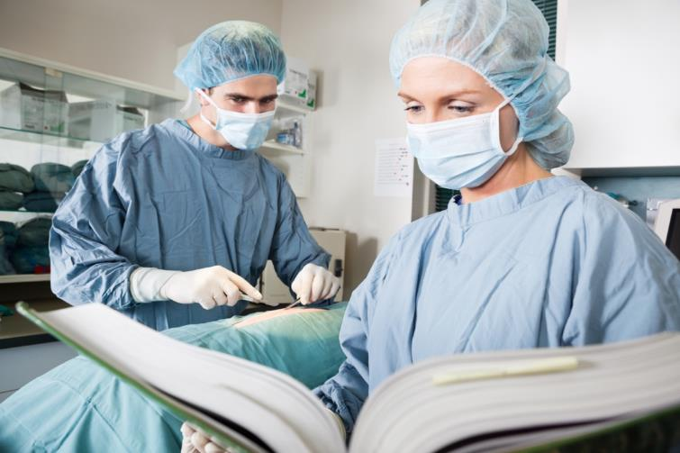
Word Structure
Is important for veterinarians to comprehend in order to understand and learn medical terminology
Includes:
root words
prefixes
suffixes
compound words
combining forms

Slide 5
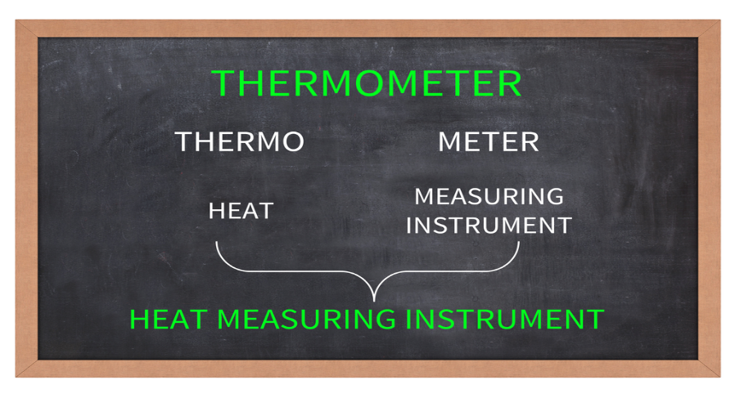
Root Words
Are the foundation of most medical terms
Gives a word meaning
May contain one or more roots
Clinic Corner: The letter “o” is often used as a combining vowel at the end of most words allowing the term to be pronounced more easily.

Slide 6
Common Root Words
Examples include:
cardi/o - heart
cephalo/o - head
dent/o - teeth
ophthalm/o - eye
steth/o - chest
nas/o - nose
ot/o - ear
derm/o, dermato/o - skin

Slide 7
Prefixes
Come before the root word
Modify the meaning of the root word
Often qualify the following:
number
measurement
position or direction
negatives
color
Clinic Corner: Prefixes are not complete words without the rest of the word parts.

Slide 8
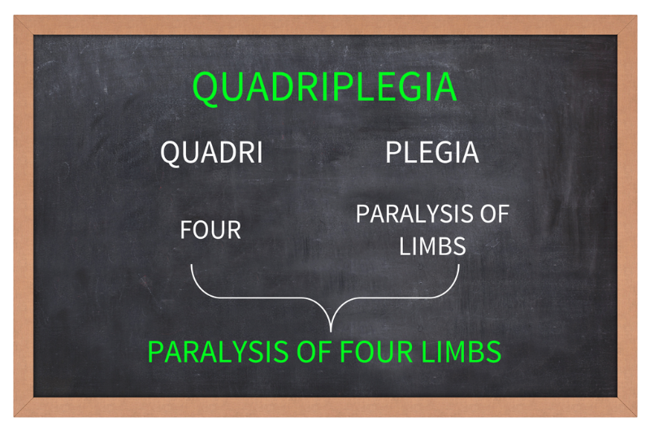
Prefixes
As number qualifiers include:
uni (one)
bi (two)
tri (three)
quadra (four)
quinta (five)
sexta (six)
octo (eight)
nona (nine)
deca (ten)

Slide 9
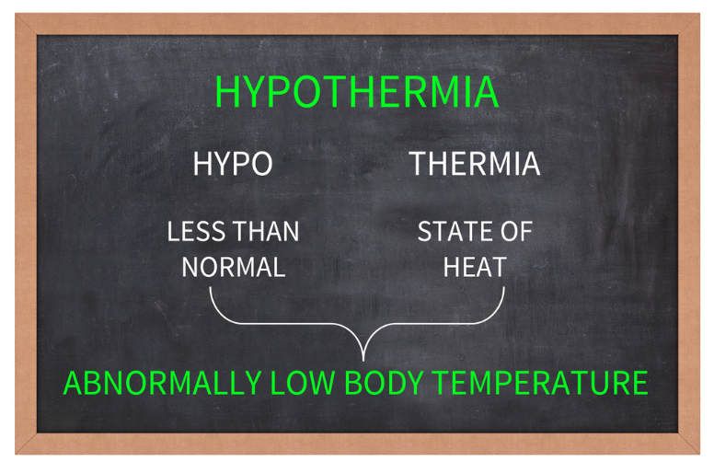
Prefixes
As measurement qualifiers include:
hyper (excessive)
hypo (less than normal)
for example:
hypothermia

Slide 10
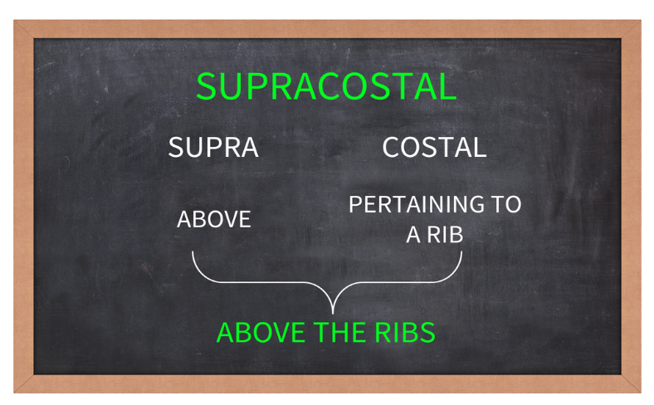
Prefixes
As position or direction qualifiers include:
sub (under)
peri (around)
supra (above)
for example:
supracostal

Slide 11
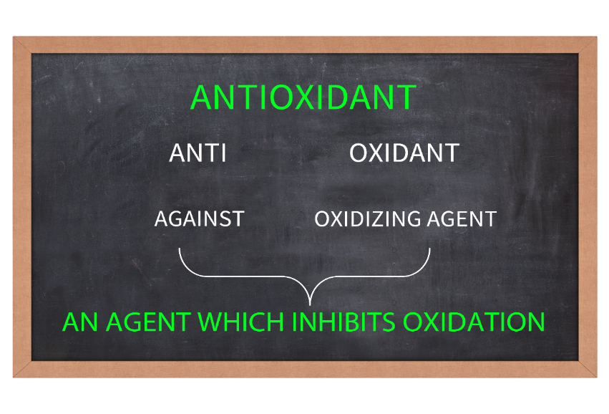
Prefixes
As negative qualifiers include:
an (without)
anti (against)
for example:
antioxidant

Slide 12
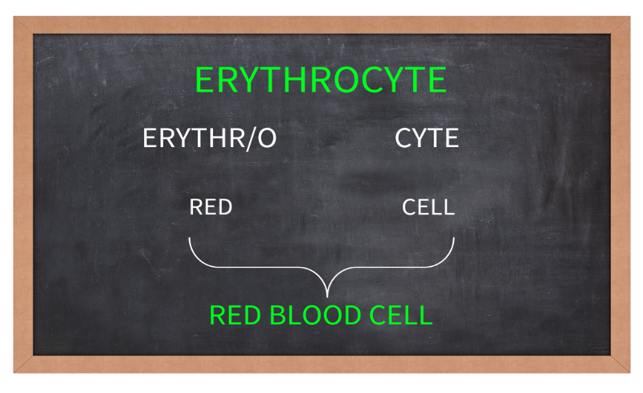
Prefixes
As color qualifiers include:
cyan/o (blue)
jaund/o (yellow)
erythr/o (red)
for example:
erythrocyte

Slide 13
Prefixes
Often have opposites which can be beneficial to learn
common opposite prefixes include:
pre (before)
post (after)
hypo (high, above normal)
hyper (low, below normal)

Slide 14
Suffixes
Come after the root word or words
Modify the meaning of the root word
Can be grouped together by meaning, which include:
pertaining to
surgical
procedural
double R
conditional and structural
Clinic Corner: The suffix used will determine the speech classification of
the word. (e.g., anemia (noun) ; anemic (adjective))

Slide 15
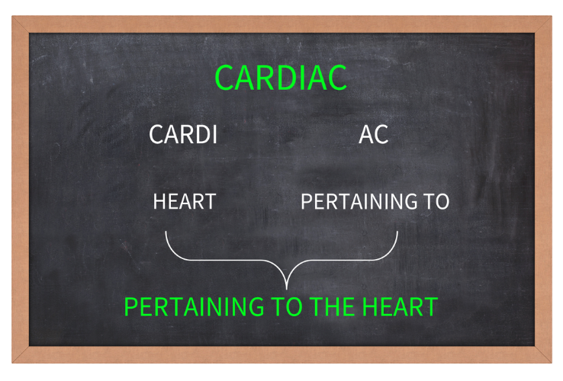
Common “Pertaining to” Suffixes
ic
al
ine
ary
an
ar
ous
tic
eal
ac
for example:
cardiac
Examples include:

Slide 16
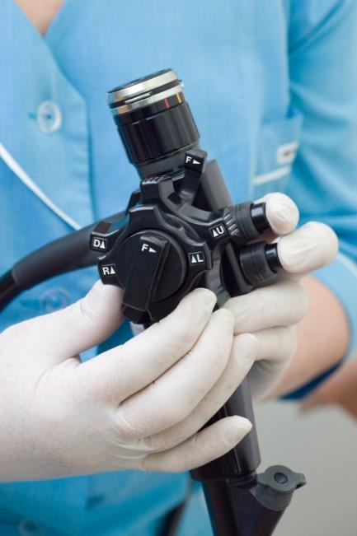
Common Surgical Suffixes
Include:
ectomy - removal of
tomy – cutting, incision
plasty – surgical repair
centesis – surgical puncture to remove fluid or gas
pexy – suture to stabilize
scope – instrument or exam
for example:
endoscope

Slide 17
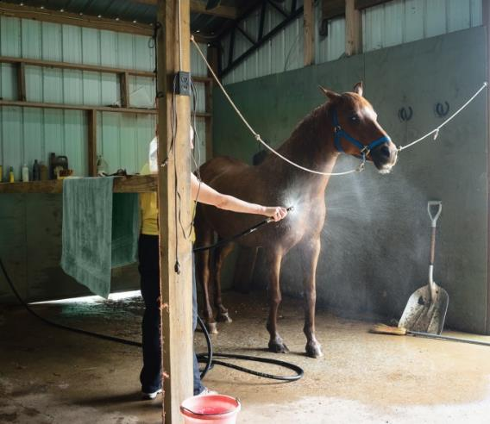
Common Procedural Suffixes
Include:
gram – record of
graphy – procedure which records
scopy – procedure to visually examine
logy – study of
therapy – treatment
for example:
hydrotherapy

Slide 18
Common Double R Suffixes
Include:
rrhagia or rrhage – bursting forth
for example:
hemmorrhage – bursting forth of blood from the vessels
rrhaphy – to suture
for example:
enterorrhaphy – suturing of the intestine
rrhexis – rupture
for example:
myorrhexis – rupture of the muscle

Slide 19
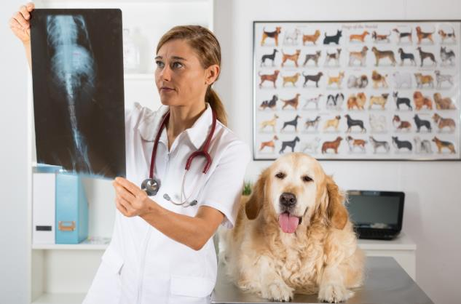
Common Conditional & Structural Suffixes
Include:
rhexis – rupture
itis – inflammation
osis – abnormal condition
pathy – disease
algia or dynia – pain
for example:
myalgia

Slide 20
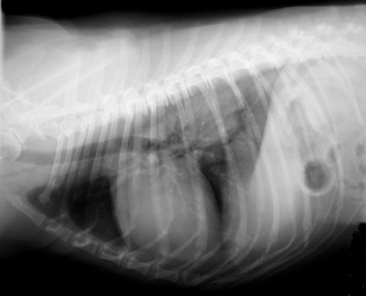
Common Conditional & Structural Suffixes
Include:
um – structure
al (as in renal) – pertaining to kidney
ic (as in enteric) – pertaining to the intestines
an (as in ovary) – pertaining to the ovary
ac (as in cardiac) – pertaining to the heart
for example:
cardiac

Slide 21
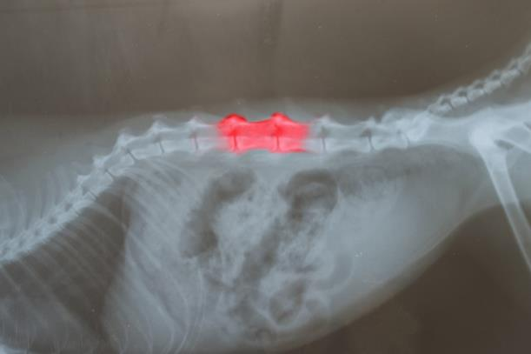
Compound Words
Have two or more roots
roots may or may not be joined by a combining vowel
for example:
backache ( back-ache)
smallpox (small-pox)

Slide 22
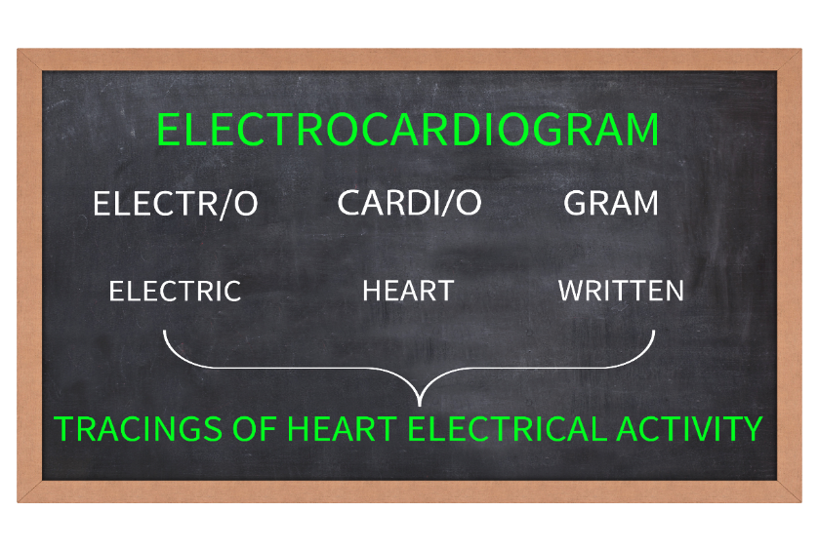
Combining Forms
Is an incomplete word containing a root word, prefix or suffix with a combining vowel
Help connect the parts of the word together
for example:
electrocardiogram

Slide 23
Anatomical Terms

Slide 24
Anatomical Terms
Describe the locations of structures in relation to other structures or locations in the body
Are used in veterinary medicine in the following ways:
directional terminology
positional terminology
anatomical planes terminology
muscle and joint actions terminology

Slide 25
Directional Terminology
Include the following:
distal - away from the body
proximal - near the center of the body
caudal - near the tail
cranial - relating to the skull
ventral - relating to the underside of the animal
rostral - situated near the nose and mouth
plantar - relating to the sole of the foot

Slide 26
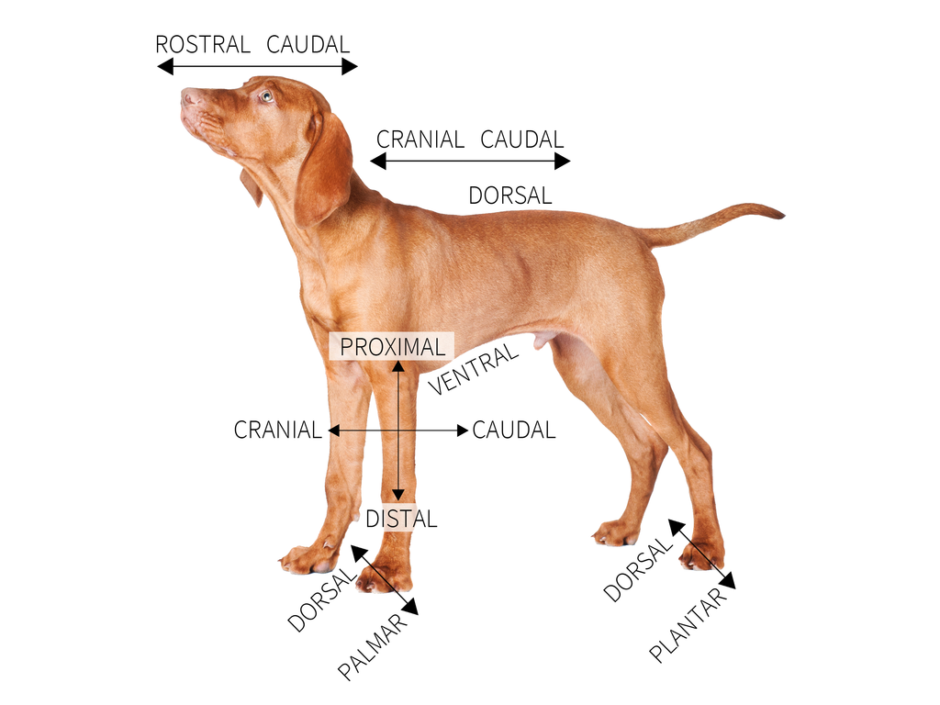
Directional Terminology

Slide 27
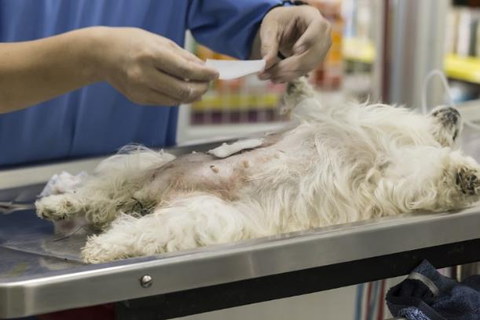
Positional Terminology
Includes the following:
recumbent - lying down
dorsal recumbency - lying on the back
ventral or sternal recumbency - lying on the belly
left lateral recumbency - lying on the left side
right lateral recumbency - lying on the right side

Slide 28
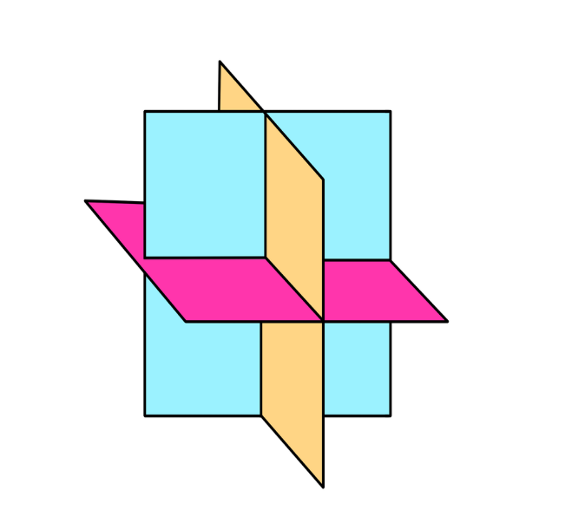
Anatomical Planes Terminology
Is also important when describing locations of wounds or producing radiographs
Divides the animal into four planes
Include the following:
median plane
sagittal planes
dorsal plane
transverse plane

Slide 29
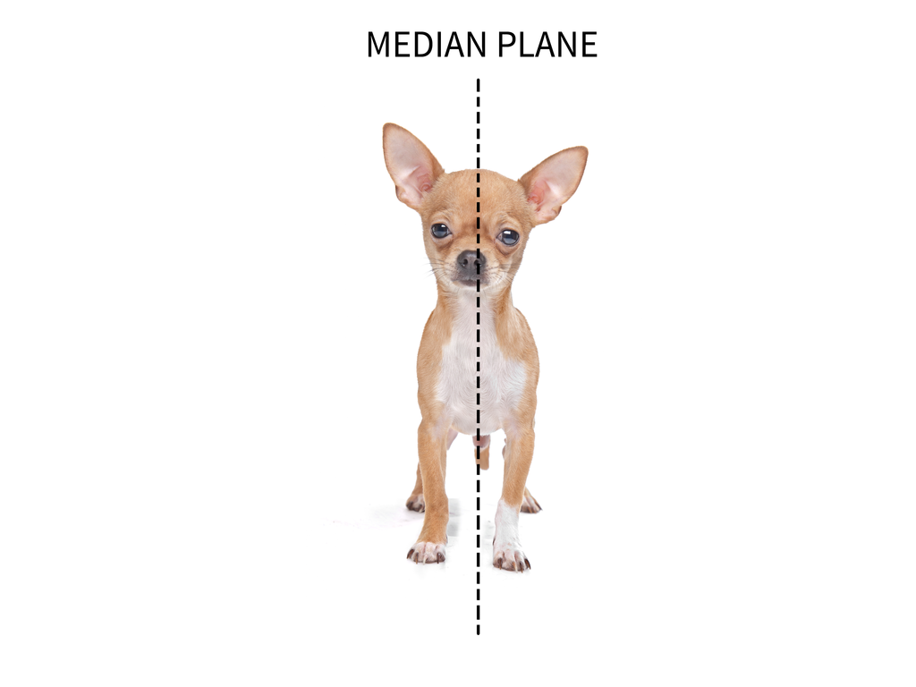
Median Plane
Divides the body into equal right and left halves

Slide 30
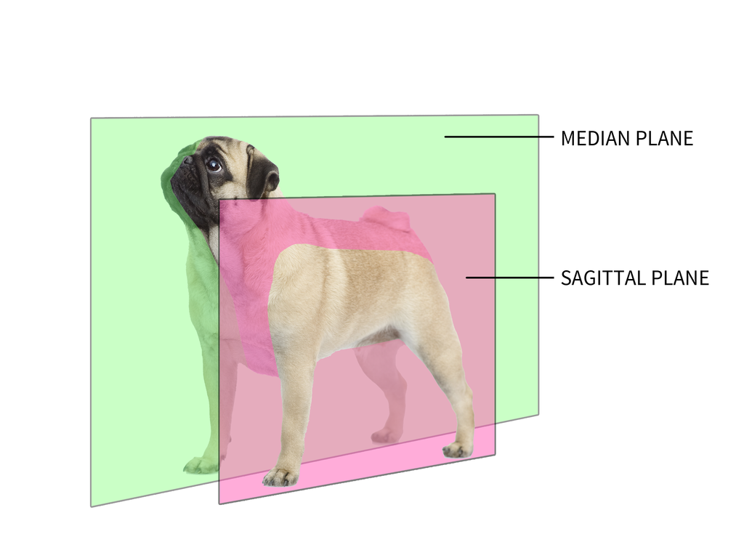
Sagittal Planes
Are any planes to the right or left, which lie parallel to the median plane

Slide 31
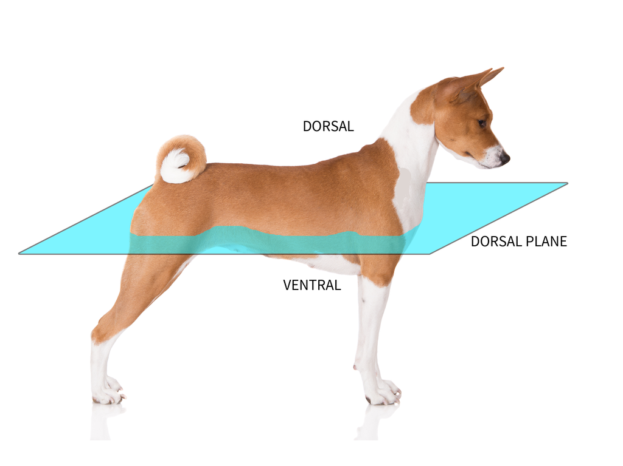
Dorsal Plane
Divides the animal into dorsal and ventral

Slide 32
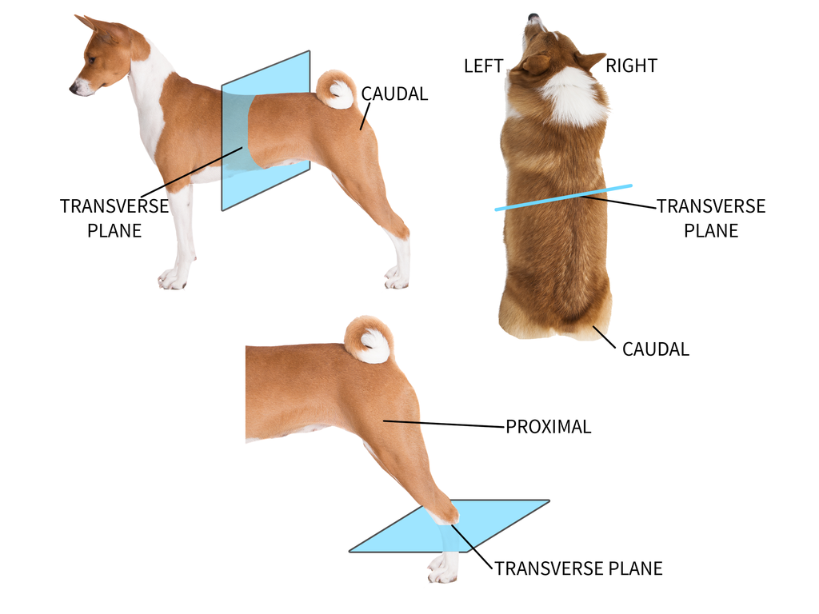
Transverse Plane
Divides the trunk of the animal or the extremities

Slide 33
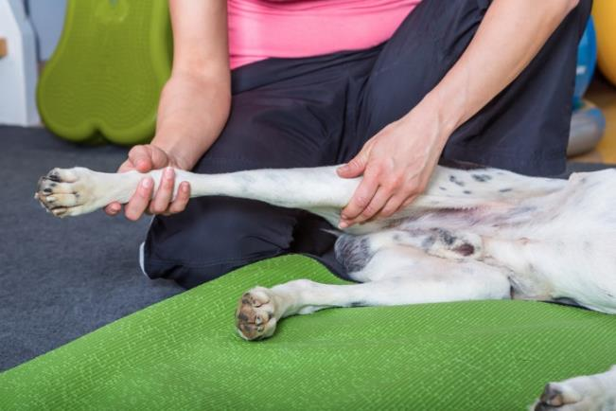
Muscle & Joint Actions Terminology
Is used to describe the movements of both muscles and joints
Includes:
extension
flexion
abduction
adduction
supination
pronation

Slide 34
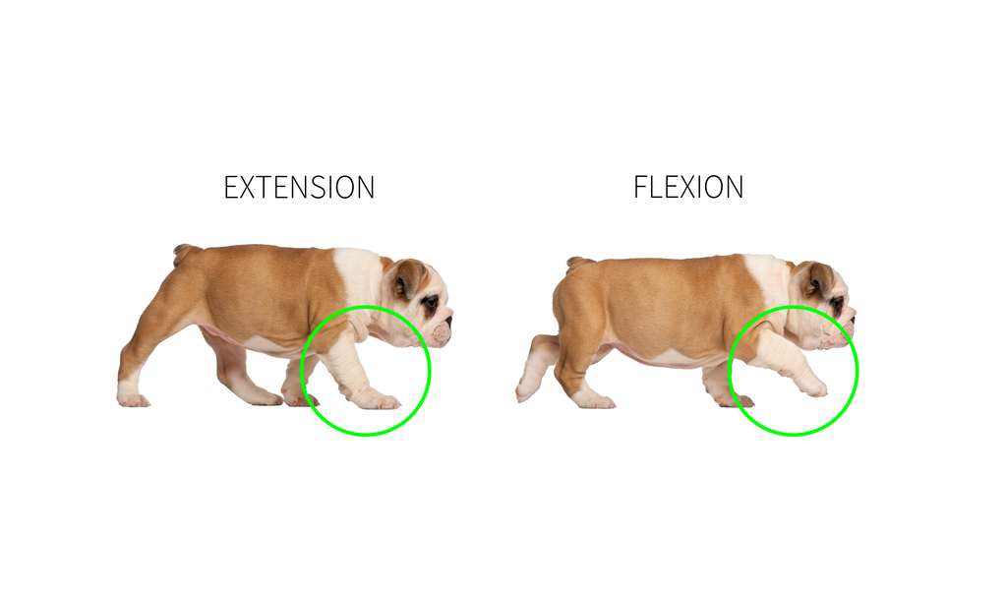
Extension & Flexion
Are defined as the following:
extension is when the joint angle increases
flexion is when the joint angle decreases

Slide 35
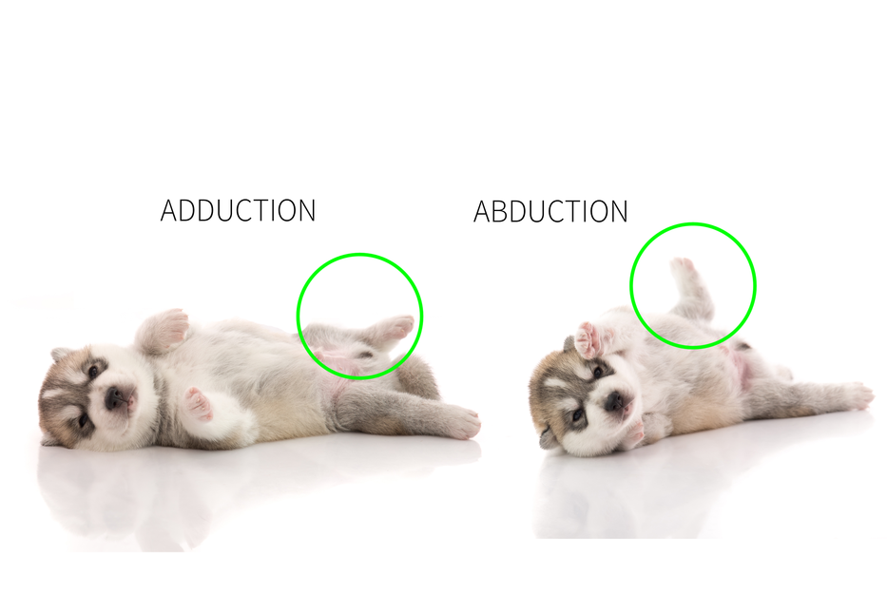
Abduction & Adduction
Are defined as the following:
abduction is when the joint moves away from the body
adduction is when the joint moves towards the body

Slide 36
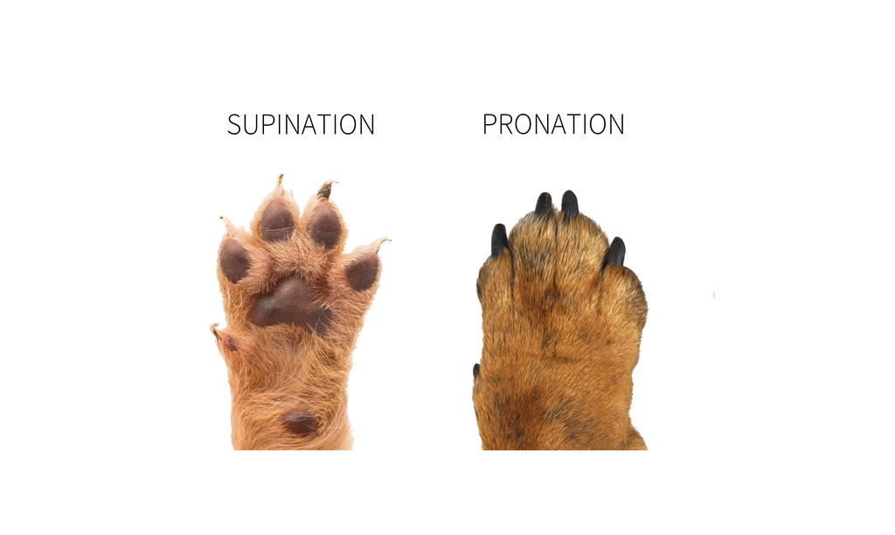
Supination & Pronation
Are defined as the following:
supination is when the palm faces upward
pronation is when the palms face downward

Slide 37
Veterinary & Human Terms
Are common in most directional terms and have the same meaning, however there are a few differences in directions and planes due to anatomy
Differences include the following:
Human Term | Veterinary Term
Superior | Cranial
Inferior | Caudal
Anterior | Ventral
Posterior | Dorsal

Slide 38
Body Systems Terms

Slide 39
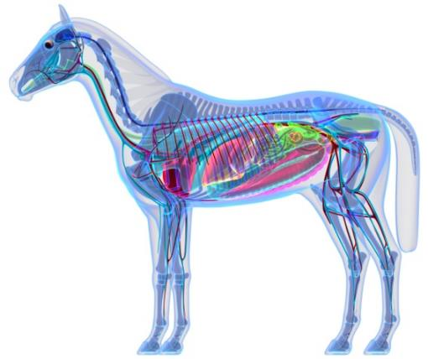
Body Systems
Are complex structures made up of millions of cells
Each work together to carry out a special job
Are highly affected by pathogens which disrupt normal cell functions which sometimes results in the death of cells and tissues

Slide 40
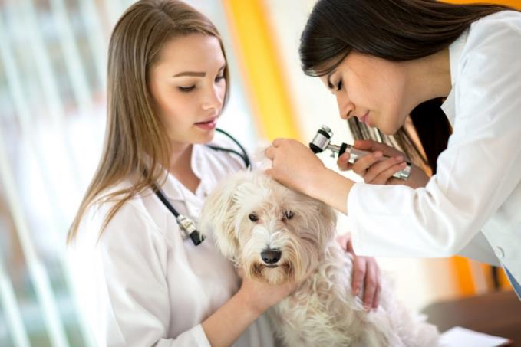
Body Systems
Include:
circulatory
respiratory
digestive
endocrine
immune
integumentary
nervous
skeletal
reproductive

Slide 41
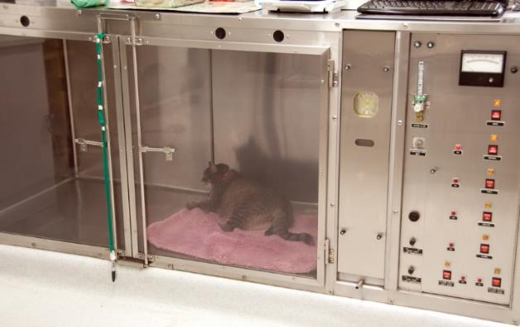
Circulatory System
Is designed to pump and deliver blood to the body’s tissues
Is made up of the heart, arteries, veins and blood
Common conditions or diseases include:
heartworm
heart disease
hypertension

Slide 42
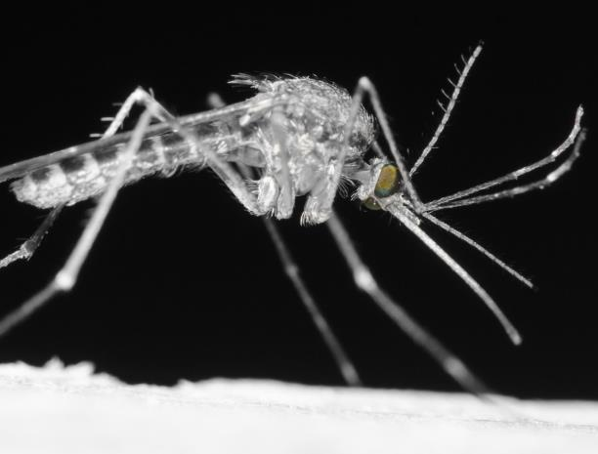
Heartworm
Is a parasitic worm transmitted by mosquitoes which lives in the heart and arteries of an infected animal
Is an often serious and fatal disease
Harms arteries and vital organs

Slide 43
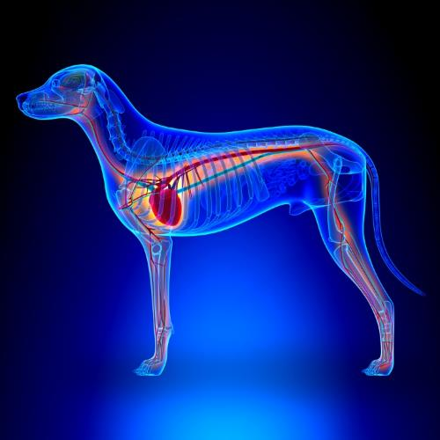
Heart Disease
Is any condition of the heart or blood vessels which inhibits the normal function of the heart and delivery of blood to the body
Is often heritable in animals and can be acquired over time

Slide 44
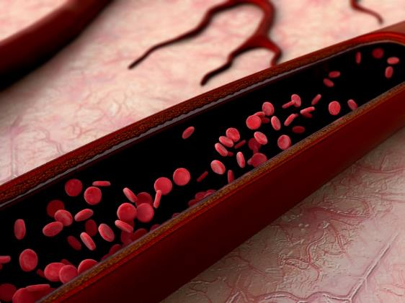
Hypertension
Is a condition which elevates the animal’s normal blood pressure
Is usually caused by an underlying disease
Clinic Corner: Blood pressure is the force which is generated within
the body’s blood vessels by the beating of an animal’s heart.

Slide 45
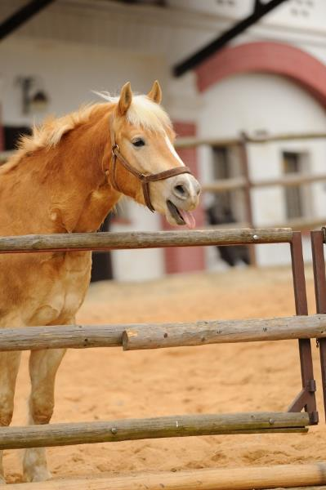
Respiratory System
Provides the body with the exchange of oxygen and carbon dioxide
Is made up of the nose, mouth, trachea, bronchi and lungs
Common conditions or diseases include:
canine distemper
equine influenza
bovine respiratory disease

Slide 46
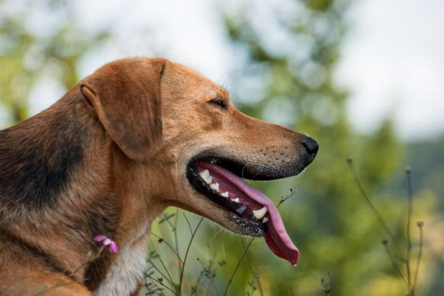
Distemper
Is a virus which is passed to animals through direct contact with fresh urine, blood or saliva
Causes the following:
sneezing
coughing
nasal and eye discharge
fever
lethargy
vomiting
diarrhea
depression

Slide 47
Equine Influenza
coughing
nasal discharge
fever
depression
loss of appetite
Is one of the most common infectious diseases of the respiratory tract in horses
Damages the lining and mucous membranes of the respiratory tract
Causes the following:
Clinic Corner: Equine Influenza is commonly seen in young horses around two to three years of age.

Slide 48
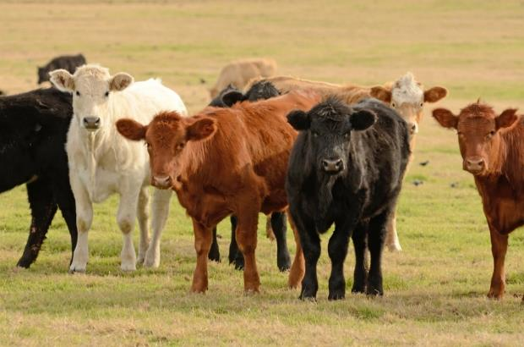
Bovine Respiratory Disease
Is the most common disease affecting the North American beef cattle industry
Causes the following:
rapid, shallow breathing
coughing
salivation
nasal and eye discharge
fever
depression
loss of appetite

Slide 49
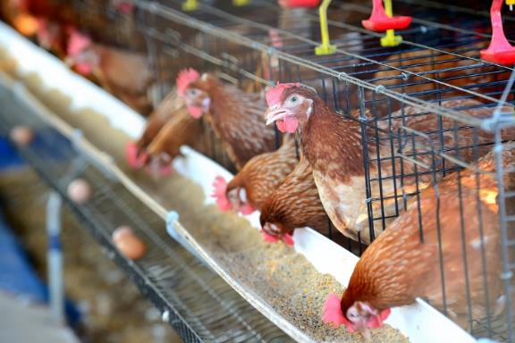
Digestive System
Breaks down food into simple substances which can be absorbed by the body
Absorbs digested parts of food into the blood stream
Includes four basic types of systems:
monogastric (simple)
ruminant (polygastric)
hindgut-fermenter
avian

Slide 50
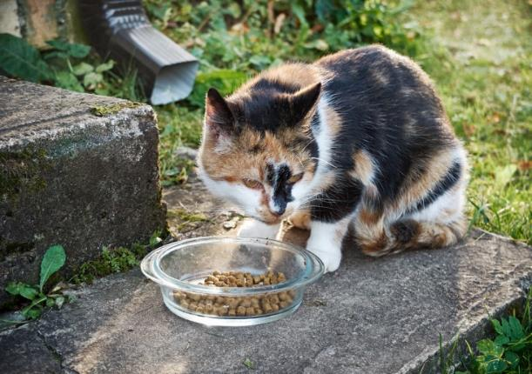
Monogastric Digestive System
Contains a single-chambered stomach
Stomach is very muscular and stores ingested food and moves it into the small intestine
Is found in humans, swine, dogs and cats

Slide 51
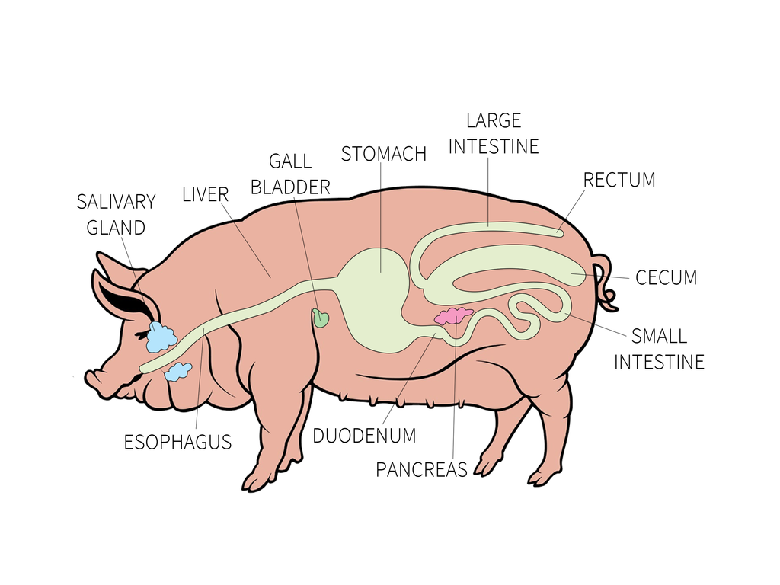
Monogastric Digestive System

Slide 52
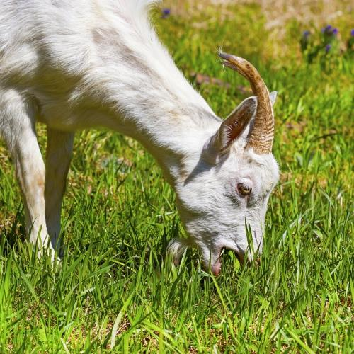
Ruminant Digestive System
Is also known as polygastric
Contains one large stomach which is divided into four compartments:
rumen
reticulum
omasum
abomasum
Is found in cattle, sheep and goats

Slide 53
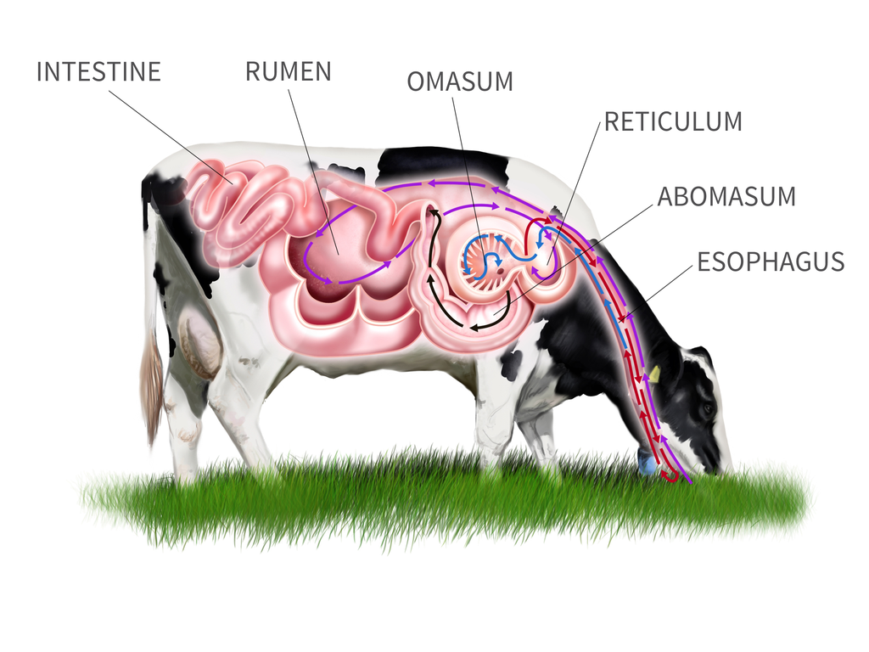
Ruminant Digestive System

Slide 54
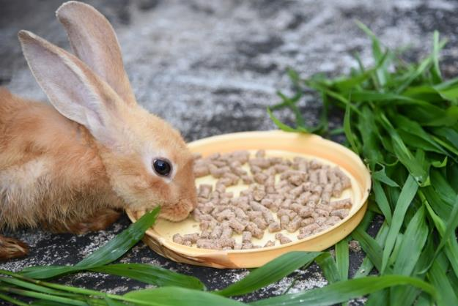
Hindgut-Fermenter Digestive System
Is found in animals who eat large amounts of roughage
Is similar to ruminants, however does not have stomachs with several compartments
Is found in horses, rabbits, guinea pigs and hamsters

Slide 55
Hindgut-Fermenter Digestive System

